Slide 1
Jeopardy Review
People | Places | Texts | Art and Architecture | Wars and Warfare
100 | 100 | 100 | 100 | 100
200 | 200 | 200 | 200 | 200
300 | 300 | 300 | 300 | 300
400 | 400 | 400 | 400 | 400
500 | 500 | 500 | 500 | 500

Slide 2
People 100
He is credited with starting the Reformation in Europe when he famously nailed his 95 Theses to the church door in Wittenberg.
ANSWER

Slide 3
People 200
This Spartan king died with his bodyguard of 300 at Thermopylae.
ANSWER

Slide 4
People 300
This Renaissance man designed the Il Duomo in Florence. He also introduced perspective to art.
ANSWER

Slide 5
People 400
This Athenian ordered citizens to retreat behind the long walls of the city to protect themselves from a Spartan invasion.
ANSWER

Slide 6
People 500
He is the first monotheistic ruler we studied. This Egyptian pharaoh moved the capital away from Thebes.
ANSWER

Slide 7
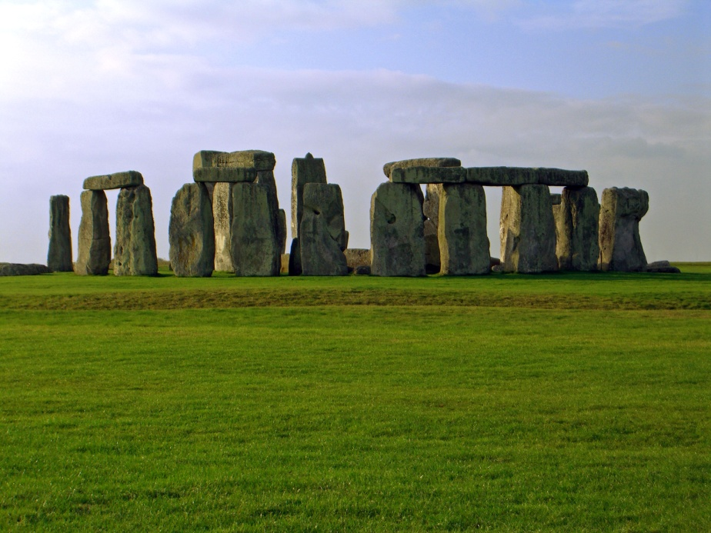
Places 100
Found in England, this site was a burial place.
ANSWER

Slide 8
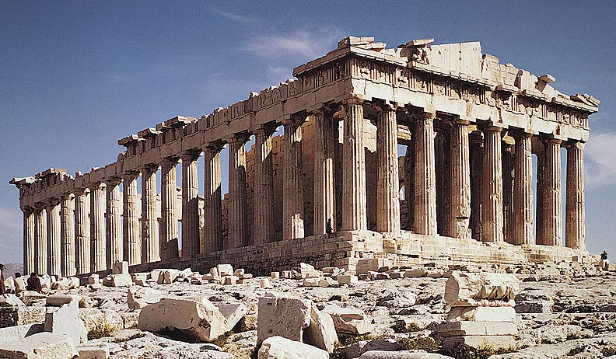
Places 200
This iconic Greek structure mounts the Acropolis in Athens.
ANSWER

Slide 9
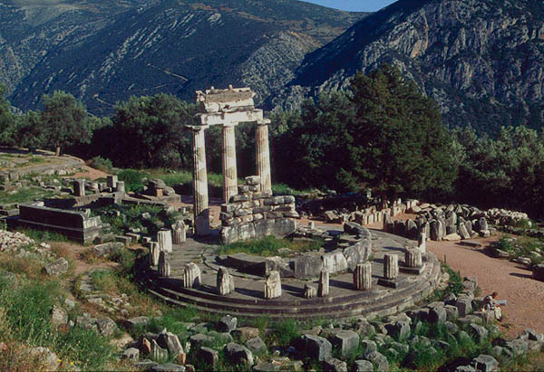
Places 300
Alexander the Great visited this site to learn about his future.
ANSWER

Slide 10
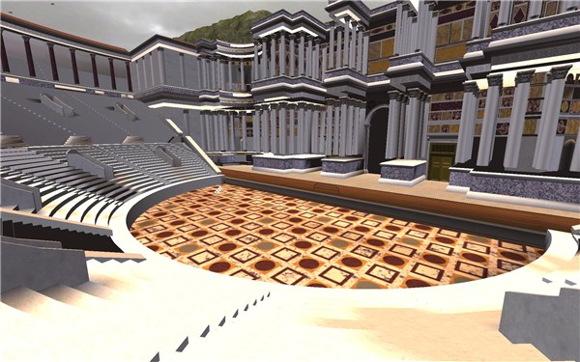
Places 400
Modelled after Greek theatres, this theatre, named after a member of the First Triumvirate, is found in Rome.
ANSWER

Slide 11
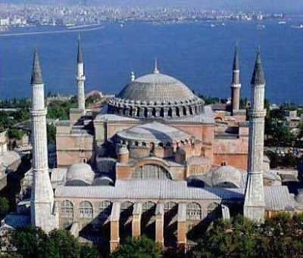
Places 500
Situated in Constantinople, it was emperor Justinian’s most ambitious building project.
ANSWER

Slide 12
Texts 100
Characters in this epic poem include Achilles, Agamemnon, Hector, Helen, and Paris.
ANSWER

Slide 13
Texts 200
This epic poem, written during the Augustan age, described the founding of Rome.
ANSWER

Slide 14
Texts 300
In this work of literature, the main character travels through hell, purgatory and heaven.
ANSWER

Slide 15
Texts 400
Marcus Aurelius recorded his thoughts and stoic ideas in this work of philosophy.
ANSWER

Slide 16
Texts 500
Christopher Marlowe’s most famous play tells the story of man who sells his soul in exchange for power and knowledge.
ANSWER

Slide 17
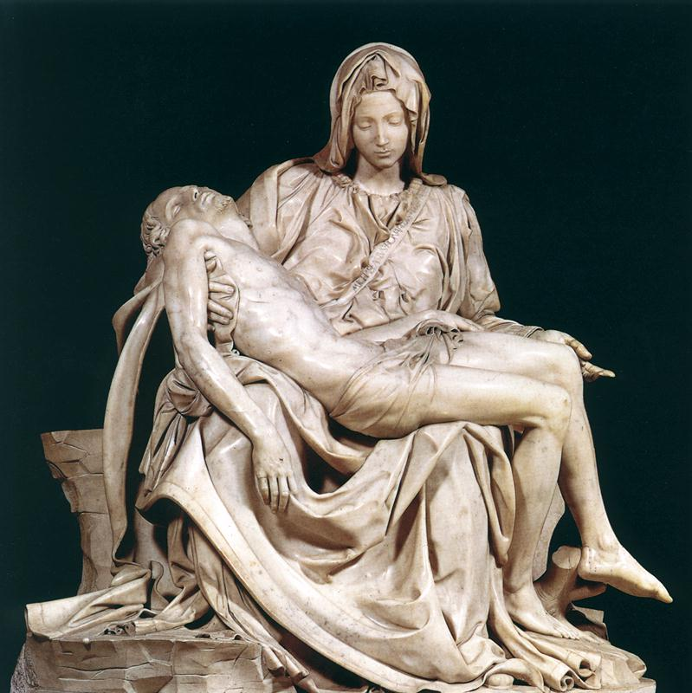
Art and Architecture 100
This Renaissance artist created this sculpture, the pieta.
ANSWER

Slide 18
Art and Architecture 200
This style of architecture dominated the Middle Ages. Its features included vaulted arches, flying buttresses, stained-glass windows, and gargoyles and grotesques.
ANSWER

Slide 19
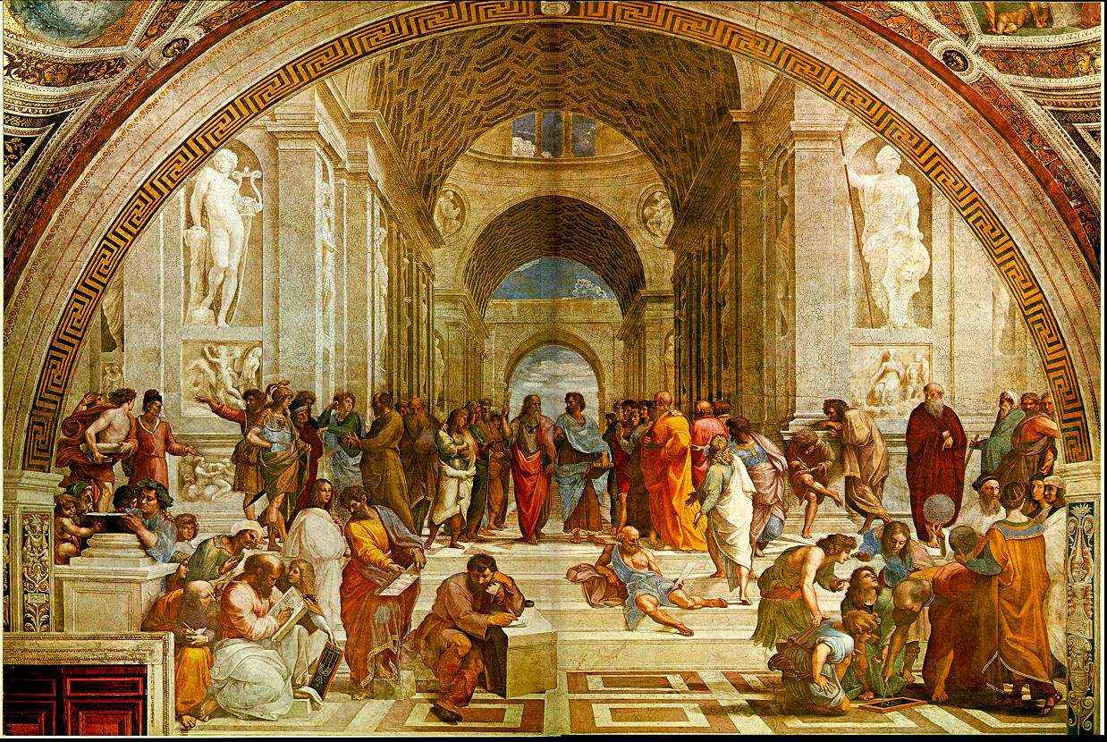
Art and Architecture 300
Raphael, a Renaissance artist, illustrated the influence of Greek thinkers on himself and his contemporaries in this painting.
ANSWER

Slide 20
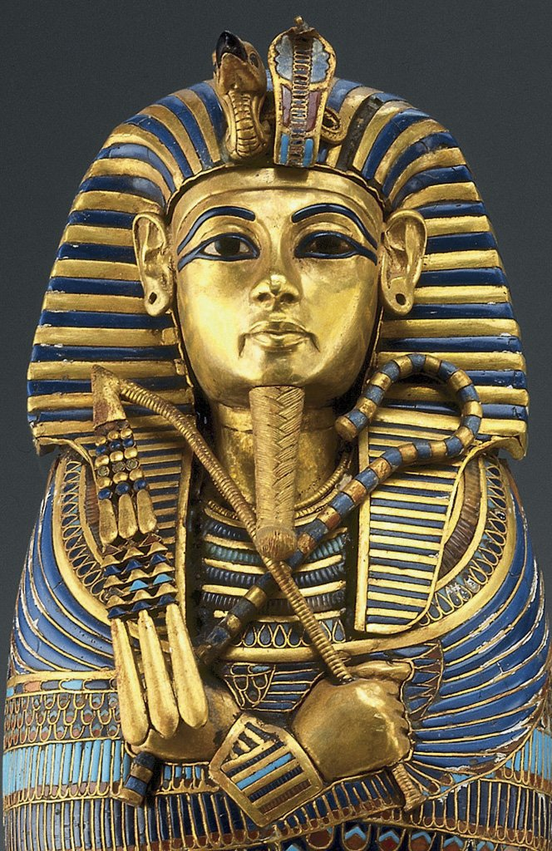
Art and Architecture 400
Some of the most impressive Egyptian art was found in elaborate tombs, such as the coffin for this pharaoh.
ANSWER

Slide 21
Art and Architecture 500
This site in France is most famous for its cave paintings in the paleolithic era.
ANSWER

Slide 22
Wars and Warfare 100
This Chinese invention radically changed warfare in medieval Europe and even contributed to the disappearance of the knight.
ANSWER

Slide 23
Wars and Warfare 200
The trireme helped the Athenians defeat the Persian fleet during the sea battle.
ANSWER

Slide 24
Wars and Warfare 300
This English king, who renewed his claim to the French throne during a period of calm during the Hundred Years War, led his army to a victory in the Battle of Agincourt. He was also immortalized by Shakespeare.
ANSWER

Slide 25
Wars and Warfare 400
This Egyptian pharaoh earned himself the nickname “the Napoleon of Egypt” for his military conquests and expansion.
ANSWER

Slide 26
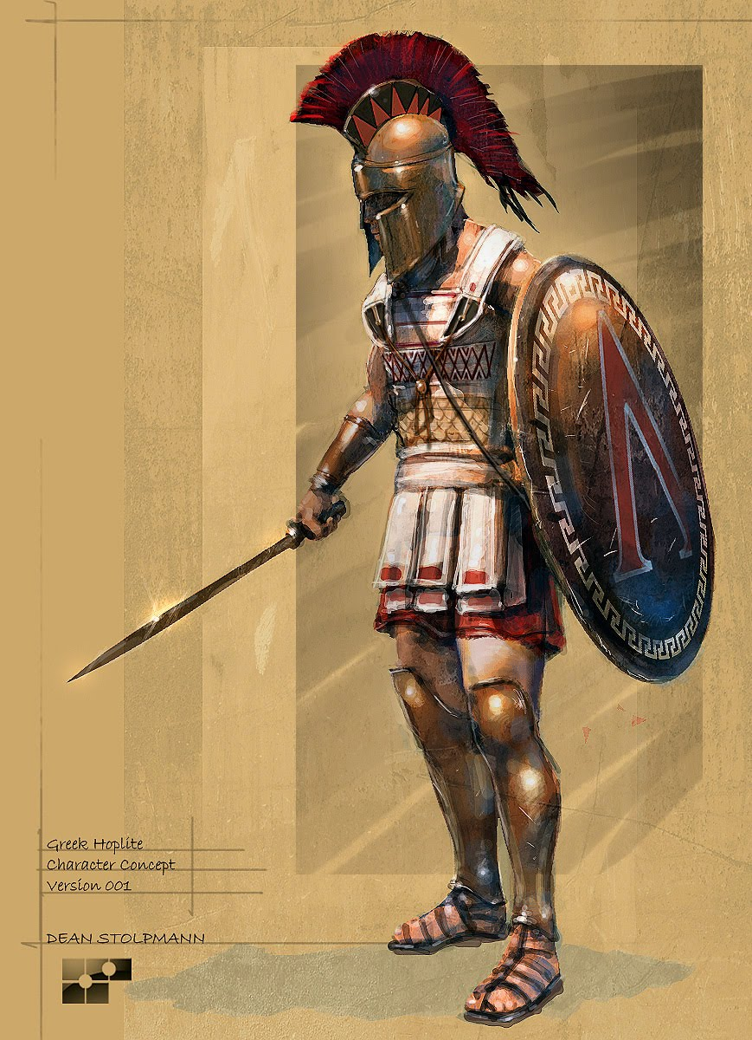
Wars and Warfare 500
This Greek soldier-citizen, dressed in body armor and carrying a shield and a spear, used the phalanx tactic in battle.
ANSWER

Slide 27
People 100
Martin Luther
RETURN

Slide 28
People 200
Leonidas
RETURN

Slide 29
People 300
Brunelleschi
RETURN

Slide 30
People 400
Pericles
RETURN

Slide 31
People 500
Akhenaton
RETURN

Slide 32
Places 100
Stonehenge
RETURN

Slide 33
Places 200
Parthenon
RETURN

Slide 34
Places 300
Temple of Apollo at Delphi
RETURN

Slide 35
Places 400
Pompey’s Theatre
RETURN

Slide 36
Places 500
Hagia Sophia
RETURN

Slide 37
Texts 100
The Iliad
RETURN

Slide 38
Texts 200
The Aeneid
RETURN

Slide 39
Texts 300
The Divine Comedy
RETURN

Slide 40
Texts 400
Meditations
RETURN

Slide 41
Texts 500
Dr. Faustus
RETURN

Slide 42
Art and Architecture 100
Michelangelo
RETURN

Slide 43
Art and Architecture 200
Gothic
RETURN

Slide 44
Art and Architecture 300
School of Athens
RETURN

Slide 45
Art and Architecture 400
Tutankhamun
RETURN

Slide 46
Art and Architecture 500
Lascaux Caves
RETURN

Slide 47
Wars and Warfare 100
gun powder
RETURN

Slide 48
Wars and Warfare 200
Salamis
RETURN

Slide 49
Wars and Warfare 300
Henry V
RETURN

Slide 50
Wars and Warfare 400
Tuthmosis III
RETURN

Slide 51
Wars and Warfare 500
hoplite
RETURN

