Slide 1
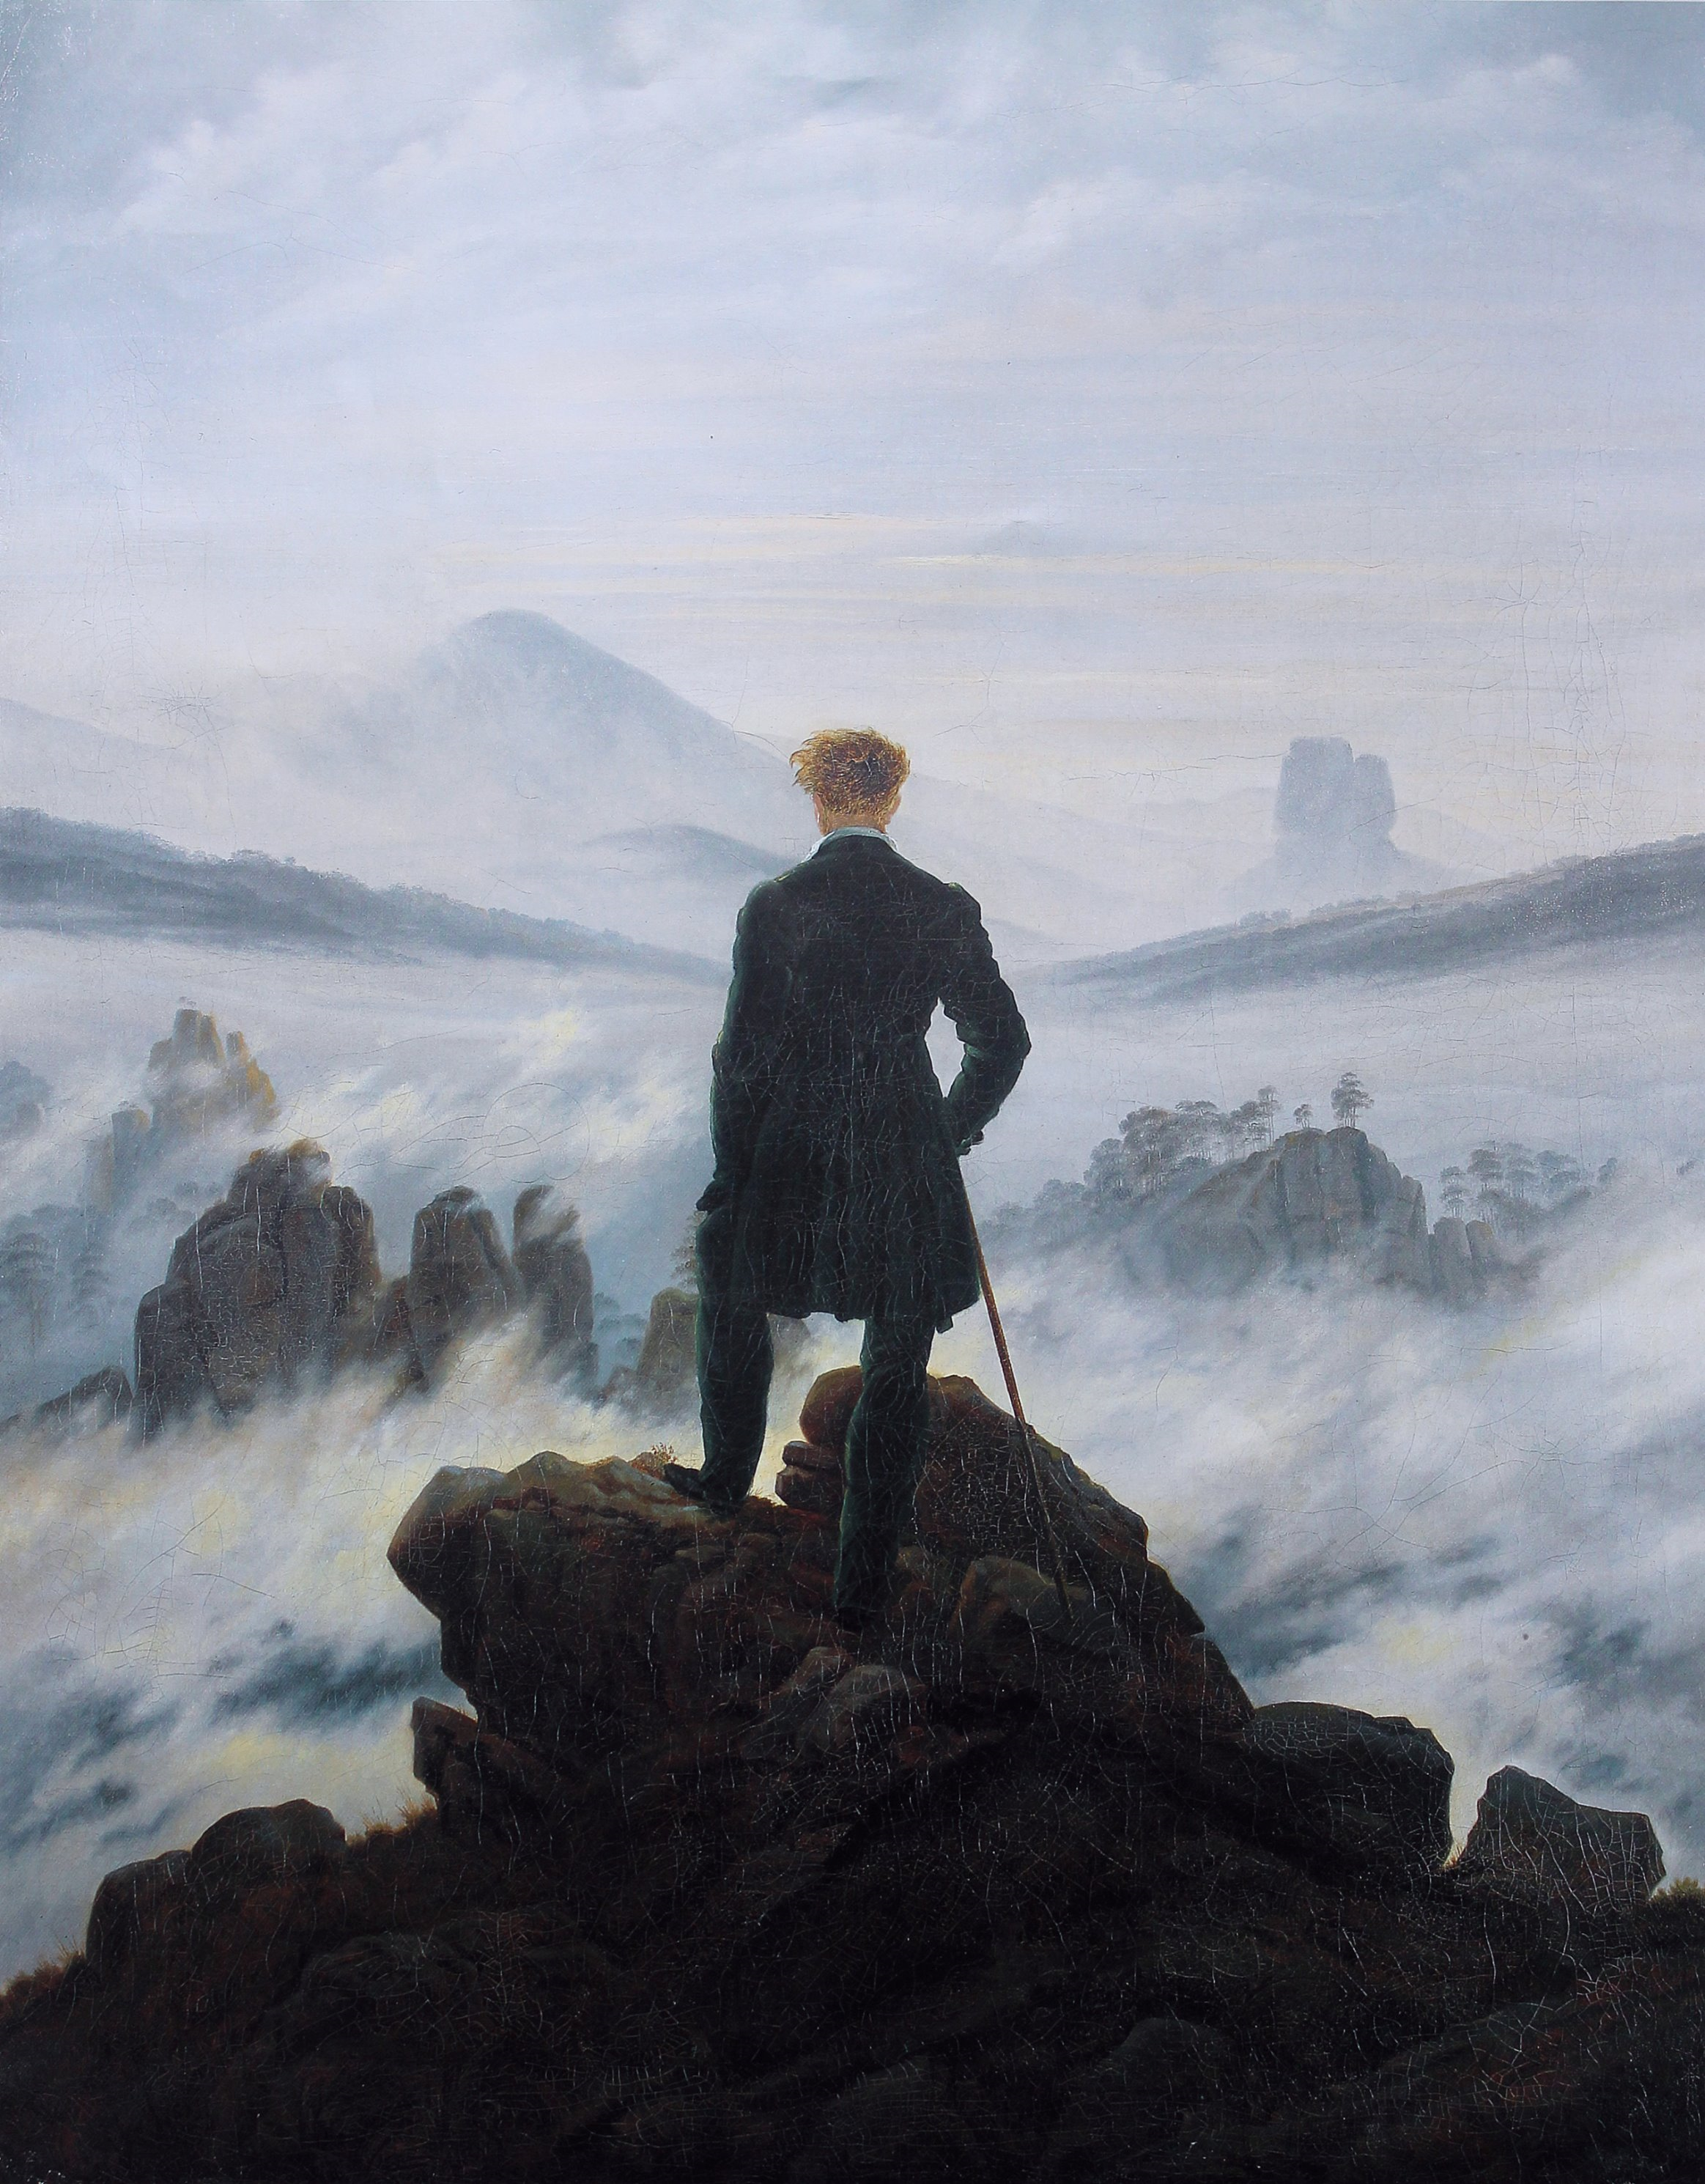
Romanticism
In literature and art

Slide 2
Social, Political and Economic Conditions
Period of rapid change: from agricultural to industrial
Laws of free market dominated people’s lives.
Wealth of Nations by Adam Smith
Power and wealth was transferred from landholding aristocracy to factory-owning capitalists.
Rural farm laborers became urban industrial workers
The country became divided into “two nations”
People who owned property and land (the rich)
People who did not (the poor)

Slide 3
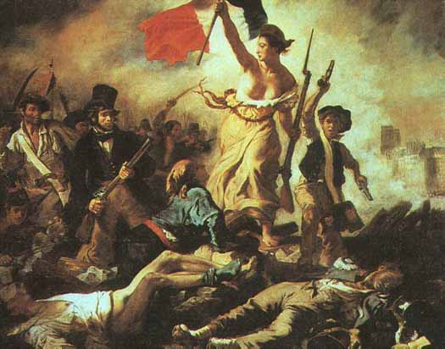
Influence of French Revolution
French Revolution inspired new social philosophy which advocated gradual evolution towards the removal of poverty and equal distribution of wealth.
Support for the revolution in Britain declined with the Reign of Terror in France.
After the defeat of Napoleon, the government and ruling classes adapted repressive measures, especially with groups of workers demanding social and political reforms.
Peterloo Massacre of 1819
“All changed, changed utterly,
A terrible beauty is born.”
-W. B. Yeats
(“Easter 1916”)

Slide 4
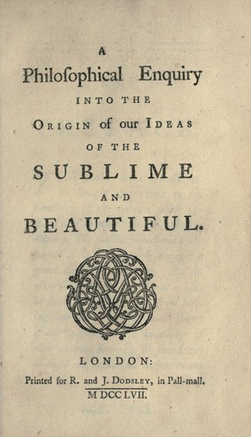
The Sublime
The question of what is beautiful has been discussed by many philosophers, dating back to Plato.
For Plato, beauty arouses feelings of pleasure.
Aristotle believes that tragedy, more than any other genre, can excite the greatest passions.
During the Enlightenment, philosophers including Edmund Burke and Immanuel Kant also speculated on the “sublime.”
Kant: "We call that sublime which is absolutely great.”
One type of sublime for Kant: terrifying

Slide 5
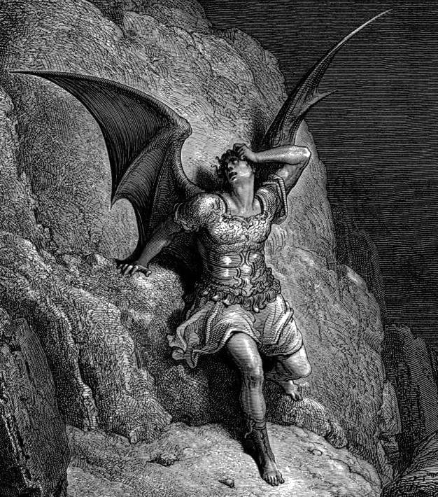
The Sublime according to Burke
Feelings aroused by danger and pain are more powerful than feelings aroused by pleasure.
Passion aroused by the sublime produces astonishment, which is a state of suspension when the mind is filled some degree of horror.
Fear has a paralyzing effect on the mind, robbing an individual of his or her ability to reason or act.
Burke quotes Milton’s Paradise Lost:
The other shape,
If shape it might be called that shape had none
Distinguishable, in member, joint, or limb,
Or substance might be called that shadow seemed,
For each seemed either; black he stood as night;
Fierce as ten furies, terrible as hell,
And shook a deadly dart. What seemed his head
The likeness of a kingly crown had on.

Slide 6
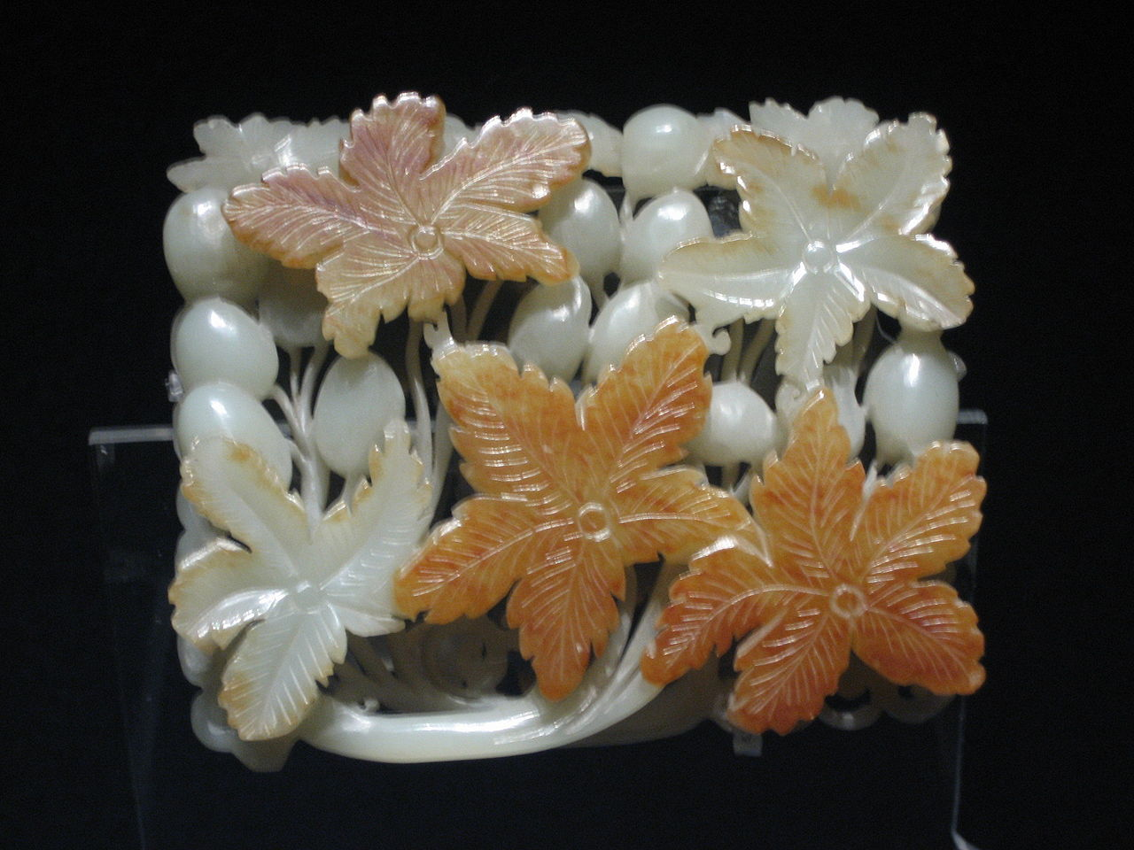
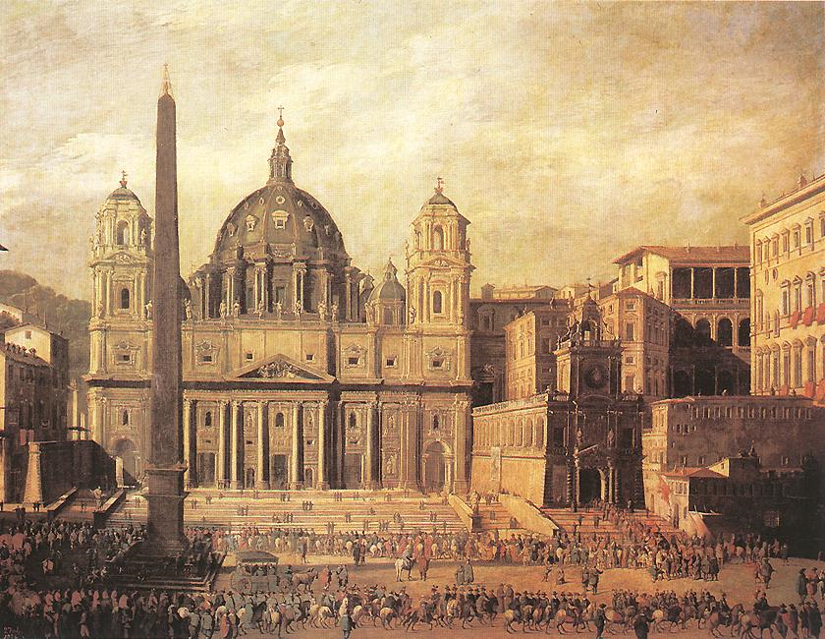
The Sublime according to Burke
Beauty
Sublime
comparatively small
smooth and polished
partial deviation from the right line
light and delicate
founded on pleasure
vast in dimension
rugged, negligent
strong deviation from the right line
dark and gloomy
solid and massive
founded on pain

Slide 7
A break from the Age of the Reason
Neo-Classicism
Romanticism
Stressed reason, intellect and order (the head)
Feelings and imagination were controlled, restrained
Human progress and perfectibility of man and society are attainable if man’s baser instincts are held in check
Look outward to society
Stressed feelings, intuition (the heart)
Attracted by irrational, mystical and supernatural world
Look inward to their own soul and imagination
Celebrates freedom of nature and individual human experience

Slide 8
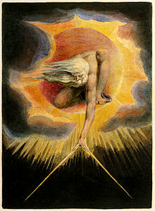
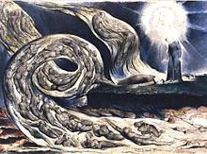
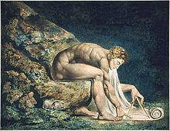
The Romantics grew tired of the excessive intellectualizing and a mechanistic view of the universe. These only fettered the human spirit. They believed that cultural creativity depended on spontaneity, richness and uniqueness of human experience. They reached deep into their imaginations because, for them, “creation from nothingness” was original and genius.

Slide 9
Alexander Pope
William Wordsworth
The proper study of Mankind is Man. Placed on this isthmus of a middle state, A Being darkly wise, and rudely great: With too much knowledge for the Sceptic side, With too much weakness for the Stoic's pride, He hangs between; in doubt to act, or rest; In doubt to deem himself a God, or Beast; In doubt his mind or body to prefer; Born but to die, and reas'ning but to err; Alike in ignorance, his reason such, Whether he thinks too little, or too much; Chaos of Thought and Passion, all confus'd; Still by himself, abus'd or disabus'd; Created half to rise and half to fall; Great Lord of all things, yet a prey to all, Sole judge of truth, in endless error hurl'd; The glory, jest and riddle of the world.
I wandered lonely as a Cloud
That floats on high o’er Vales and Hills,
When all at once I saw a crowd
A host of dancing Daffodils;
Along the Lake, beneath the trees,
Ten Thousand dancing in the breeze.
…
For oft when on my couch I lie
In vacant or in pensive mood,
They flash upon that inward eye
Which is the bliss of solitude,
And then my heart with pleasure fills,
And dances with the Daffodils.

Slide 10
Two Views of Children
Neo-Classicism
Romanticism
Children will grow into adults.
Their base instincts must be trained, restrained.
Children must be taught how to be civilized and sophisticated.
Children are holy and pure, in greatest proximity of God.
They are corrupted by civilization.
The child is the source of natural and spontaneous feeling.

Slide 11
In practice
Neo-Classicism
Romanticism
emphasis on ordered and formal way of writing.
emphasis on balance and symmetry
Heroic couplet in the poetry of Alexander Pope
emphasis on ebb and flow of individual experience
forms and language closer to everyday experience
more accessible to general reader

Slide 12
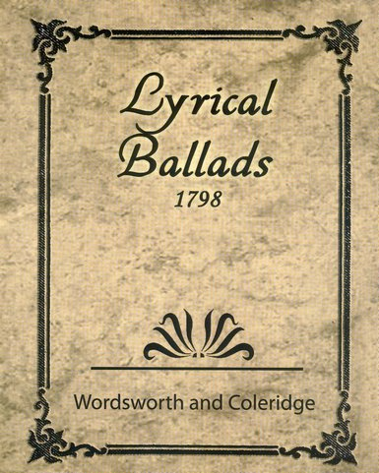
Preface to Lyrical Ballads
“The principal object, then, which I proposed to myself in these poems was to choose incidents and situations from common life, and to relate or describe them, throughout, as far as was possible, in a selection of language really used by men; and, at the same time, to throw over them a certain colouring of imagination, whereby ordinary things should be presented to the mind in an unusual way.”

Slide 13
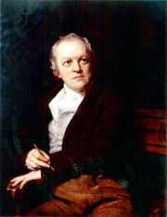
William Blake
rejected 18th century rationalism
rejected formal restrictions of Augustan poetry, preferring a lyrical visionary style
used terms of opposites in his poetry
The Marriage of Heaven and Hell
uses symbolism extensively

Slide 14
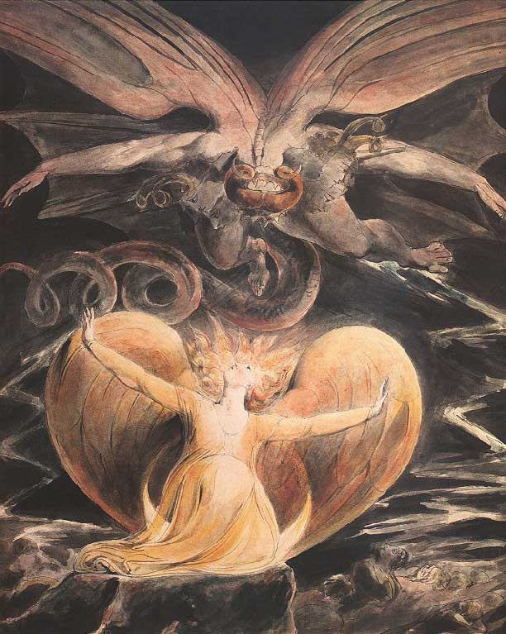
Symbols in Blake’s Poetry
Oppression
Innocence
urban, industrial landscapes
machines
authority figures (e.g., priests)
social institutions
children
lambs
flowers
particular seasons

Slide 15
From Blake’s “Milton”
“To bathe in the Waters of Life, to wash off the Not Human,
I come in Self-annihilation & the grandeur of Inspiration,
To cast off Rational Demonstration by Faith in the Saviour,
To cast off the rotten rags of Memory by Inspiration,
To cast off Bacon, Locke & Newton from Albion’s covering,
To take off his filthy garments & clothe him with Imagination…”

Slide 16
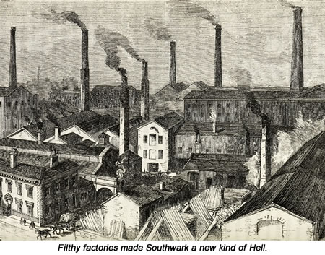
“London”
I wander thro' each charter'd street,
Near where the charter'd Thames does flow.
And mark in every face I meet
Marks of weakness, marks of woe.
In every cry of every Man,
In every Infants cry of fear,
In every voice: in every ban,
The mind-forg'd manacles I hear
How the Chimney-sweepers cry
Every blackning Church appalls,
And the hapless Soldiers sigh
Runs in blood down Palace walls
But most thro' midnight streets I hear
How the youthful Harlots curse
Blasts the new-born Infants tear
And blights with plagues the Marriage hearse

Slide 17
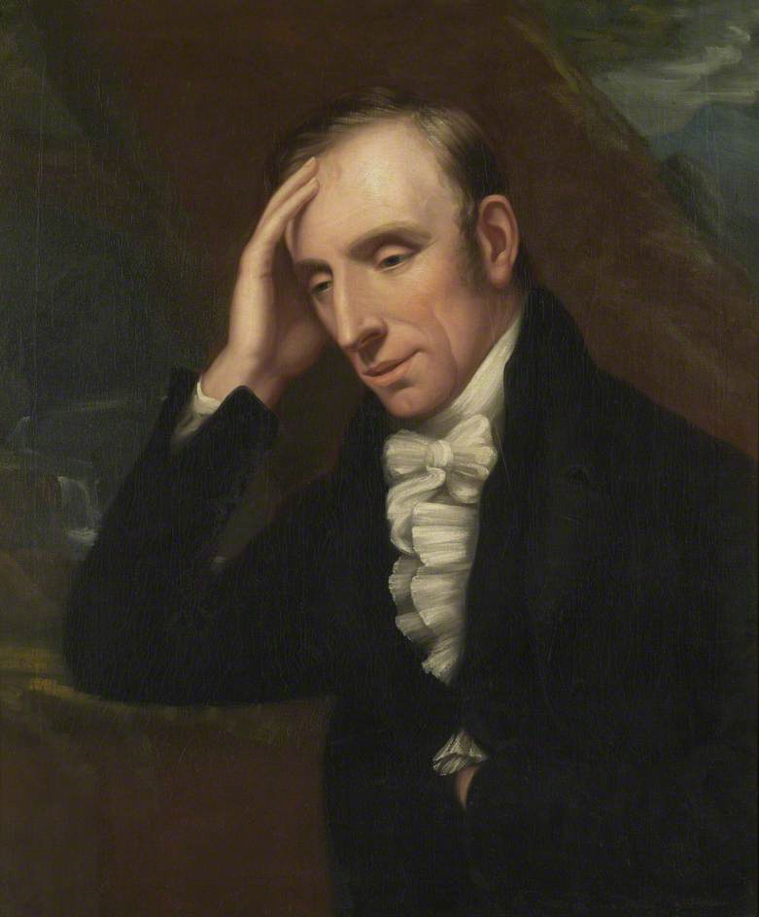
William Wordsworth
published Lyrical Ballads in 1798 and added a Preface to the second edition
articulated a new philosophy of poetry, one employed “the real language of men.”
examined his own feelings through observations of nature

Slide 18
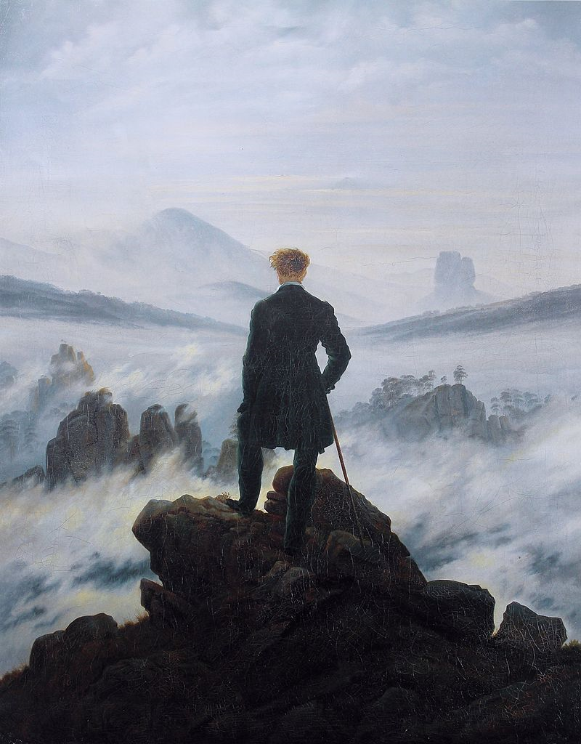
The Sublime in Nature
“For I have learned
To look on nature, not as in the hour
Of thoughtless youth, but hearing oftentimes
The still, sad music of humanity,
Not harsh nor grating, though of ample power
To chasten and subdue.”
Wanderer above the Sea of Fog (1817) by Caspar David Friedrich

Slide 19
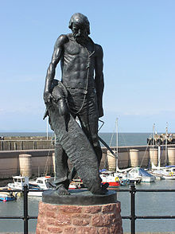
Samuel Taylor Coleridge
English poet, philosopher and literary critic
influenced by German Romanticism, which he introduced to English culture
wrote The Rime of the Ancient Mariner and Kubla Khan

Slide 20
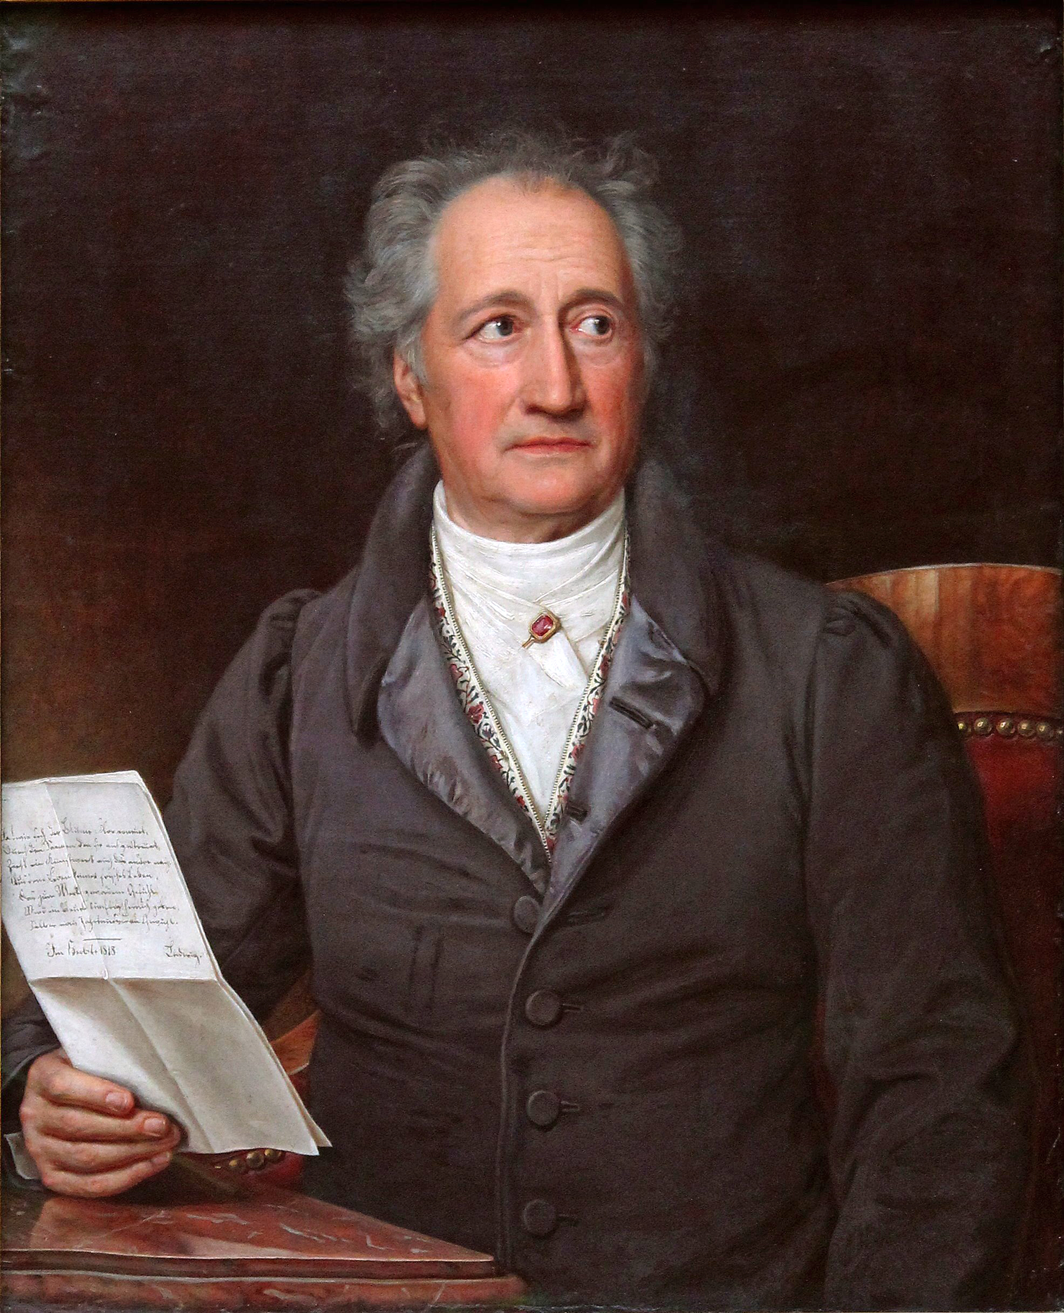
Goethe
German playwright, novelist, poet, literary critic…considered the greatest German literary figure of modern times.
He stands in relation to Romanticism as Shakespeare in relation to the Renaissance.
Faust is considered one of Europe’s greatest long poems, in tradition of Milton’s Paradise Lost and Dante’s The Divine Comedy.

Slide 21
Gothic Literature
The Gothic novel became an important literary genre with the publication of Horace Walpole’s The Castle of Otranto.
Look at the examples of Gothic novels. What are the recurring or conventional…
settings?
character types?
themes?
motifs?
plot elements?

Slide 22
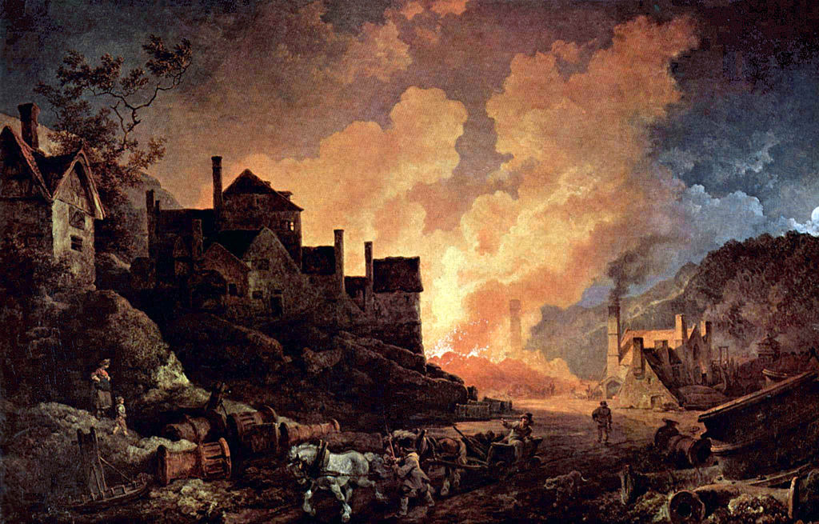
Capturing the Industrial Revolution
Coalbrookdale by Night (1801) by Philip James de Loutherberg

Slide 23
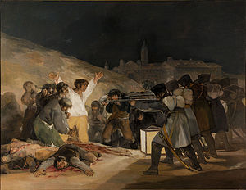
Francisco de Goya’s The Third of May, 1808

Slide 24
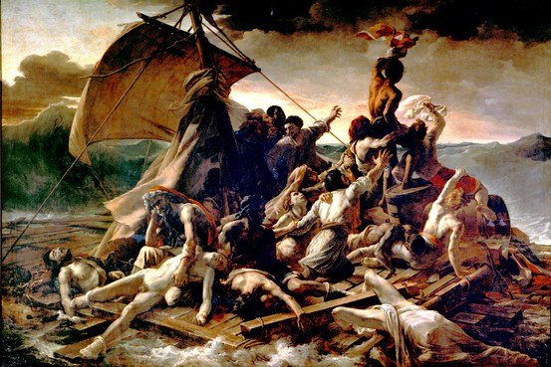
Theodore Gericault’s The Raft of Medusa

Slide 25
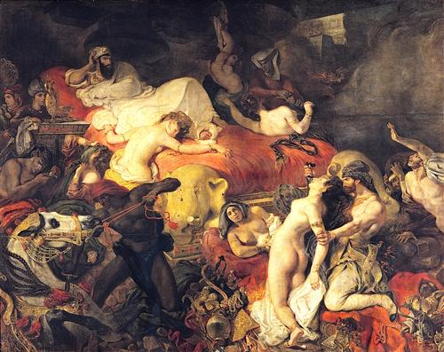
Eugene Delacroix’s Death of Sardanapalus

