Slide 1
2019 Student Exchange Program
Summary and Application

Slide 2
About the Program
33rd year
Originally started by Maple Leaf Foundation
Taken over by Fulbright Canada
Brings together students from Boston Public School Board and Canadian students
Last year: first year for STA

Slide 3
Program Coordinators
St. Thomas Aquinas Catholic High School
Tech Boston Academy
Danik Lafleur
English and history teacher at STA
David Brookes
Culinary arts and law teacher at STA
Lianne Hughes
History teacher at TBA
Another teacher from TBA

Slide 4
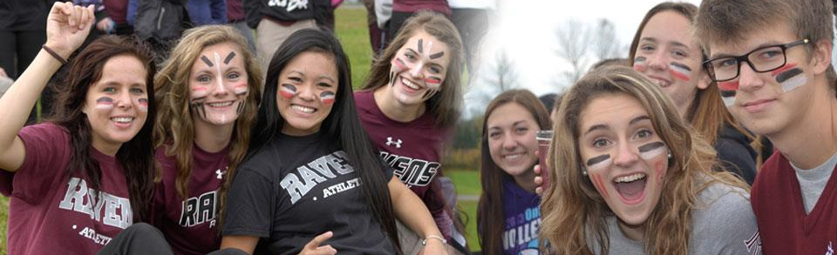
Who Can Participate?
Any Grade 11 STA student
10 students will be selected
Boy-to-girl ratio TBD

Slide 5
How Will Students be Selected?
The letters in the application package
Student letter
Family letter
Student’s marks and learning skills
Student’s participation in school clubs and activities
Student’s interaction with other, including other students and STA staff

Slide 6
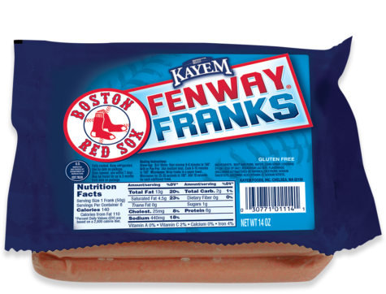
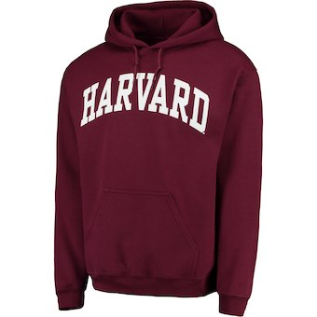
What Costs Will Families Incur?
What’s Not Covered
Additional beverages, snacks and food items outside of programming
An additional mouth to feed in Russell
Extra activities outside programming
Gifts, souvenirs

Slide 7
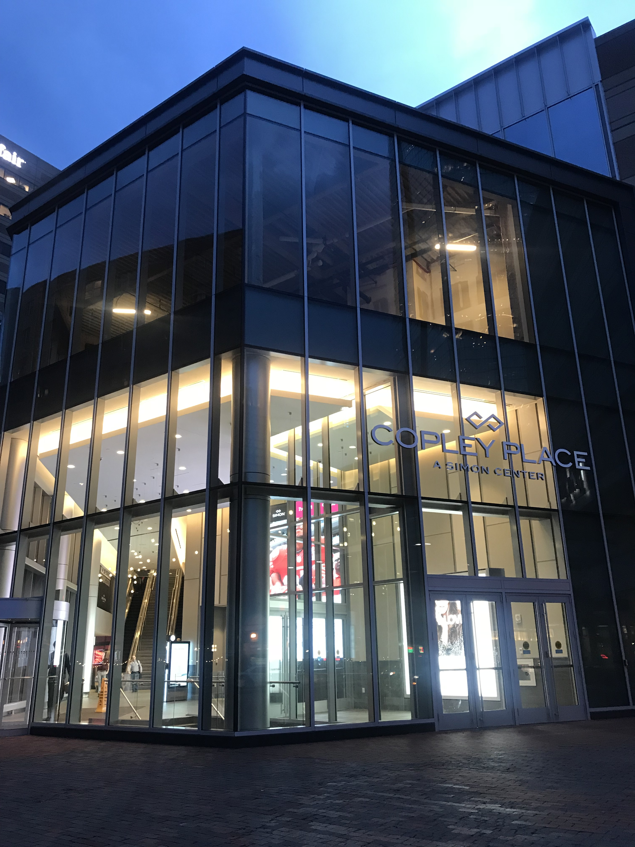
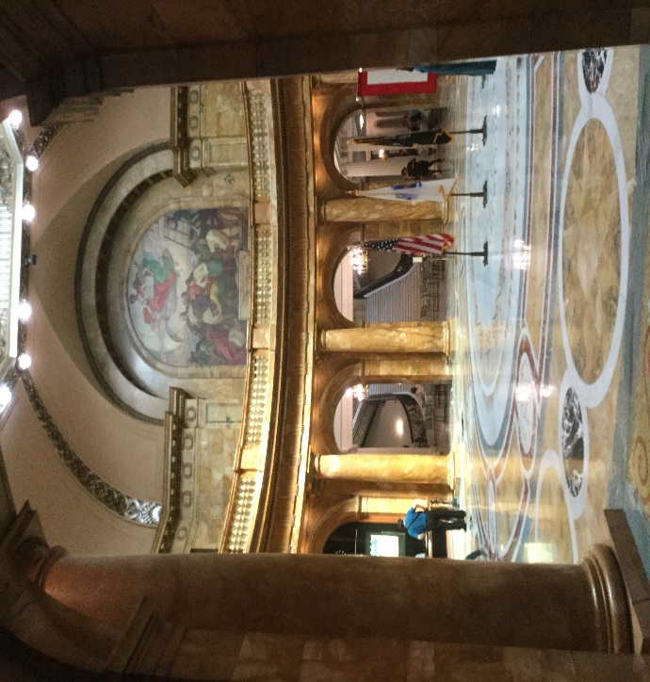
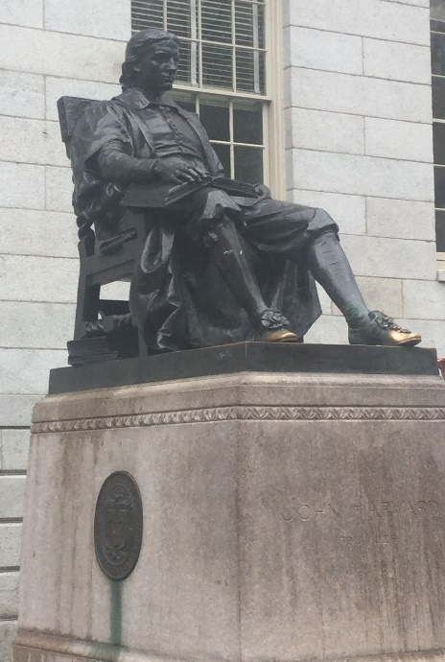
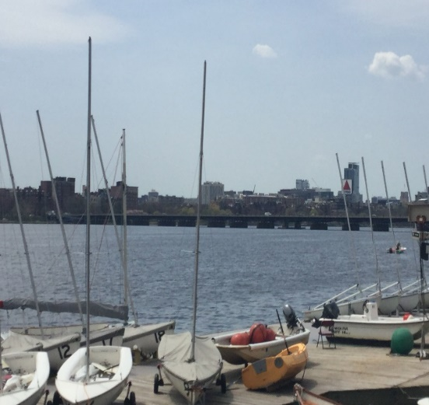
What Does the Itinerary Look Like?
Boston
Red Sox game
State Legislature
1st African-American school house
Boston Tea Party Museum
Museum of Fine Arts
MIT Media Lab
Harvard University
Blue Man Group
Duck Boat Tour

Slide 8
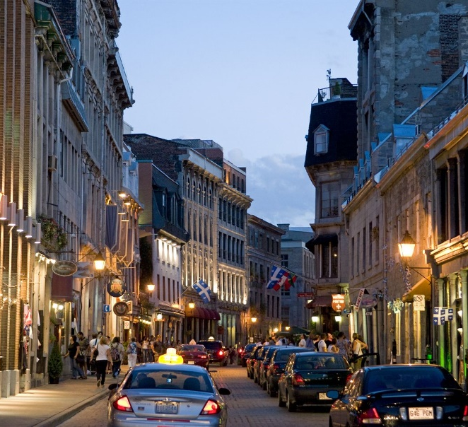
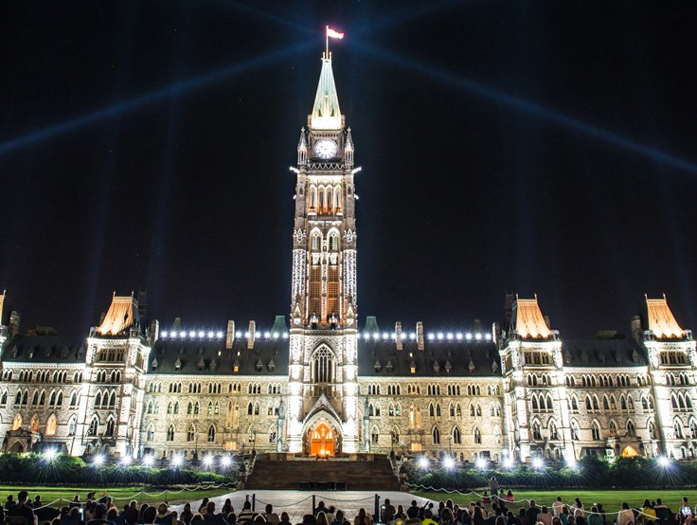
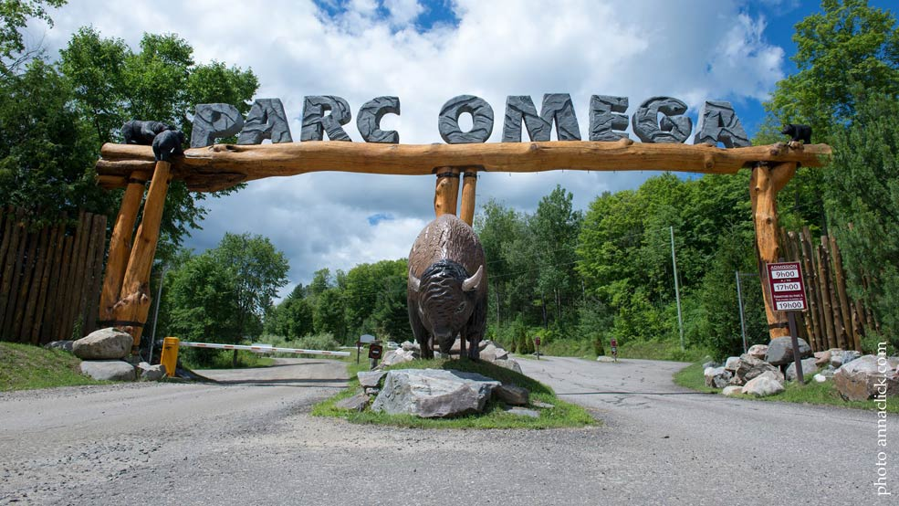
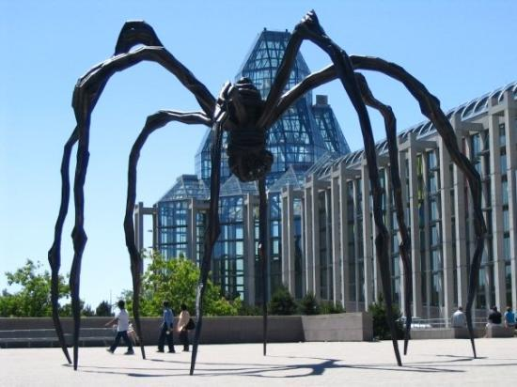
What Does the Itinerary Look Like?
Russell
Parliament of Canada
Notre Dame Cathedral
National Gallery of Arts
Omega Park
Old Montreal
McGill University
RCMP Musical Ride
Escape Manor

Slide 9
2019 Student Exchange Program
Summary and Application

