Slide 1
Unification and Rise of Germany
Class notes

Slide 2
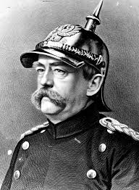
German Unification
Otto von Bismarck, a conservative supporter of the Prussian monarchy, proposed a German confederation with a national assembly and universal suffrage.
Austrian emperor, Franz Joseph opposed this confederation, and the Austro-Prussian War brought a Prussian victory over the Austrians.
A newly made North German confederation excluded Austria but extended Prussia’s borders.
Bismarck thought that, even with universal suffrage, rural voters would elect conservative landholders and not liberals. Meanwhile, the Prussian monarchy, with King Wilhelm I, had control over the military and foreign affairs.
Otto von Bismarck

Slide 3
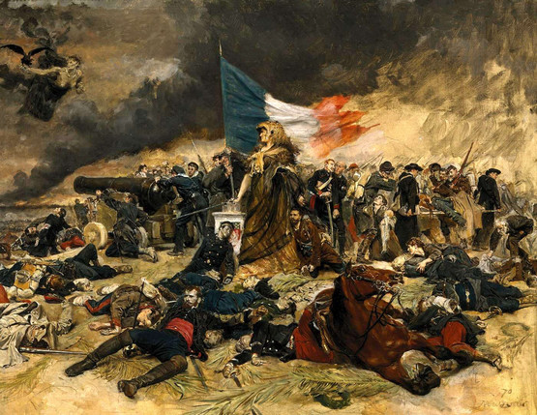
Prussia’s Military Might
During the short Austro-Prussian War of 1866, the Prussian military marched into Vienna using new industrial technology.
a new needle gun or breech-loading rifle
use railroads to transport soldiers quickly
use of telegraphs to communicate
In the Franco-Prussian War of 1870-1871, the Prussian army captured 100,000 French soldiers quickly and forced the collapse of Napoleon’s Second Empire.

Slide 4
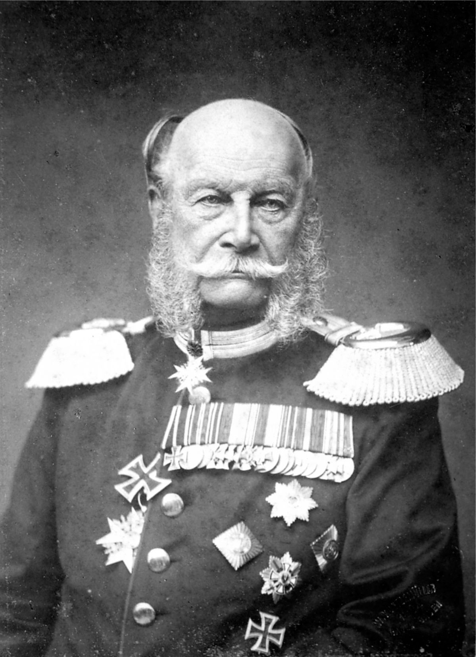
The Franco-Prussian War (1870-1)
The conflict originated in a diplomatic dispute over Spain’s succession.
Bismarck wanted Spain as an ally, and the crown was offered to a distant relative of Wilhelm I after the abdication of Queen Isabella II.
France feared being surrounded by an alliance of rivals.
Wilhelm I

Slide 5
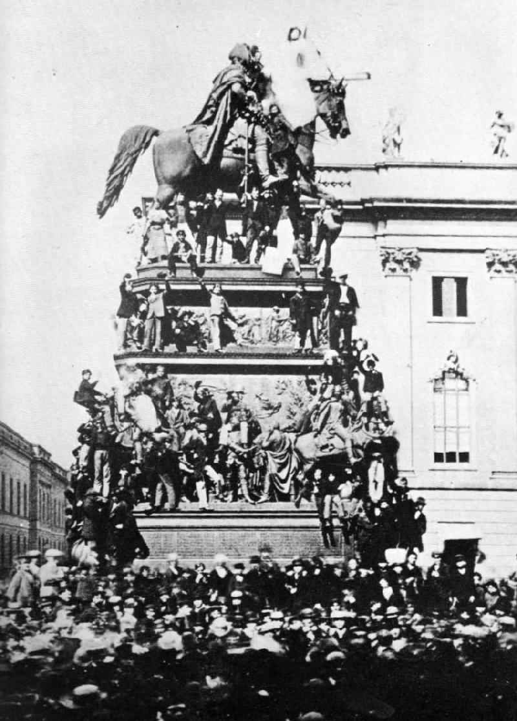
The Franco-Prussian War (1870-1)
The Prussians achieved a stunning victory and occupied Paris.
The terms of peace were harsh:
France ceded the provinces of Alsace and Lorraine.
France has forced to pay five billion francs.
The Germans would occupy France for three years.
(Wilhelm I was pronounced German emperor of a unified Germany in the Palace of Versailles’ Hall of Mirrors.)

Slide 6
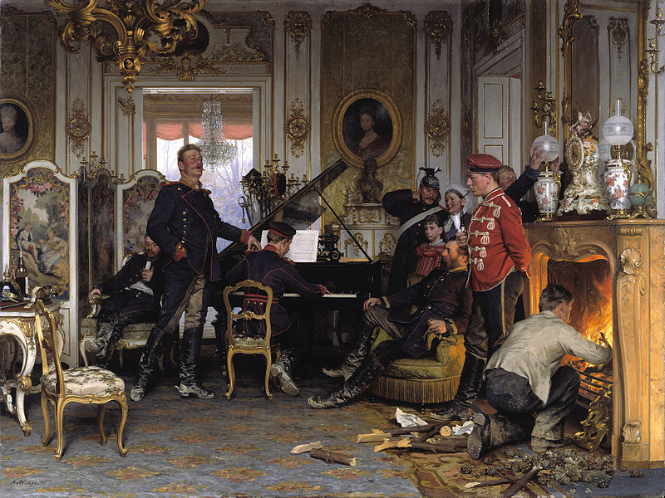
Anton von Werner’s A Billet Outside Paris

Slide 7
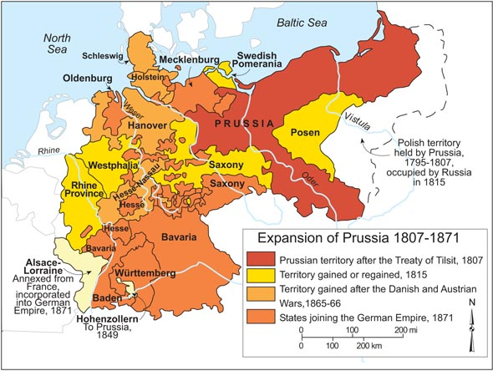
Prussia’s Expansion in the 19th Century

Slide 8
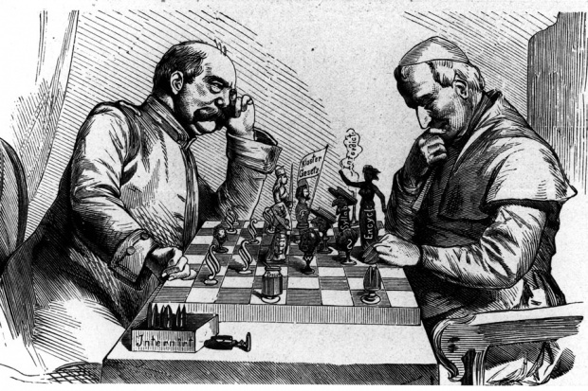
Bismarck’s Germany
The Reichstag, Germany’s elected parliament, was limited in power.
Bismarck wanted to secure support for his policies and avoid fragmentation.
He adopted an unsuccessful secular policy of Kulturkampf, an anticlerical policy limiting the rights of the Catholic Church in Germany, aimed at the Catholic or Centre Party.
He then targeted socialists, especially the Social Democratic Party.
Otto von Bismarck vs Pius IX (pope)
Germany was Protestant, but as a result of unification, 1/3 of the unified country was now Catholic. Bismarck wanted to limit the influence of the Catholic Church in Germany.

Slide 9
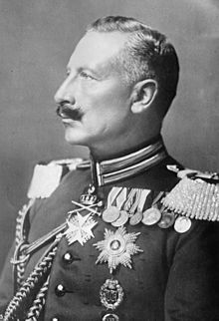
Bismarck’s Germany
Bismarck passed legislation to make socialists enemies of the state; he also restricted newspapers, meetings and socialist and trade union activities.
He also passed the most advanced social legislation in Europe, including universal sickness and accident insurance, and old-age pensions.
The SPD became the most popular party in Germany nonetheless, and in 1890, a young Wilhelm II dismissed Bismarck.
The kaiser and his ministers appealed to militant nationalism to gain support in the stem of the tide of the SPD.
Wilhelm II

Slide 10
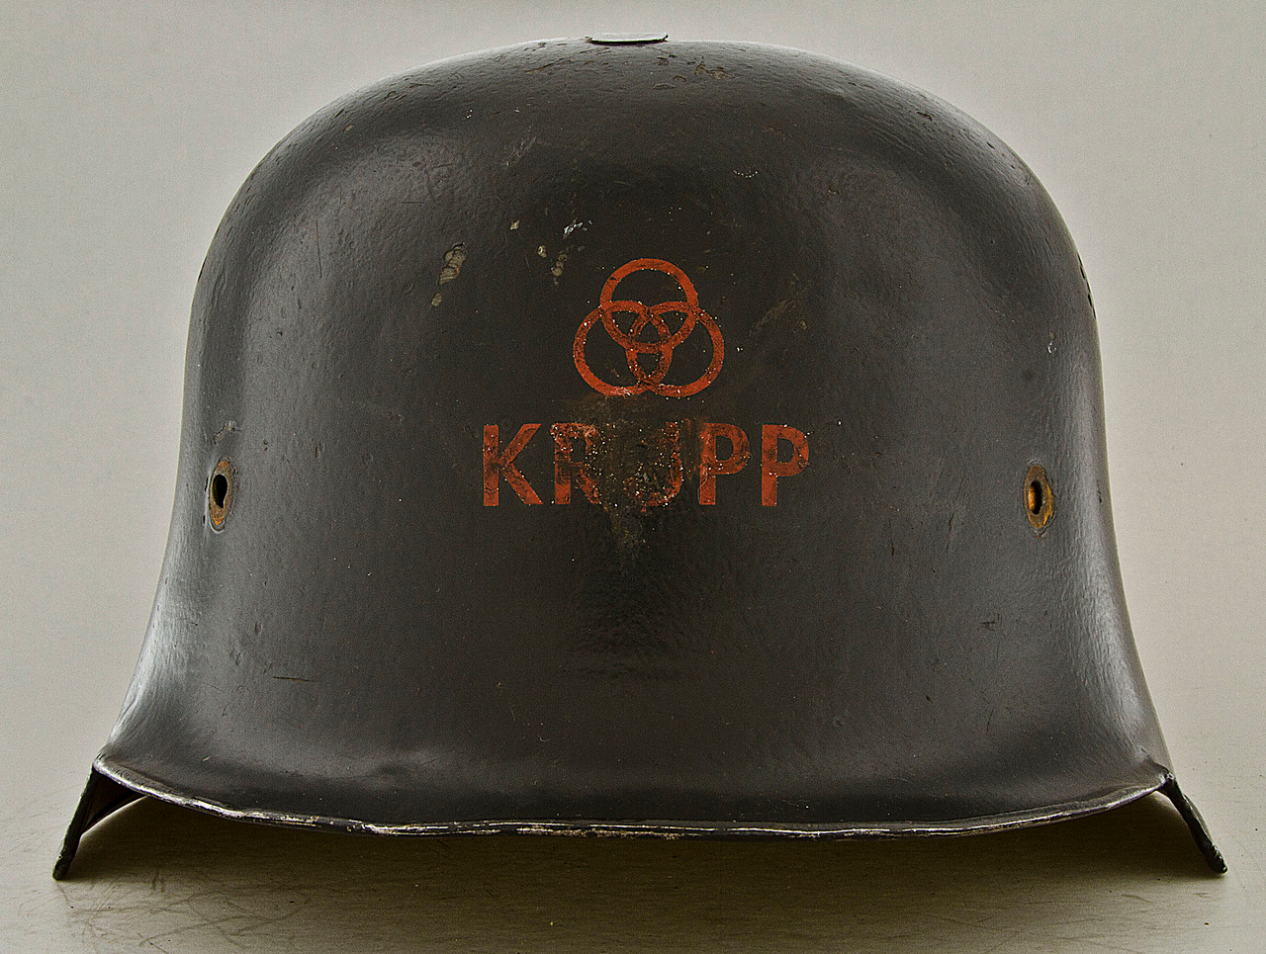
Germany’s Industrial Growth
What does this statistic suggest about Germany’s industrial growth?
In 1848, Krupp, the German steel, engineering and munitions giant of the Ruhr valley, employed only 72 people.
In 1873, it employed 12,000 people.
http://www.fordham.edu/halsall/mod/indrevtabs1.asp

Slide 11
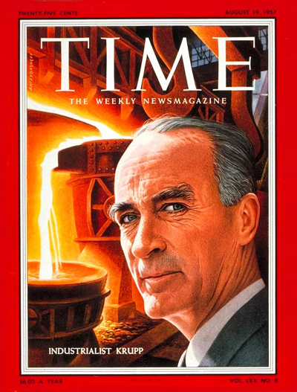
Germany’s Industrial Monopolies
Large corporations were involved in all aspects of production: extracting and processing raw materials, manufacturing the finished goods, and transporting and retailing products.
Large corporations, which enjoyed monopolies, also dominated the steel, chemical, electrical and petroleum industries.
These large corporations were headed by chief executives who had close links to political leaders.

