Slide 1
Jeopardy Review
Pharoahs | Buildings | Places | Religion | Writing
100 | 100 | 100 | 100 | 100
200 | 200 | 200 | 200 | 200
300 | 300 | 300 | 300 | 300
400 | 400 | 400 | 400 | 400
500 | 500 | 500 | 500 | 500

Slide 2
Pharaohs 100
Often compared to Elizabeth I, this person was the first woman to make herself pharaoh of Egypt.
ANSWER

Slide 3
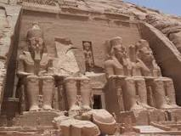
Pharaohs 200
This pharaoh ordered the building of great temples, such as Abu Simbel.
ANSWER

Slide 4
Pharaohs 300
This pharaoh is sometimes referred to as the Napoleon of Egypt because he increased Egypt’s power and wealth by military conquests.
ANSWER

Slide 5
Pharaohs 400
This young pharaoh’s tomb contained great treasures and one of Egypt’s greatest mysteries.
ANSWER

Slide 6
Pharoahs 500
This pharaoh, the first monotheist ruler of Egypt, rejected traditional Egyptian gods in favour of Aton, the sun god.
ANSWER

Slide 7
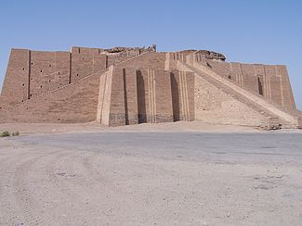
Structures 100
This massive structure, which resembles a pyramid, was built in Mesopotamia.
ANSWER

Slide 8
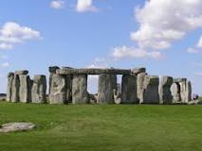
Structures 200
This megalith is found in England. It is believed to be a burial ground for wealthy and powerful families.
ANSWER

Slide 9
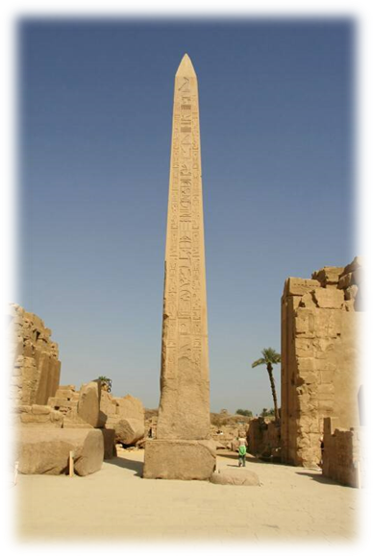
Structures 300
Found at sites like Karnak, these tall, narrow structures
were adorned with hieroglyphic text.
ANSWER

Slide 10
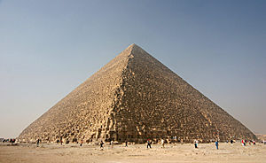
Structures 400
This pyramid, built for the pharaoh Khufu, remained the tallest man-made structure for 3,800 years.
ANSWER

Slide 11
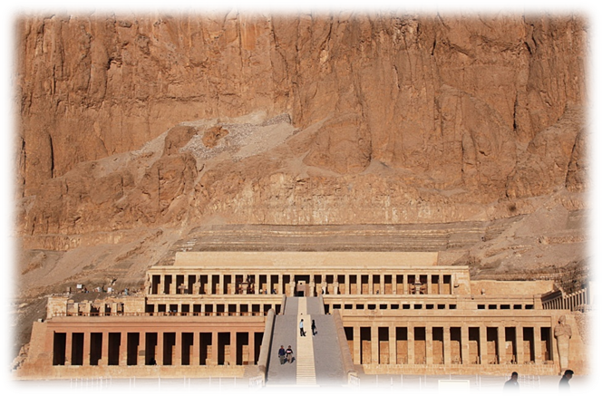
Structures 500
This pharaoh’s temple is the focal point of Deir el-Bahari, a place full of temples built for pharaohs.
ANSWER

Slide 12
Places 100
The two rivers which supported the growth of civilization in Mesopotamia.
ANSWER

Slide 13
Places 200
This name of this region is used to describe the spread of the domestication of plants and animals to support civilization. It includes Mesopotamia and Egypt.
ANSWER

Slide 14
Places 300
This region, situated in northern Egypt, is a system of rivers that connect the Nile River and the Meditaranean Sea.
ANSWER

Slide 15
Places 400
Situated in France, these caves housed Neanderthal wall paintings.
ANSWER

Slide 16
Places 500
In this battle, Tuthmosis III committed a big military mistake but ended up winning the battle against the Hittites to the north of Egypt.
ANSWER

Slide 17
Religion 100
Known as the king of gods, this god was closely associated with Thebes.
ANSWER

Slide 18
Religion 200
This term means belief in many gods as opposed to just one.
ANSWER

Slide 19
Religion 300
This term refers to the balance of the universe. It is central to Egyptian belief.
ANSWER

Slide 20
Religion 400
This Mesopotamian god is a female deity of love and war. (Tea Party sings a song about her.)
ANSWER

Slide 21
Religion 500
This god of the Underworld was also the first Egyptian mummy according to myth.
ANSWER

Slide 22
Writing 100
The written language of the Sumerians, the first to develop a writing system.
ANSWER

Slide 23
Writing 200
These instruments were used to impress wedge shaped symbols onto clay tablets.
ANSWER

Slide 24
Writing 300
This word means “sacred engravings.”
ANSWER

Slide 25
Writing 400
An Egyptian cursive writing system written onto papyrus with ink and a reed brush.
ANSWER

Slide 26
Writing 500
A hieroglyphic symbol that encloses the name of the pharaoh. It helped early translators identify the names of pharaohs.
ANSWER

Slide 27
Pharaohs 100
Hatshepsut
RETURN

Slide 28
Pharaohs 200
Ramses II
RETURN

Slide 29
Pharaohs 300
Tuthmosis III
RETURN

Slide 30
Pharaohs 400
Tutankhamun
RETURN

Slide 31
Pharaohs 500
Akhenaton
RETURN

Slide 32
Structures 100
ziggurats
RETURN

Slide 33
Structures 200
Stonehenger
RETURN

Slide 34
Structures 300
obelisk
RETURN

Slide 35
Structures 400
The Great Pyramid at Giza
RETURN

Slide 36
Structures 500
Hatshepsut
RETURN

Slide 37
Places 100
Euphrates and Tigris
RETURN

Slide 38
Places 200
Fertile Crescent
RETURN

Slide 39
Places 300
Nile Delta
RETURN

Slide 40
Places 400
Lascaux Caves
RETURN

Slide 41
Places 500
Megiddo
RETURN

Slide 42
Religion 100
Amon-Re
RETURN

Slide 43
Religion 200
polytheism
RETURN

Slide 44
Religion 300
Ma`at
RETURN

Slide 45
Religion 400
Inanna
RETURN

Slide 46
Religion 500
Osiris
RETURN

Slide 47
Writing 100
cuneiform
RETURN

Slide 48
Writing 200
Reed stylus, clay tablets
RETURN

Slide 49
Writing 300
hieroglyphics
RETURN

Slide 50
Writing 400
hieratic
RETURN

Slide 51
Writing 500
cartouche
RETURN

