Slide 1
Industrial Revolution
A View from Below

Slide 2
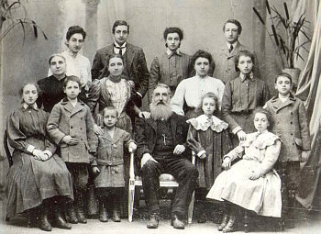
Population Explosion
Europe's population grew at unprecedented rates from about 1750-1914.
The factors contributing to population growth:
Less infant deaths
Falling mortality rates
Increase in births (the old virtue of prudence gave way to the delights of procreation)
Better living conditions
Increase of food supply
Improved transportation (made it possible to ship grain from areas of plenty to those in need)
Plentiful harvest (rising temperatures)

Slide 3
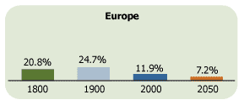
Statistics
Population of Europe
in 1750: approximately 140 million
In 1800: approximately 187 million
in 1850: approximately 266 million
early 1900’s: approximately 468 million
The sharpest climb of population occurred around between 1800 and 1913.

Slide 4
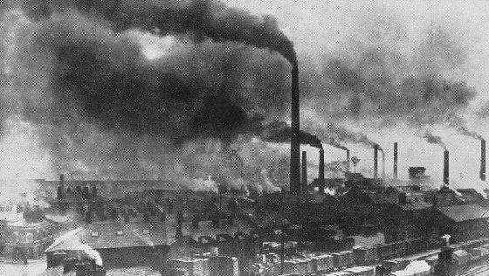
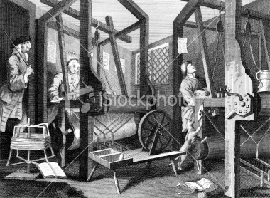
Early Urbanization
Main centres of urbanization:
Belgium, England, Germany, Northern Italy and Ireland.
Any industrial activities catered to local markets/populations at first.
Enclosures forced rural inhabitants to the cities for work.
As mill owners adopted steam power, factories were relocated near coal fields, and drew with them enough workers to transform hamlets into villages and then into small towns as jobs and population grew.

Slide 5
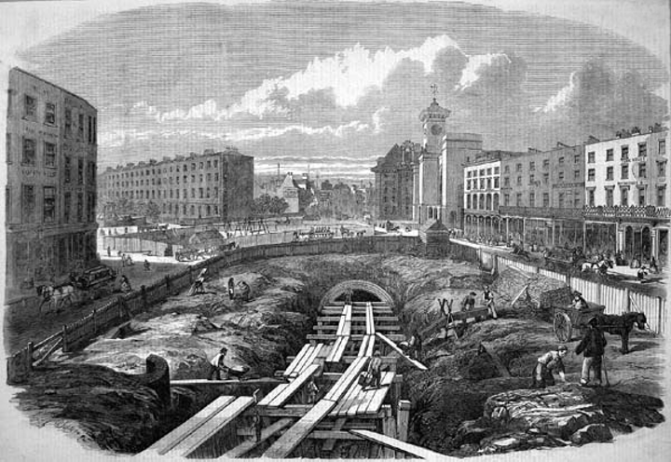
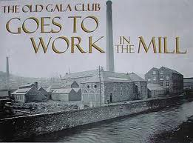
Early Urbanization
Out-migration took place first with laborers and tenants moving towards the nearest town.
Manchester was important because it supplied machinery and metal items to textile mills in surrounding towns. Consequently, it became a focal profiting point.
Manchester became important commercially due to its service to other towns.

Slide 6
Child Labour
During the Industrial Revolution, employers needed cheap labour, so they employed children.
Children worked very long hours, usually between 14-16 hours per day.
They only had one break (45min-1hour).
They didn’t get to eat their breakfast or supper, except while working.
Their food would often go bad because of the dust in the mill.
The children were beaten if they were working too slow or if they were late.
The work was exhausting, and they were paid next to nothing.

Slide 7
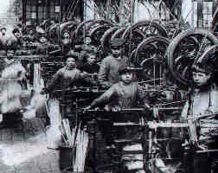
They were not educated because they worked instead.
The moral standards of the children were lowered.
For example, there was heavy use of obscene language
many of the girls had children around 16-17 years old (outside of wedlock).
Children endured poor working conditions, which were comparable to those of a slave.

Slide 8
Factory Rules
A normal working day was 6:00 am – 7:00 pm.
Workers were strictly observed.
Workers were not allowed to have conversations.
If they disobeyed the overseers and officials, they were dismissed.
No workers were able to leave their workplace at anytime.
Every worker was responsible for cleaning up his or her workspace.
If they didn’t have their rulebook, then they were fined.

Slide 9
Factory Rules
Advances were granted only to older workers.
Repeated late arrivals would result in dismissal.
Every worker was obliged to report to his superiors any acts of dishonesty or embezzlement on the part of his or her fellow worker.
If a worker reported theft, he or she would be rewarded with 2 dollars.
Watchmen allowed to search workers for stolen food.

Slide 10
Life In Urban Communities
Ruled by priests
Filthy
Disease ridden
Overcrowded
Deserted at night except for thieves
Rich lived in west
“They lived upwind to avoid the smells of the poor.”
Poor lived in east

Slide 11
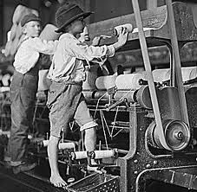
Working Conditions
Hours worked became regulated by clocks.
Work discipline was harsh.
Overcrowding destroyed privacy and dignity.
Conditions were similar to conditions in 3rd world countries today

Slide 12
Housing Conditions of the Poor
The rich lived on lower floor of apartment buildings.
Attics and cellars were unheated and unventilated.
People desired to live close to place of employment
Population Growth
Cities doubled in population every ten to twelve years.
Limited room became a problem because the infrastructure was unable to keep up with demand.

Slide 13
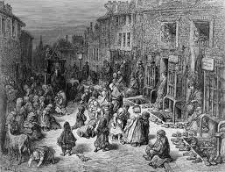
Streets
damp and shadowed because sunlight rarely reached them
muddy streets
streets littered with garbage and waste
narrow and winding streets
rainwater carried rich garbage and waste into the poor streets
floods occurred often

Slide 14
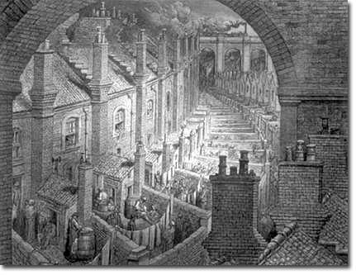
Housing Problems
Construction was in the hands of small builders and craftsmen whose ideas were not modern.
Housing was inadequate and expensive.
Each room housed 5 to 6 people.
Cramped living conditions allowed for disease to spread quickly.

Slide 15
Spread of Disease
small, cramped apartments
air-born disease (tuberculosis, influenza, pneumonia)
lack of public hygiene
water contamination
since several families used the same bathroom (“the hole filled quickly”)

