Slide 1
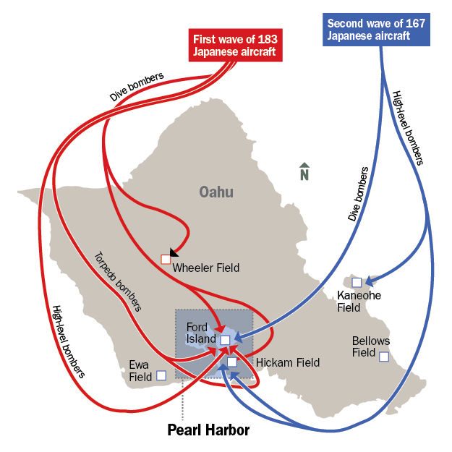
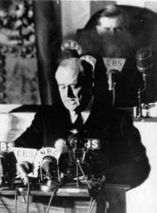
#5 The Bombing of Pearl Harbor
Want more information?
BBC History
Background:
Traditionally, Japan relied on industrial and natural resources from the US.
The Great Depression hurt Japan’s economy.
In the 1930s, Japan invaded resource-rich Manchuria and had further plans to create an empire in the Pacific.
The US and Japan were engaged in trade war, and as a result, the US stopped sending iron and oil to Japan.
Japan joined the Axis alliance, and the US was providing the Allies with military supplies.
What Happened?
On the morning of December 7, Japan attached the US fleet at Pearl Harbor.
In two hours, 5 battleships were sunk and 188 aircraft were destroyed.
After the attack, President Franklin D. Roosevelt declared war on Japan.
The US entered WWII on the Allied side. It was at war with the Axis powers (Japan, Germany and Italy).
The war in the Pacific ended with the bombing of Hiroshima and Nagasaki as it forced Japan’s surrender.
So What?
When Franklin D. Roosevelt declared war on Japan, he ended the United States’ neutrality in the war. Although the US had a “lend-lease” agreement with Britain, it did not enter into World War II until after Pearl Harbor. The US involvement in the war opened up a new theatre in WWII: the Pacific. It also tipped the balance of power to the Allies in Europe. From that moment on, the US never returned to an isolationist approach to world events. For example, during the Cold War that followed, the US were actively engaged in conflicts that arose outside its borders.
Japan attacked Pearl Harbor in two waves.
On December 8, President Roosevelt delivered his famous “infamy” speech before the Congress.
“I fear all we have done is to awaken a sleeping giant and fill it with resolve.” – Japanese Admiral Isoroku Yamamoto

