Slide 1
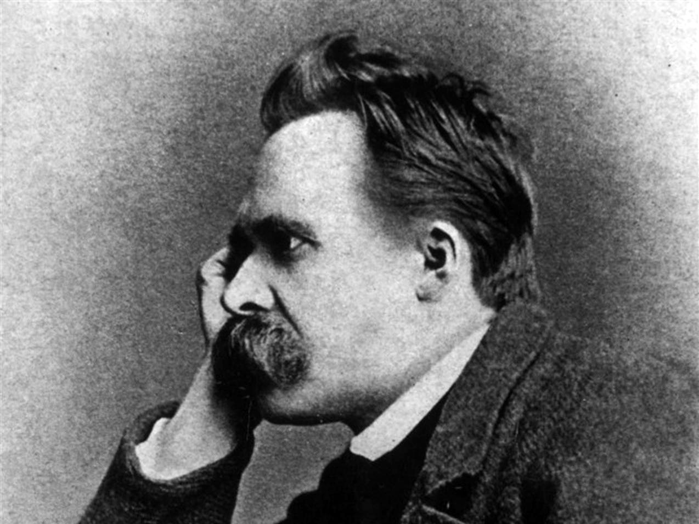
Friedrich Nietzsche

Slide 2
Draw a T-chart like this one in your notes.
What Nietzsche criticizes?
What ideologies and emotions does he reveal as inferior?
What Nietzsche values?
What do the quotations reveal are good qualities?

Slide 3
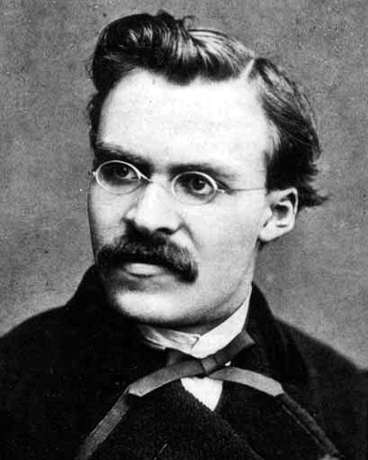
What does this quote suggest about Nietzsche?
“A society that definitely and instinctively gives up war and conquest is in decline: it is ripe for democracy and the rules of shopkeepers – In most cases, to be sure assurances of peace are merely narcotics.”

Slide 4
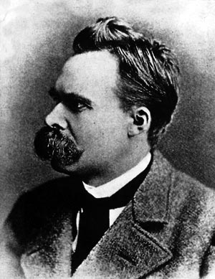
What does this quote suggest about Nietzsche?
Democracy represents the disbelief in great human beings and an elite society: “Everyone is equal to everyone else.” “At bottom we are one and all self-seeking cattle and mob.”

Slide 5
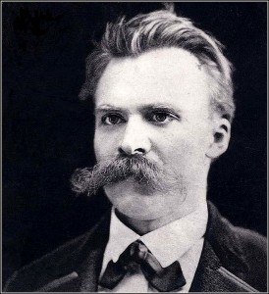
What does this quote suggest about Nietzsche?
“A declaration of war on the masses by higher men is needed! Everywhere the mediocre are combining in order to make themselves master! Everything that makes soft and effeminate, that serves the ends of the ‘people’ or the ‘feminine’ works in favor of suffrage universal, i.e., the dominion of inferior men.”

Slide 6
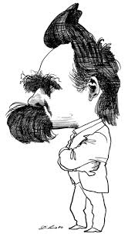
What does this quote suggest about Nietzsche?
“The root of all evil: that the slavish morality of meekness, chastity, selflessness, absolute obedience, has triumphs…the best things have been slandered because the weak or the immoderate swine have cast a bad light on them – and the best men have remained hidden – and have often misunderstood themselves.”

Slide 7
What does this quote suggest about Nietzsche?
“What is good? – All that heightens the feeling of power, the will to power, power itself in man. What is bad? – All that proceeds from weakness. What is happiness? – The feeling that power increases – that resistance is overcome.”

Slide 8
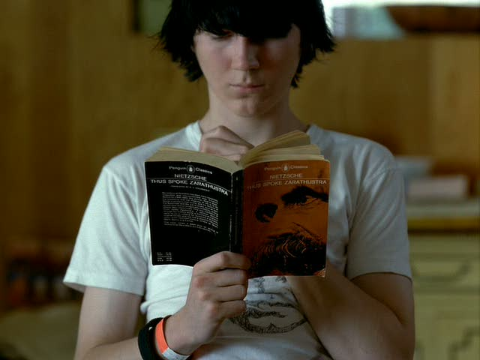
What does this quote suggest about Nietzsche?
“One should not embellish or dress up Christianity: it has waged a war to the death against this higher type of man, it has excommunicated all the fundamental instincts of this type, it has distilled evil, the Evil One, out of these instincts – the strong human being as the type of reprehensibility, as the ‘outcast.’”

Slide 9
Nietzsche’s Beliefs
challenged the belief in progress and human reason
valued creativity over reason
believed that, since God is dead, no moral values were revealed by God
challenged Christianity and argued the individual could only find meaning through exerting the human spirit

Slide 10
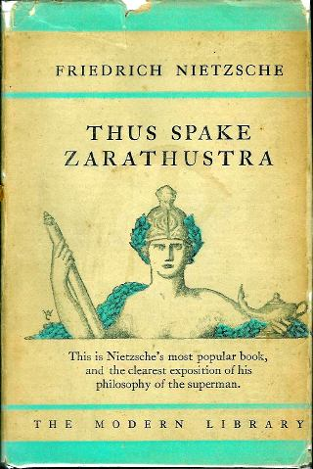
Nietzsche’s superman or overman
“Not ‘mankind’ but overman is the goal!...This world is the will to power – and nothing besides! And you yourselves are also this will to power – and nothing besides.”

Slide 11
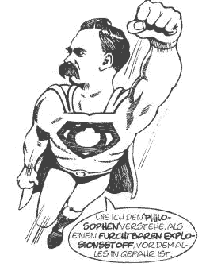
Nietzsche’s superman or overman
“The individual has always had to struggle to keep from being overwhelmed by the tribe. If you try it, you will be lonely often, and sometimes frightened. But no price is too high to pay for the privilege of owning yourself.”

Slide 12
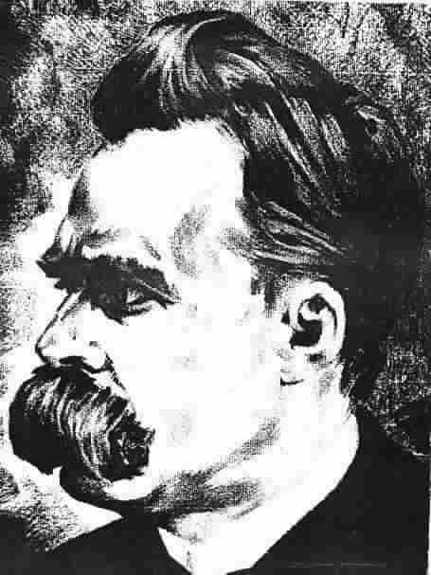
Nietzsche’s superman or overman
“You need chaos in your soul to give birth to a dancing star.”

Slide 13
Nietzsche’s Superman
higher type of human
asserts his will
makes great demands on himself
lives life with a fiery joy
aspires to self-perfection
creates his own values and defines his own life
understands that people strive for power
sees life as a contest in which the enhancement of power is the ultimate purpose of our actions

Slide 14
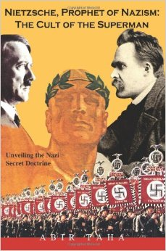
Nietzsche’s Reputation
remains to be associated with composer Richard Wagner, who dedicated his art to German nationalism
associated with the rise of Hitler and the Nazis, since some of Nietzsche’s ideas were used to justify atrocities

Slide 15
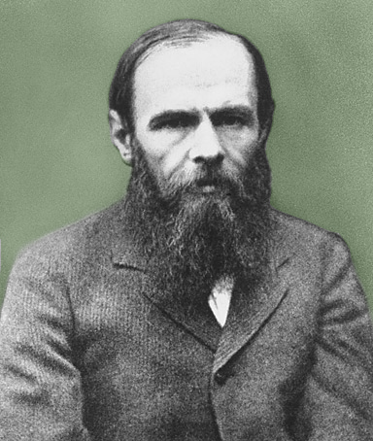
Fyodor Dostoevsky
Russian writer of short stories and novels
gambler and alcoholic, often in debt and poverty
wrote Crime and Punishment

Slide 16
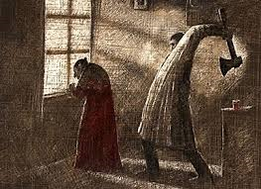
Crime and Punishment
Raskolnikov, a student, kills an old Jewish lender.
He uses a superman theory based on utilitarian theory to justify the murder.
His guilty conscience torments him while he is being investigated for the murder.

Slide 17
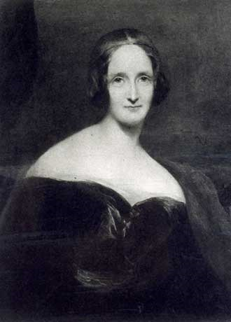
Mary Shelley
daughter of Mary Wollstencraft and William Godwin
married P. B. Shelley, a poet and radical
wrote Frankenstein

Slide 18
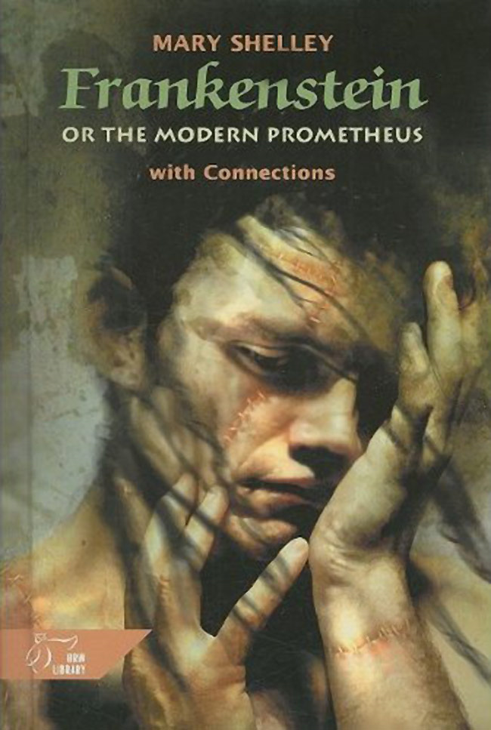
Frankenstein
Dr. Frankenstein creates a human-like creature but abandons it in horror.
The creature, alone, abandoned and shunned by those he meets, turns to revenge.

Slide 19
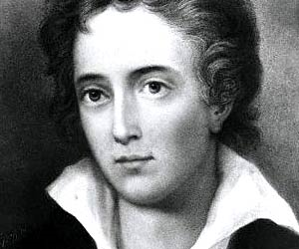
P. B. Shelley
Romantic poet
radical nonconformist
wrote Prometheus Unbound

Slide 20
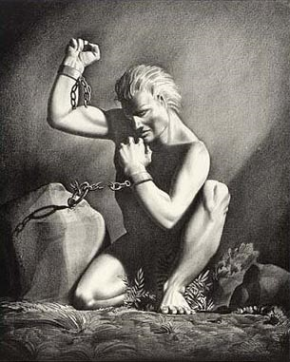
Prometheus Unbound
retells Aeschylus’ story about Prometheus, who is punished for defying Zeus to help humans
symbolic story about the origins of evil and possibility of overcoming it

Slide 21
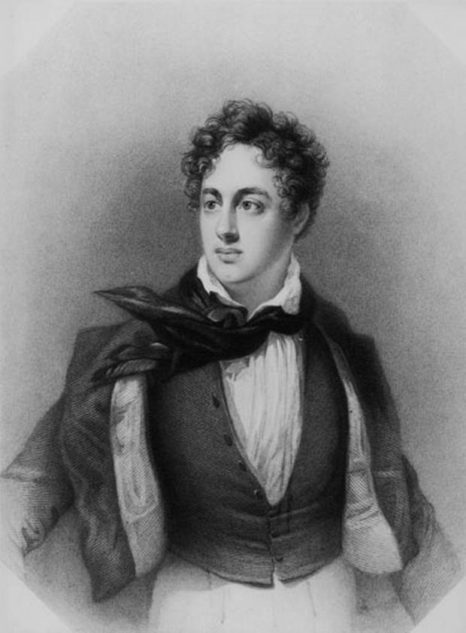
Lord Byron
Romantic poet
close relationship with Mary Shelley and P. B. Shelley
died in Greece helping its war for independence from the Ottoman Empire
wrote Manfred

Slide 22
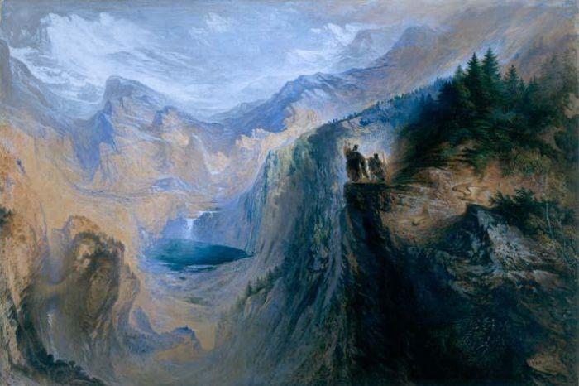
Manfred
written when Byron lived in the Swiss Alps
Manfred is a Byronic hero:
He rejects a pact with the devil.
He becomes totally autonomous, independent of any external authority or power.

