Slide 1
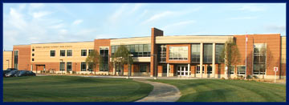
WELCOME TO ST. THOMAS
AQUINAS CHS
HOME OF THE RAVENS

Slide 2
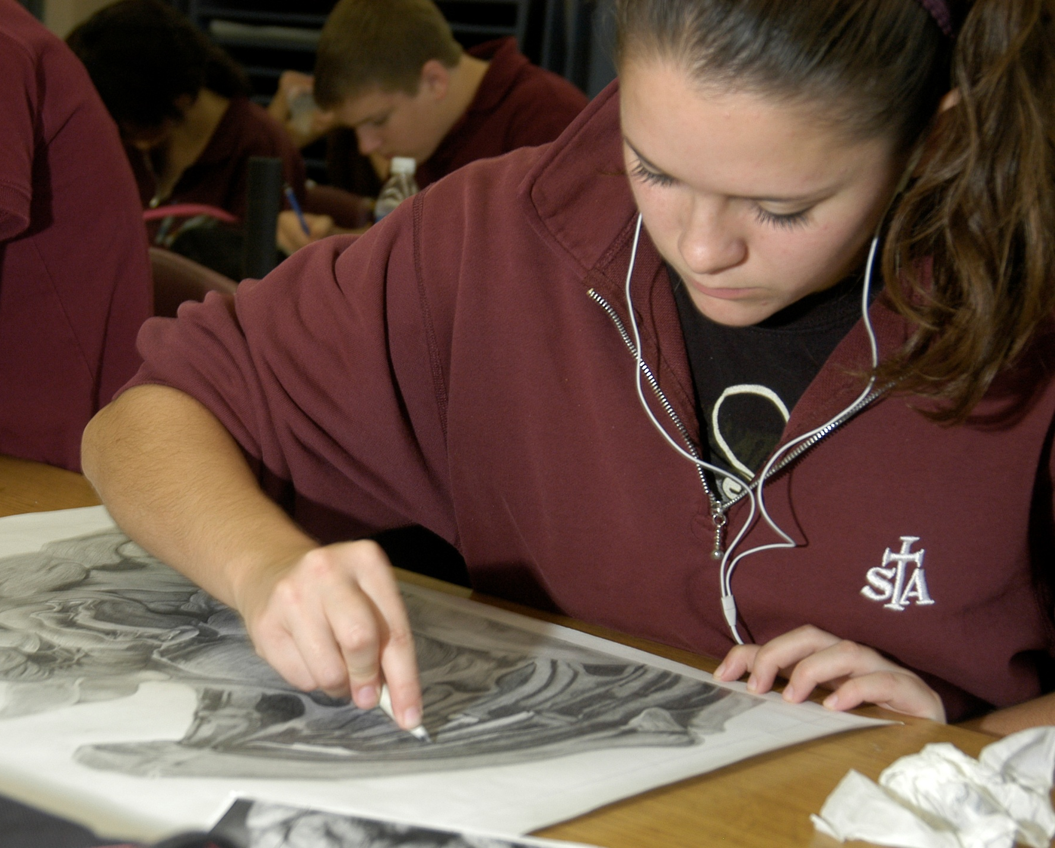
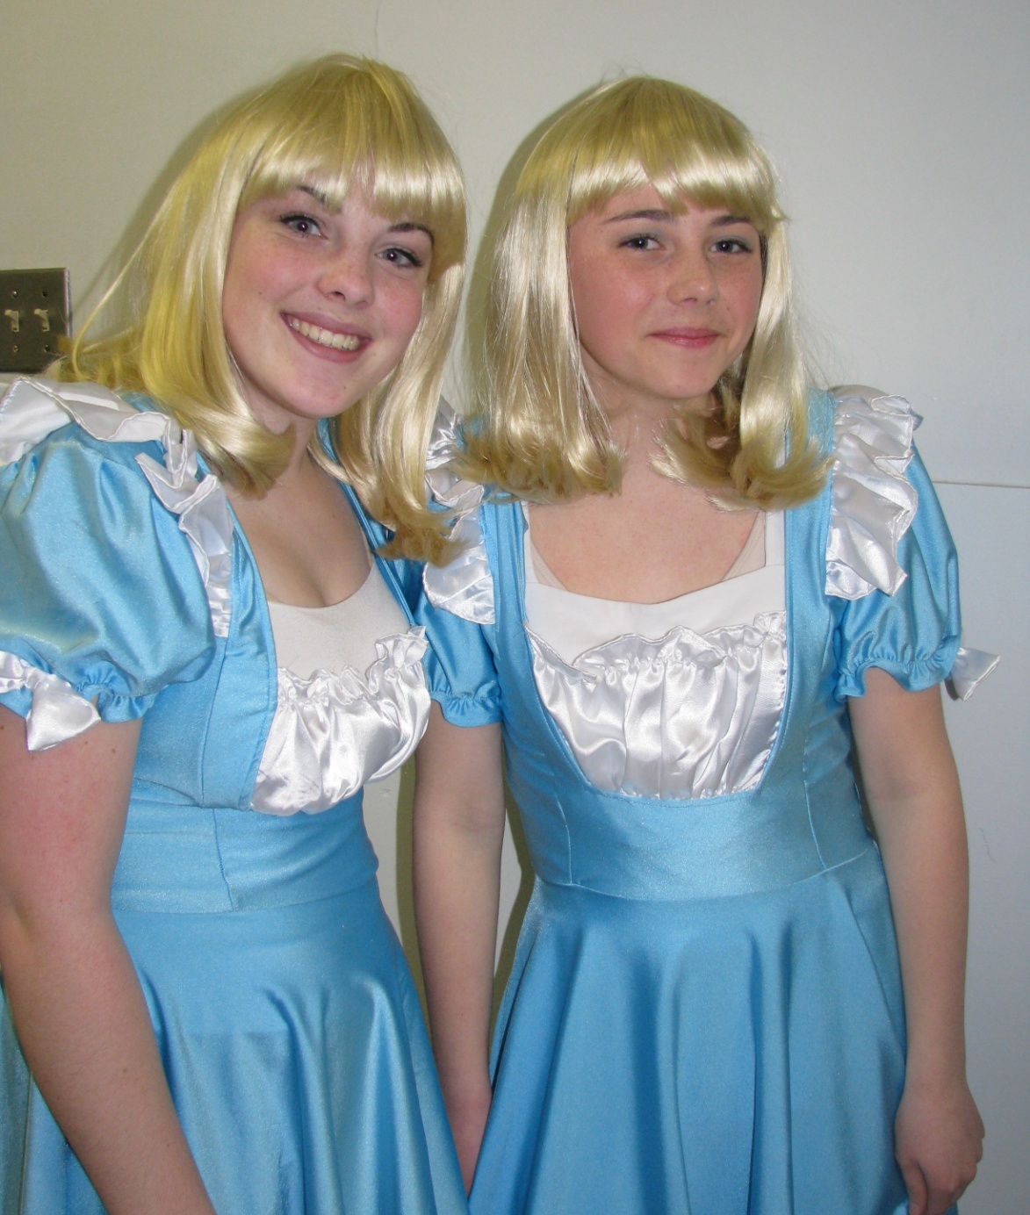
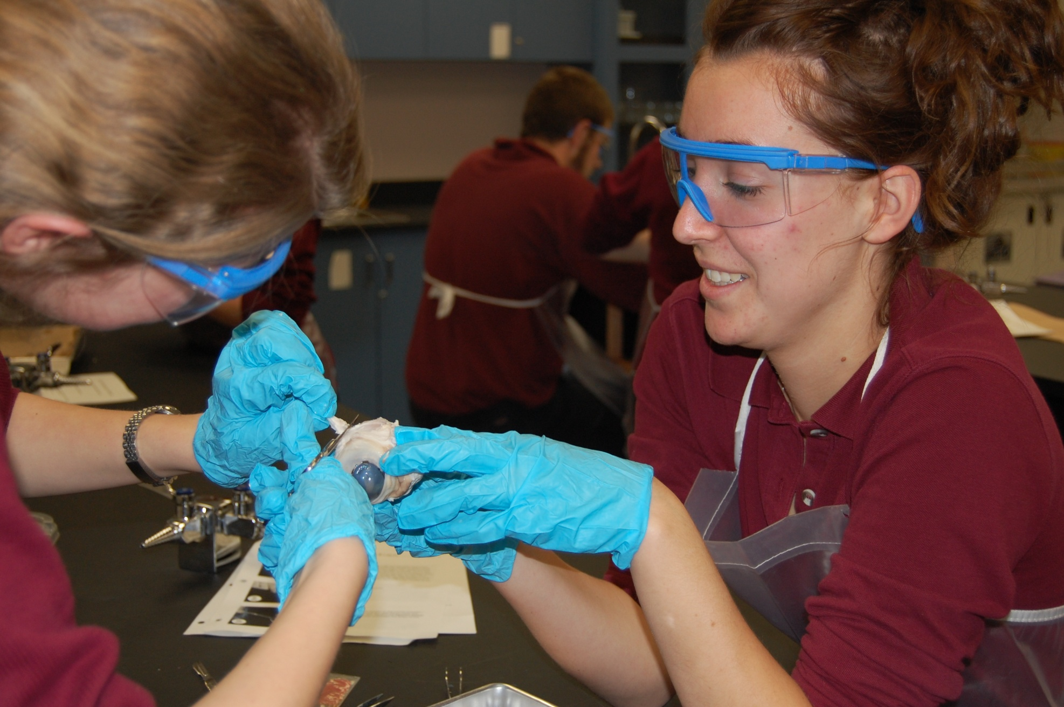
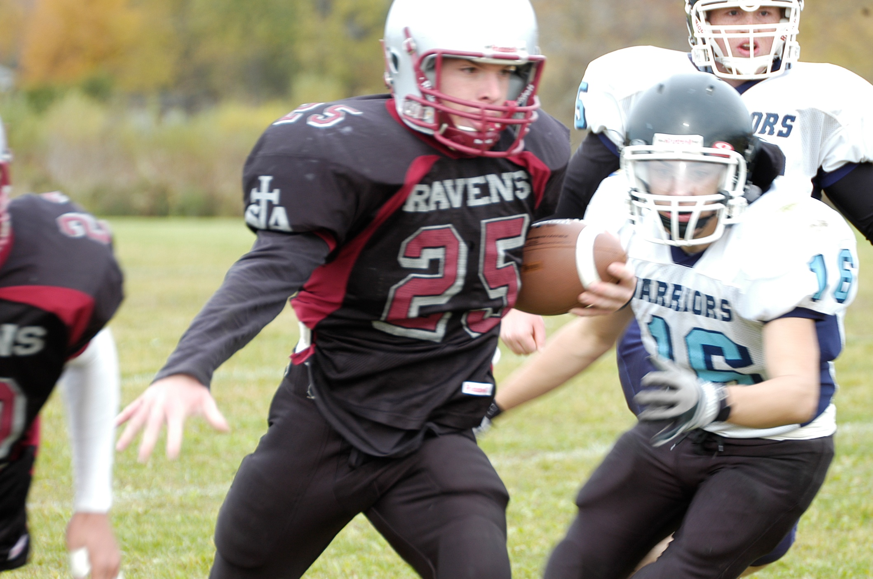
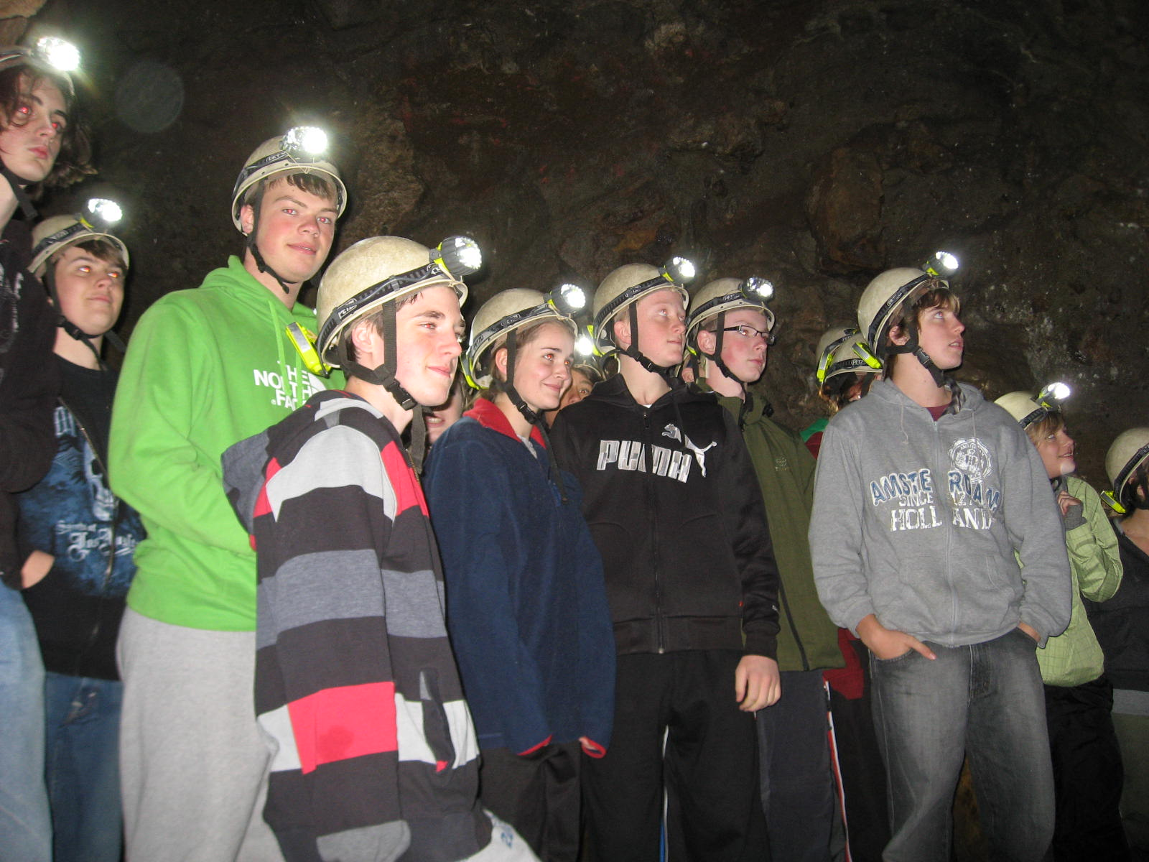
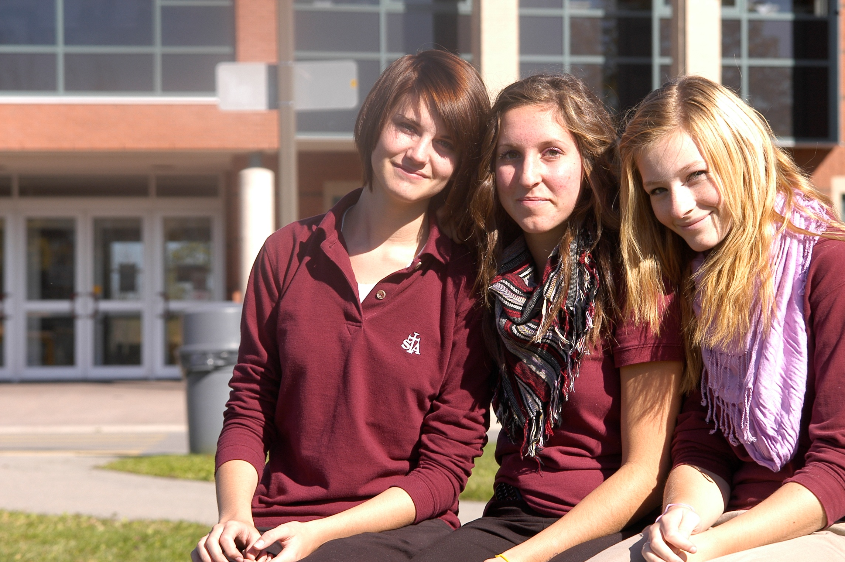
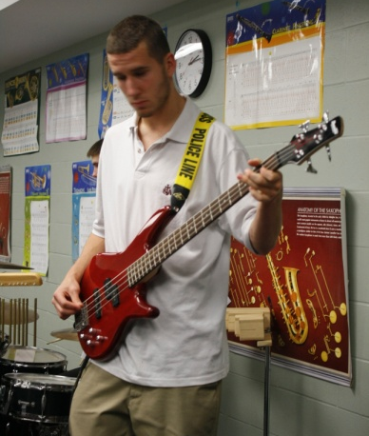
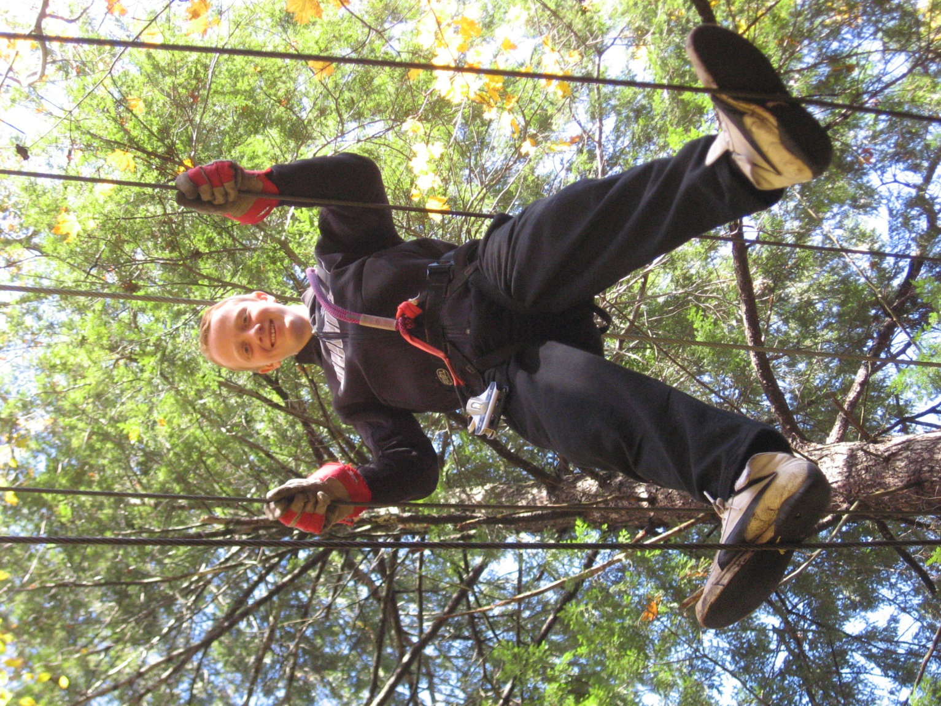
WHY CHOOSE ST. THOMAS
AQUINAS CATHOLIC
HIGH SCHOOL?

Slide 3
GREAT ACADEMICS AND
LEARNING OPPORTUNITIES

Slide 4
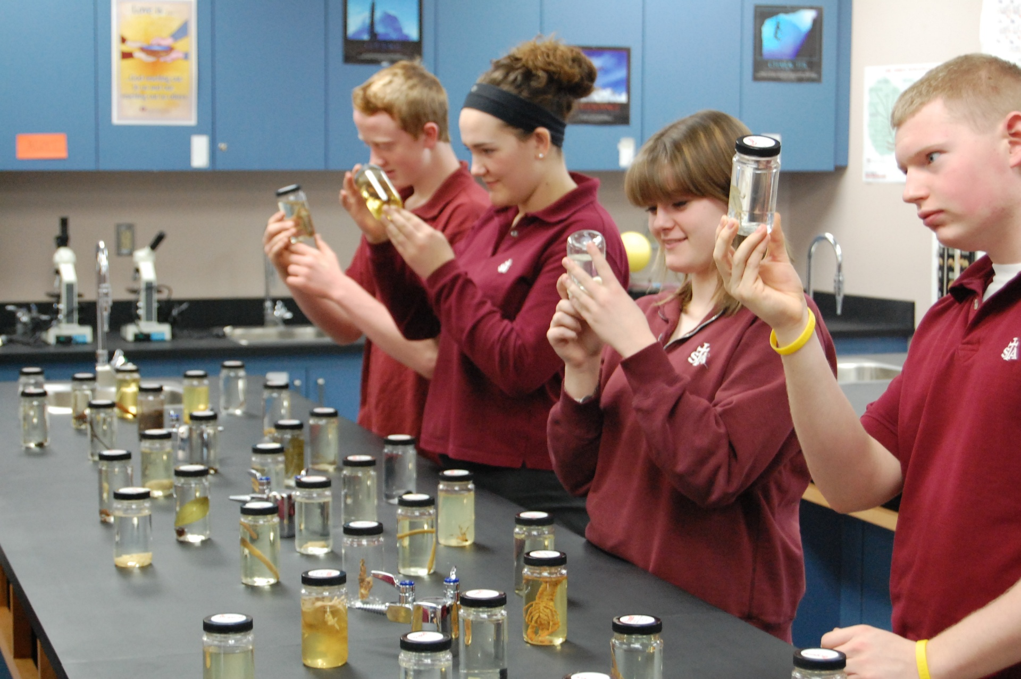

Slide 5
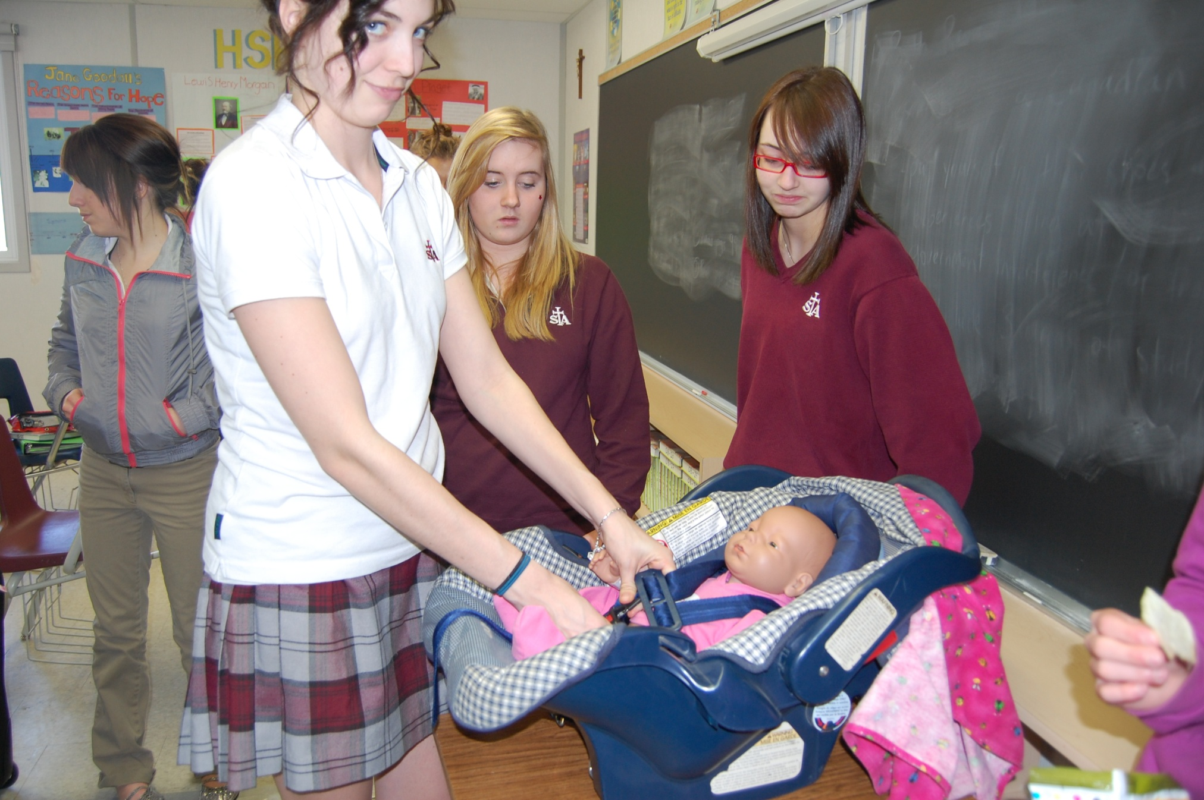

Slide 6
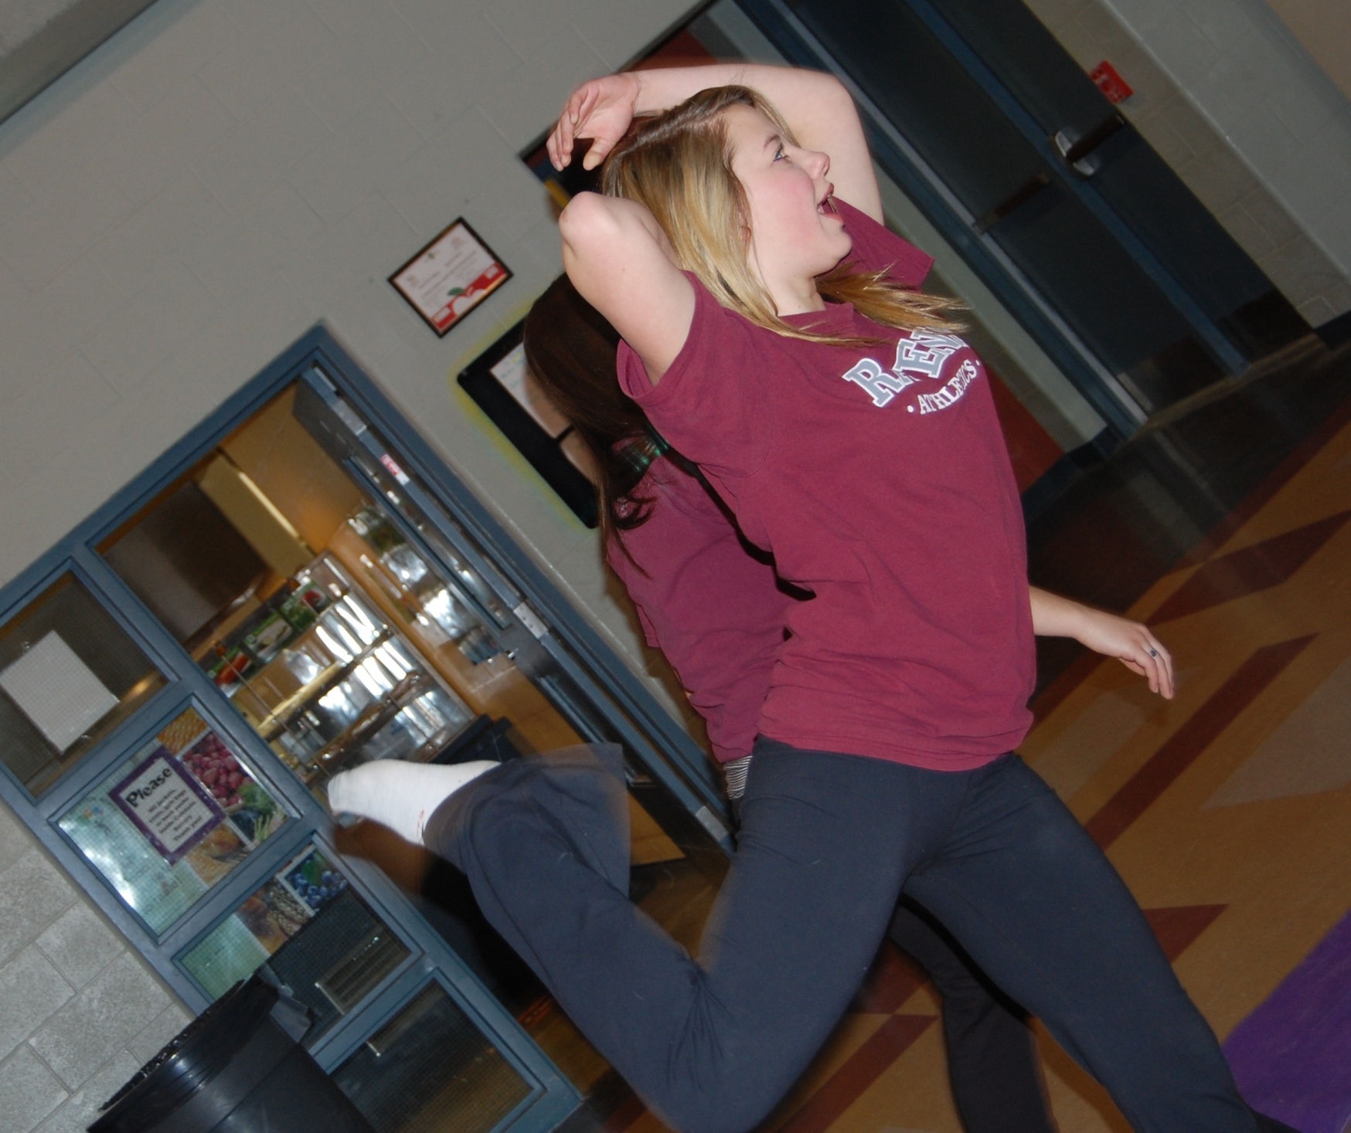

Slide 7
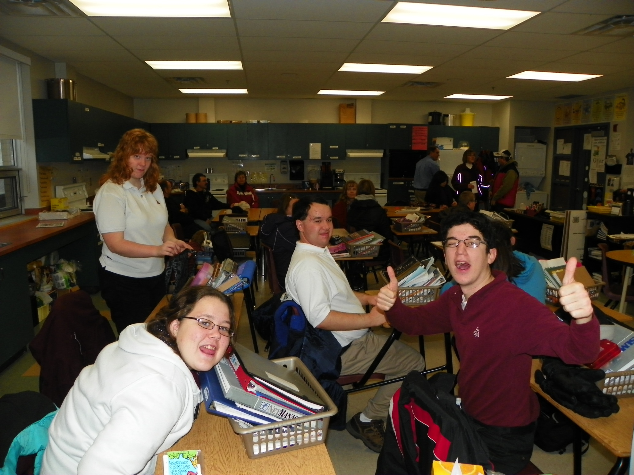

Slide 8
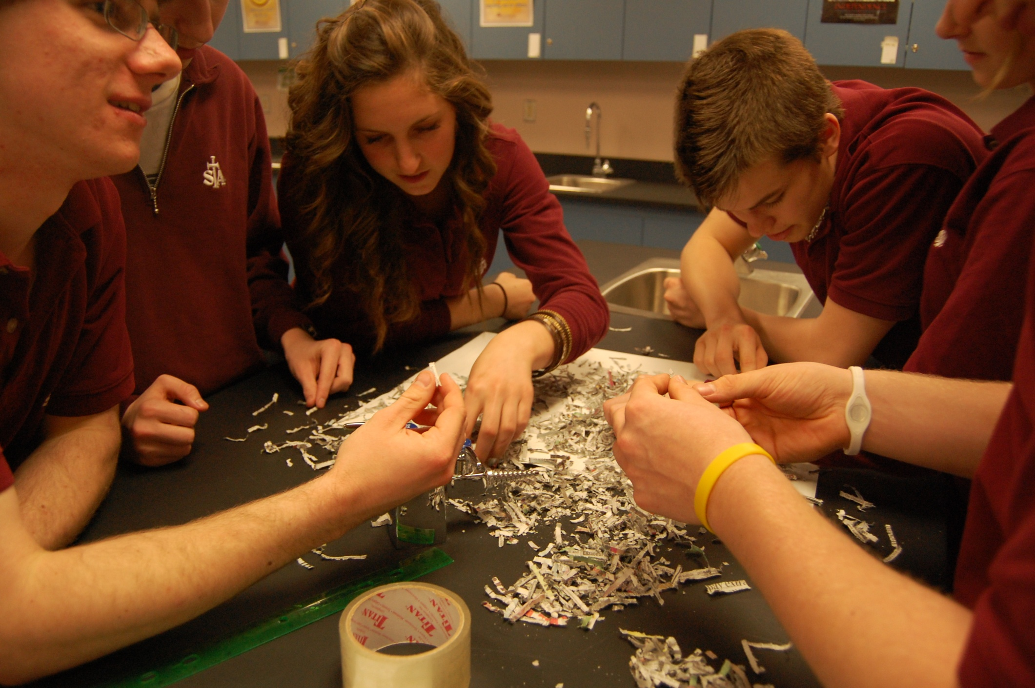

Slide 9
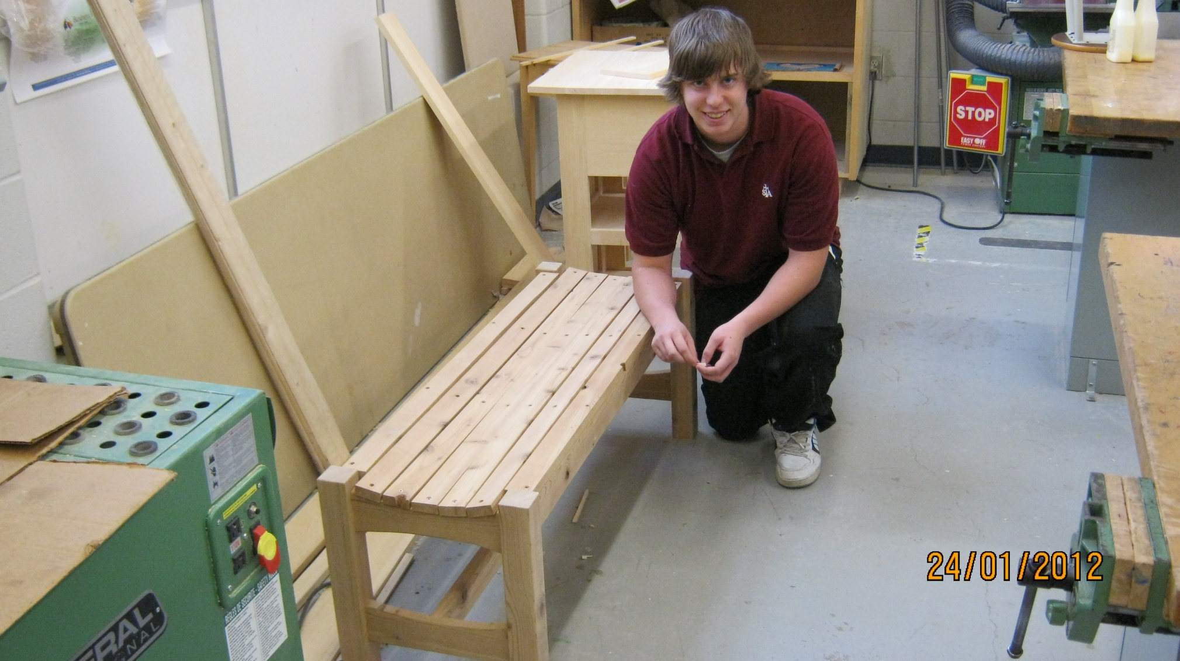

Slide 10
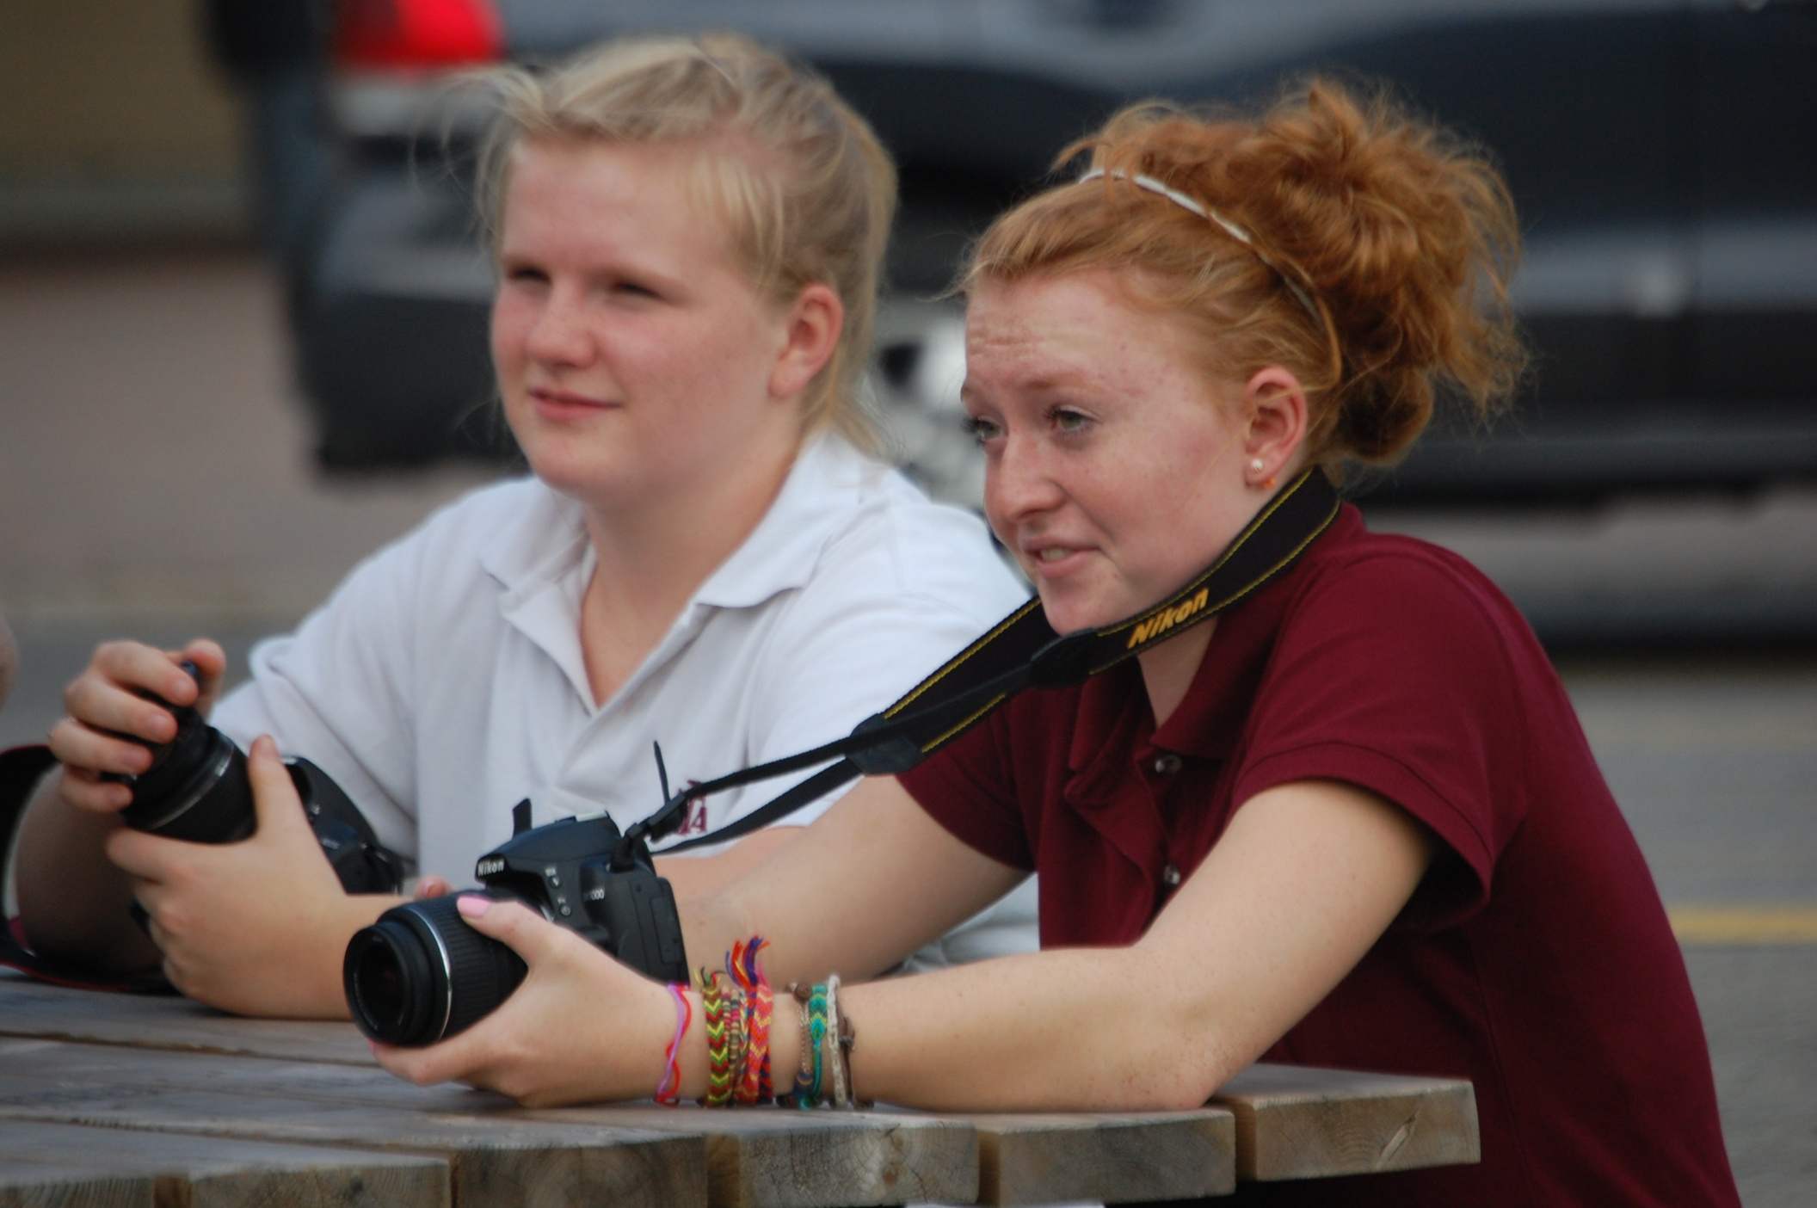

Slide 11
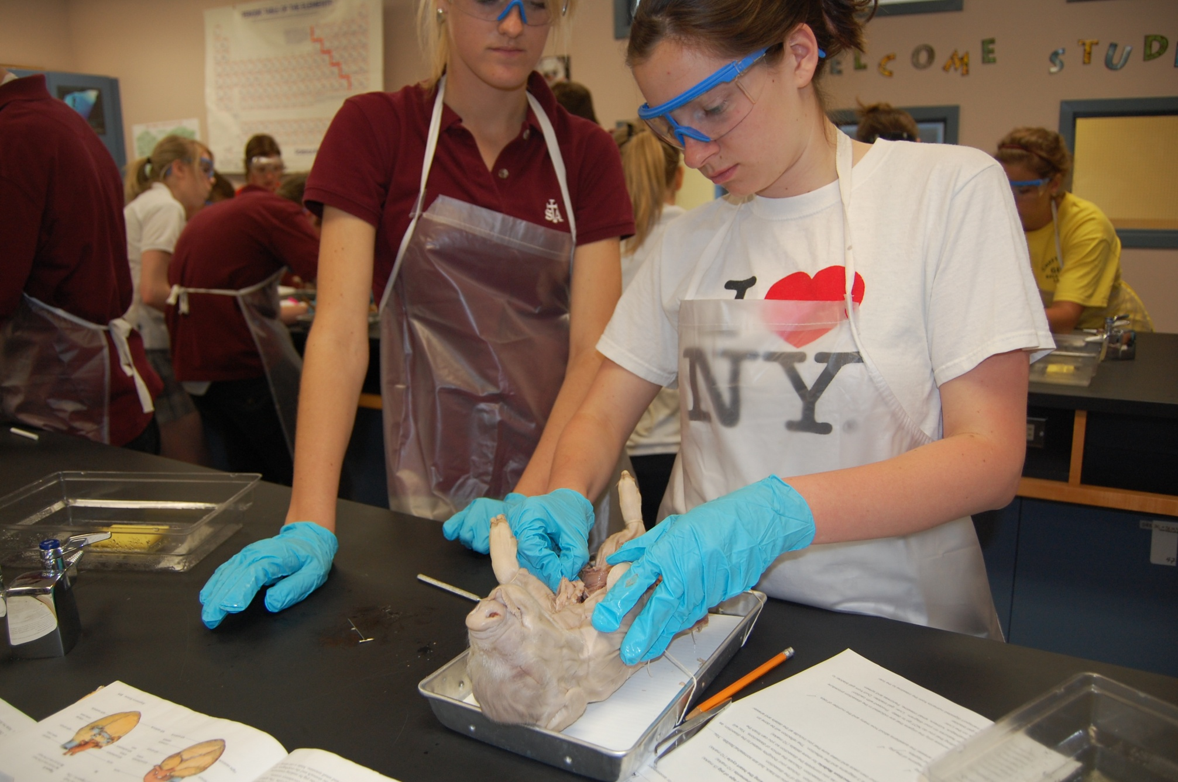

Slide 12
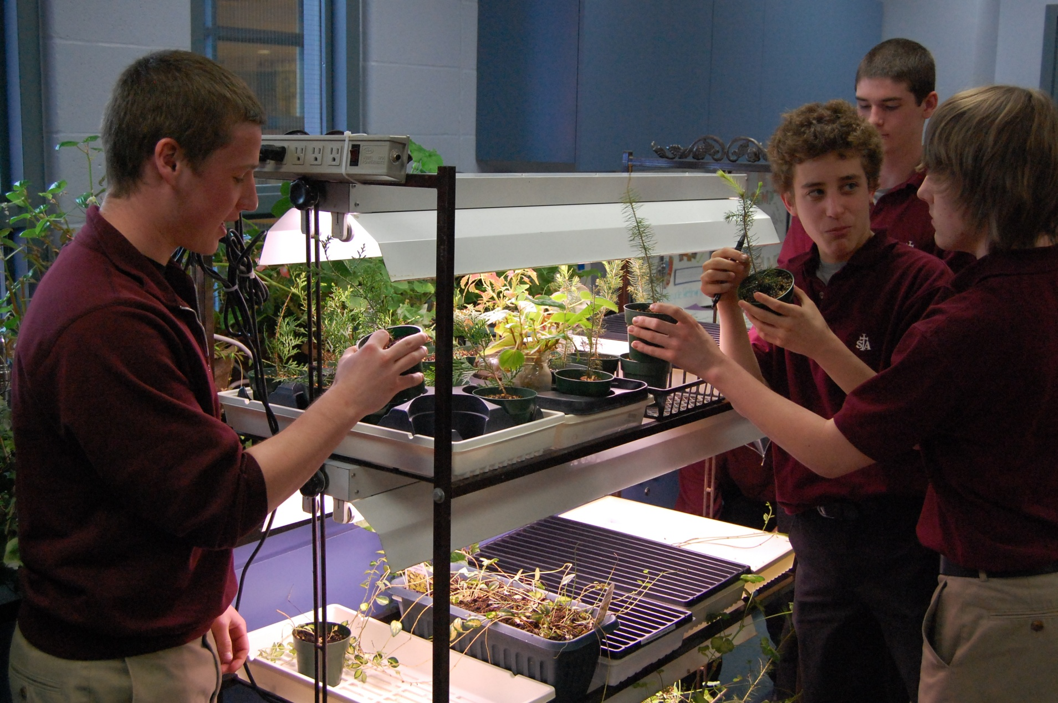

Slide 13
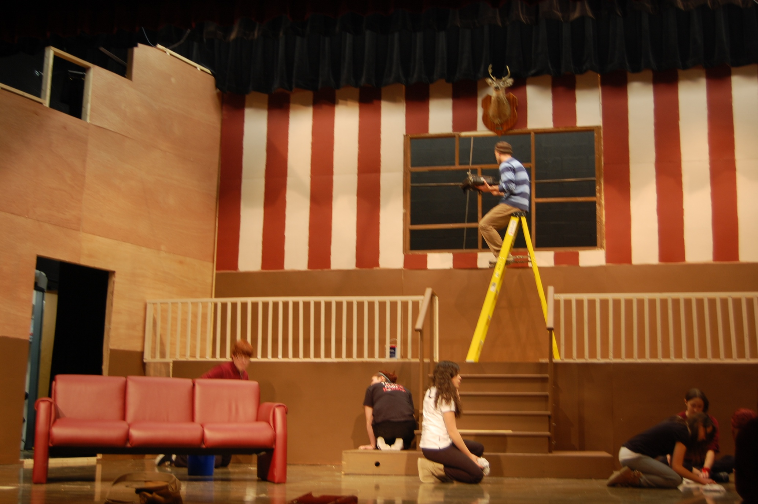

Slide 14
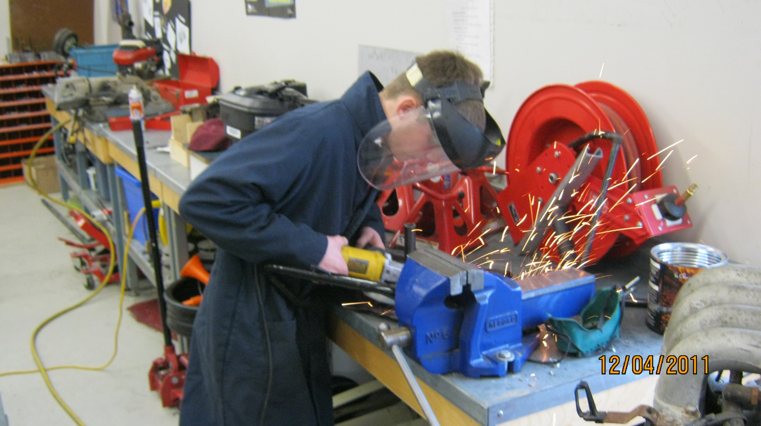

Slide 15
WHY CHOOSE ST. THOMAS
AQUINAS CATHOLIC
HIGH SCHOOL?

Slide 16
WE ARE STUDENTS AND
STAFF WHO GIVE
BACK TO THE COMMUNITY

Slide 17
BECKY RYAN’S FIRST EVER HAIR CUT
FOR CANCER RESEARCH

Slide 18
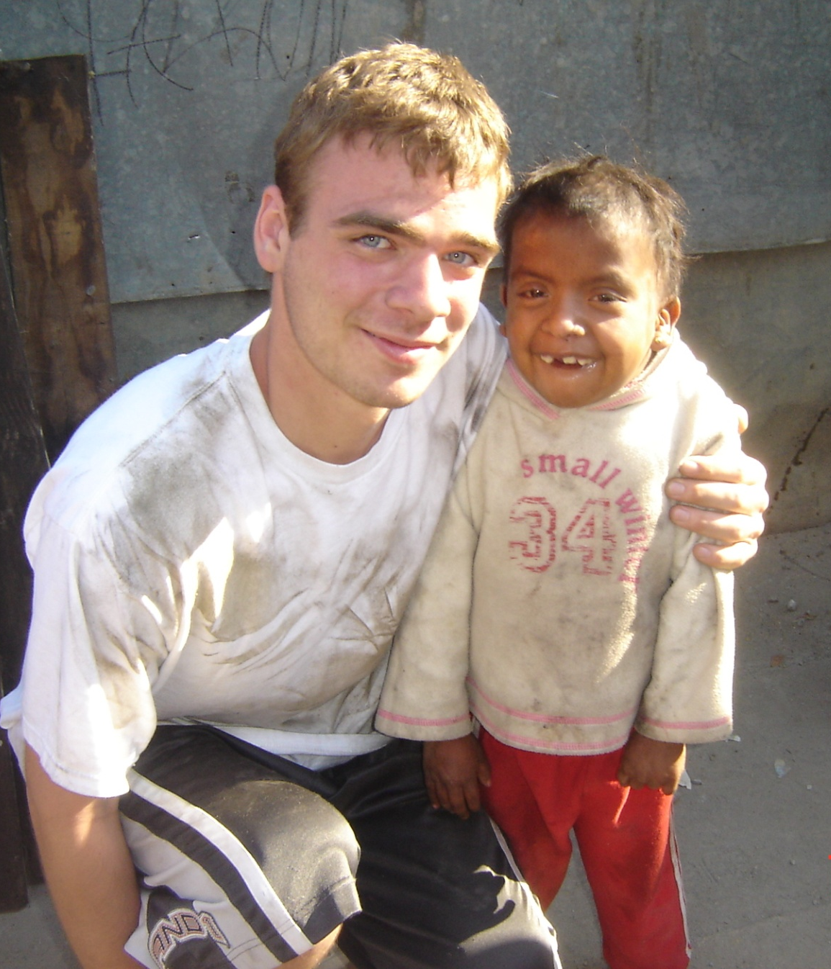
ST. THOMAS AQUINAS
MEXICO MISSION TEAM

Slide 19
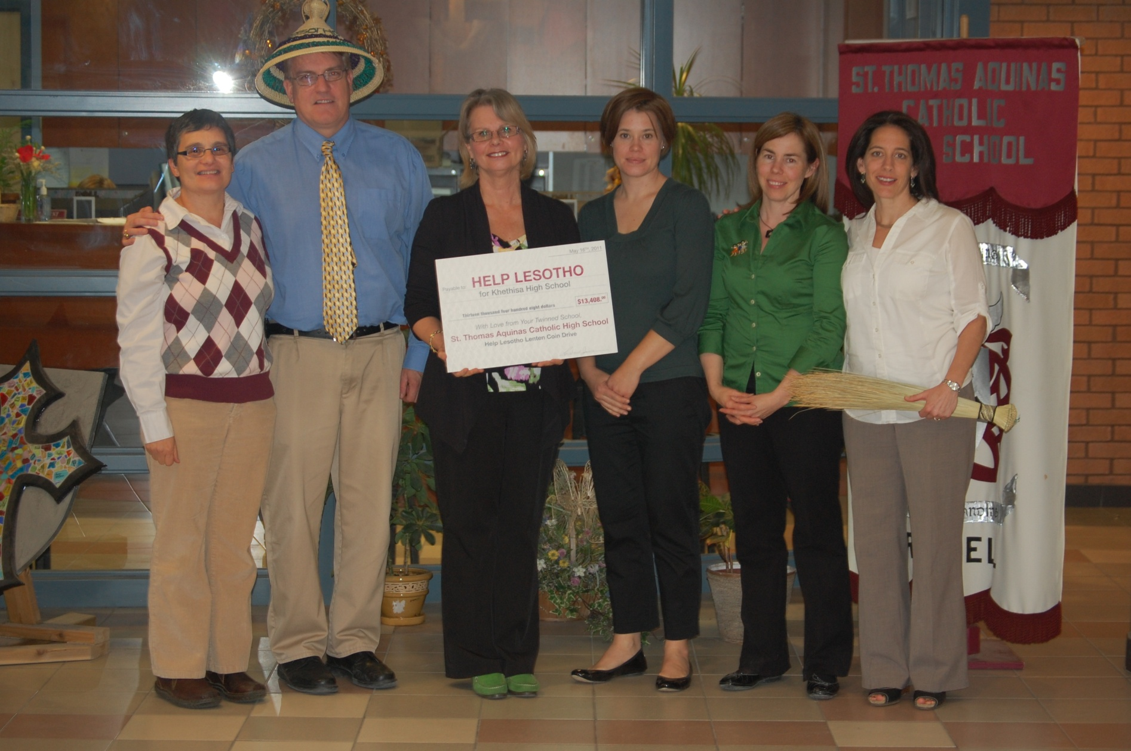
HELP LESOTHO ANNUAL COIN DRIVE

Slide 20
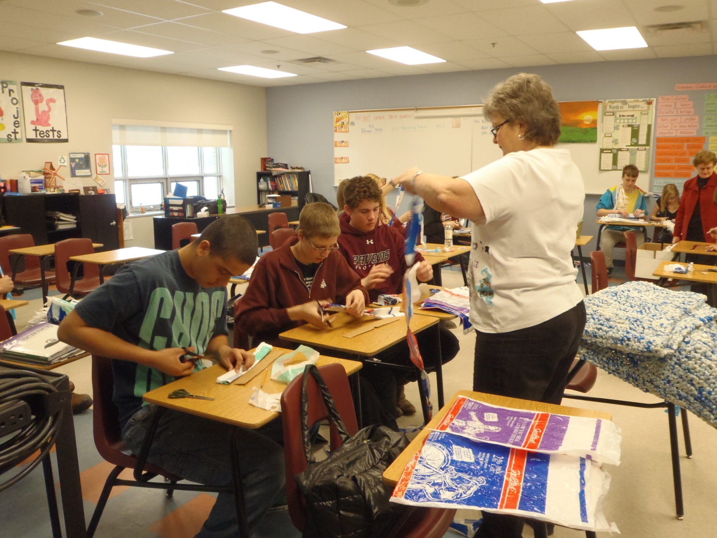
MILK BAG MATS

Slide 21
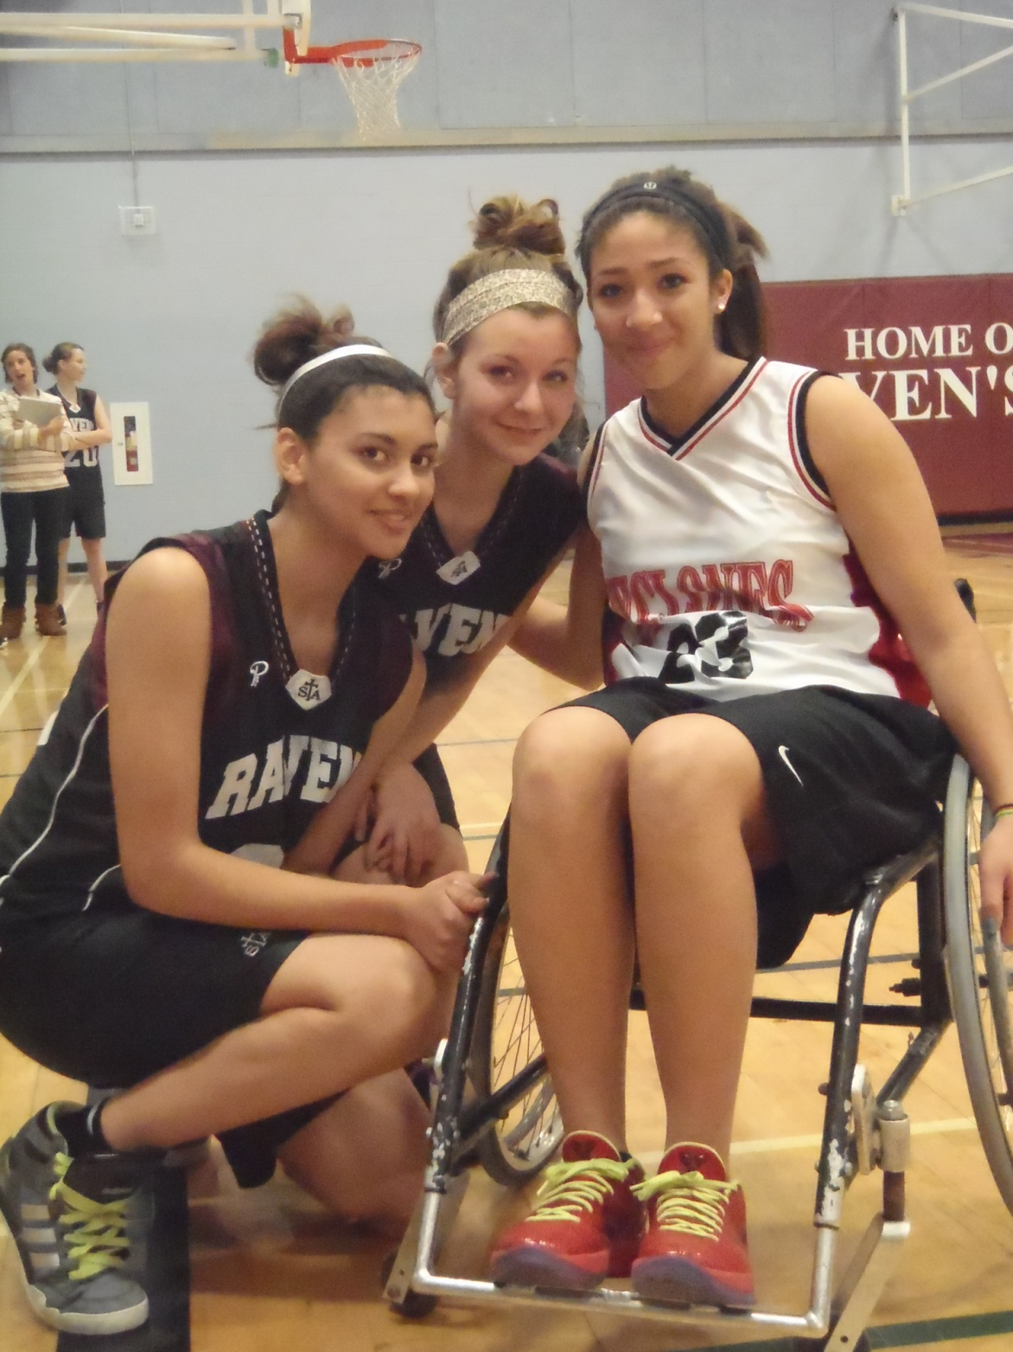
JUSTIN MCKENNA
WHEEL CHAIR BASKETBALL TOURNAMENT

Slide 22
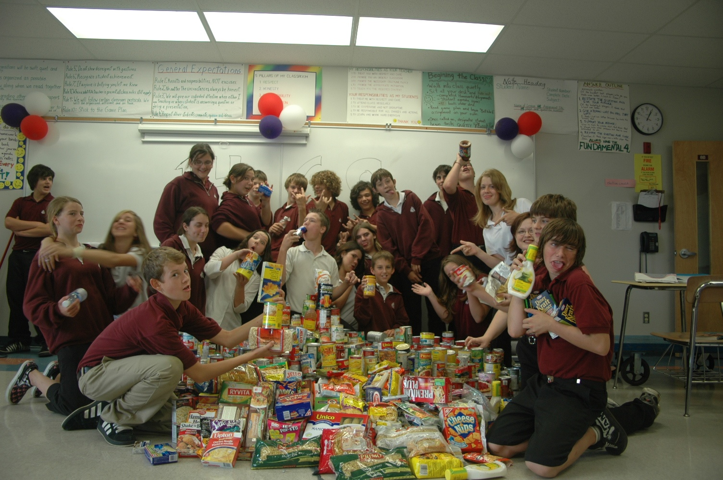
STA’s ANNUAL THANKGIVING CAN DRIVE

Slide 23
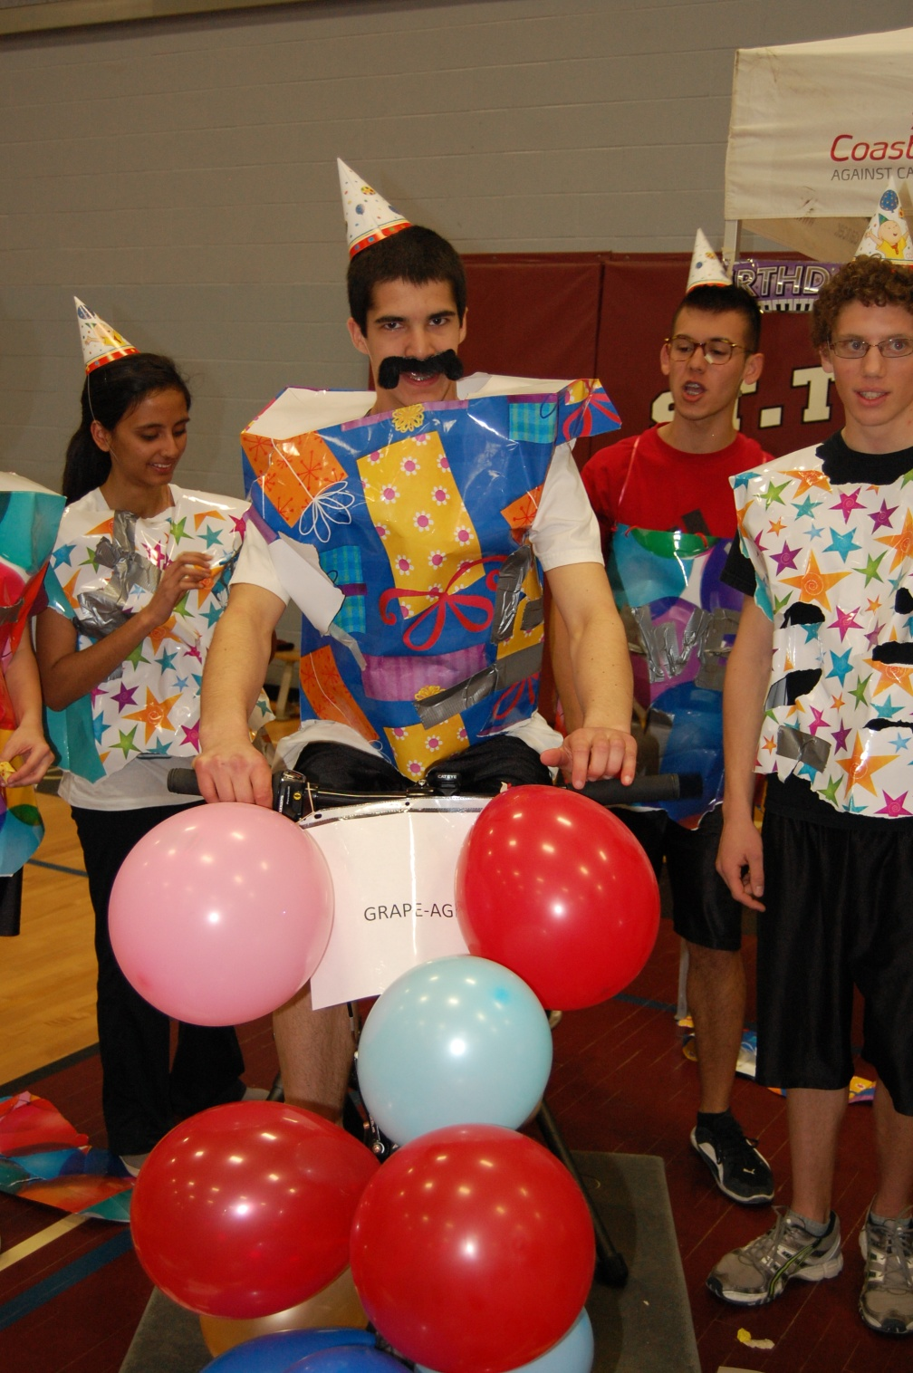
THE INSIDE RIDE
FUNDRAISING FOR CANCER RESEARCH

Slide 24
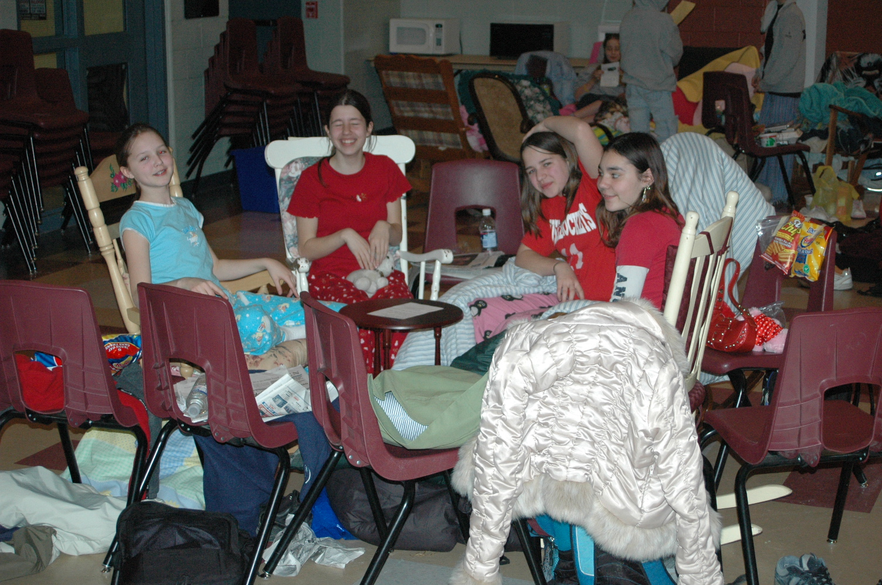
GRADE 7/8 ANNUAL ROCK-A-THON

Slide 25
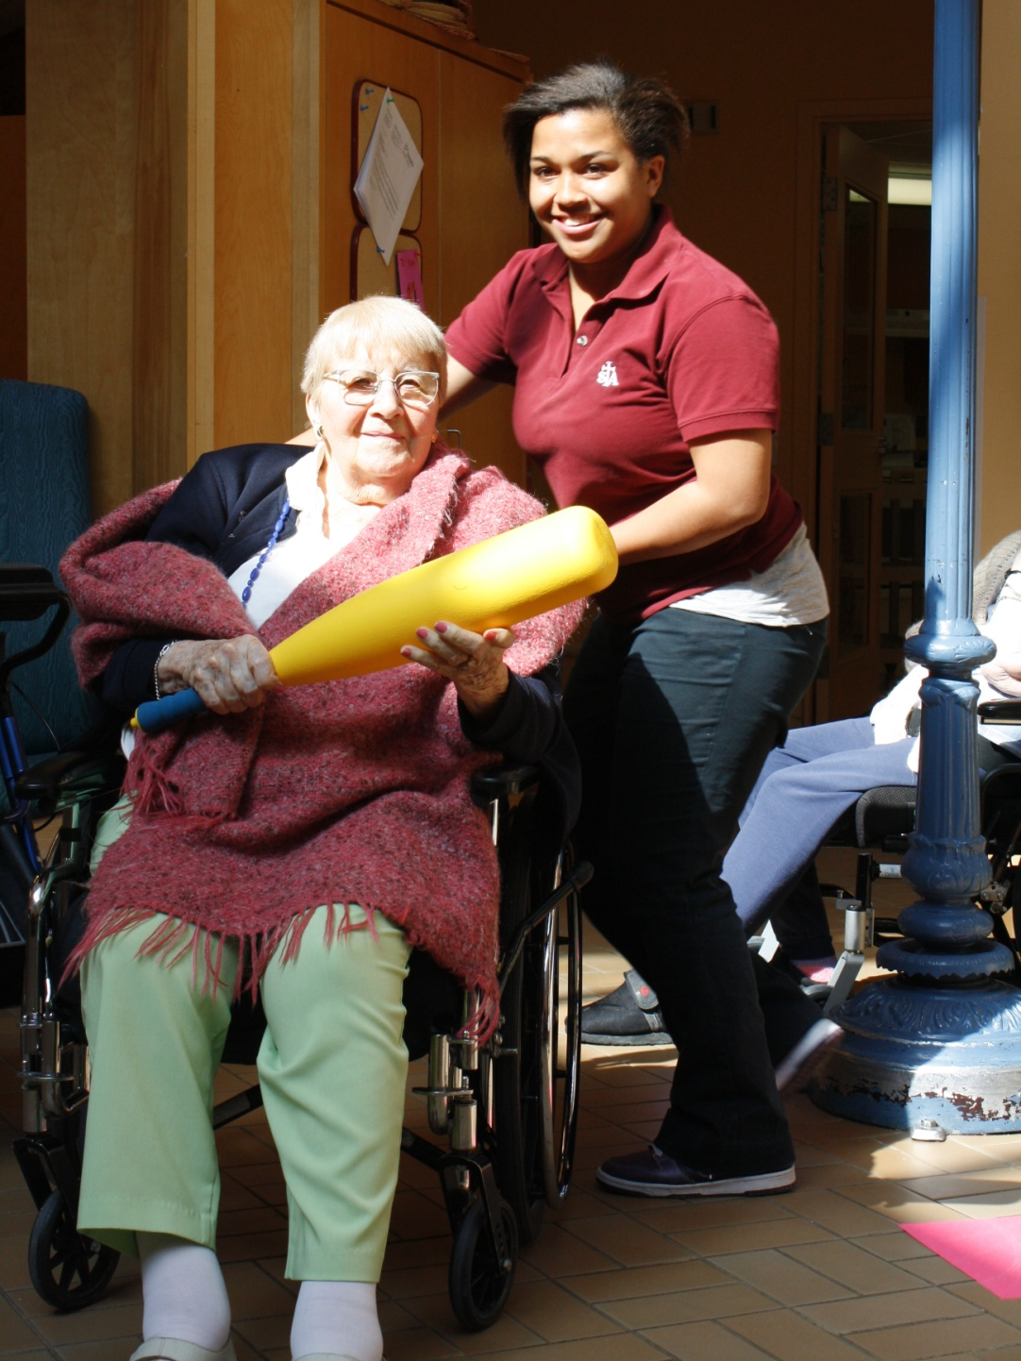
OSGOODE CARE CENTRE VISITS
SENIORS HELPING SENIORS

Slide 26
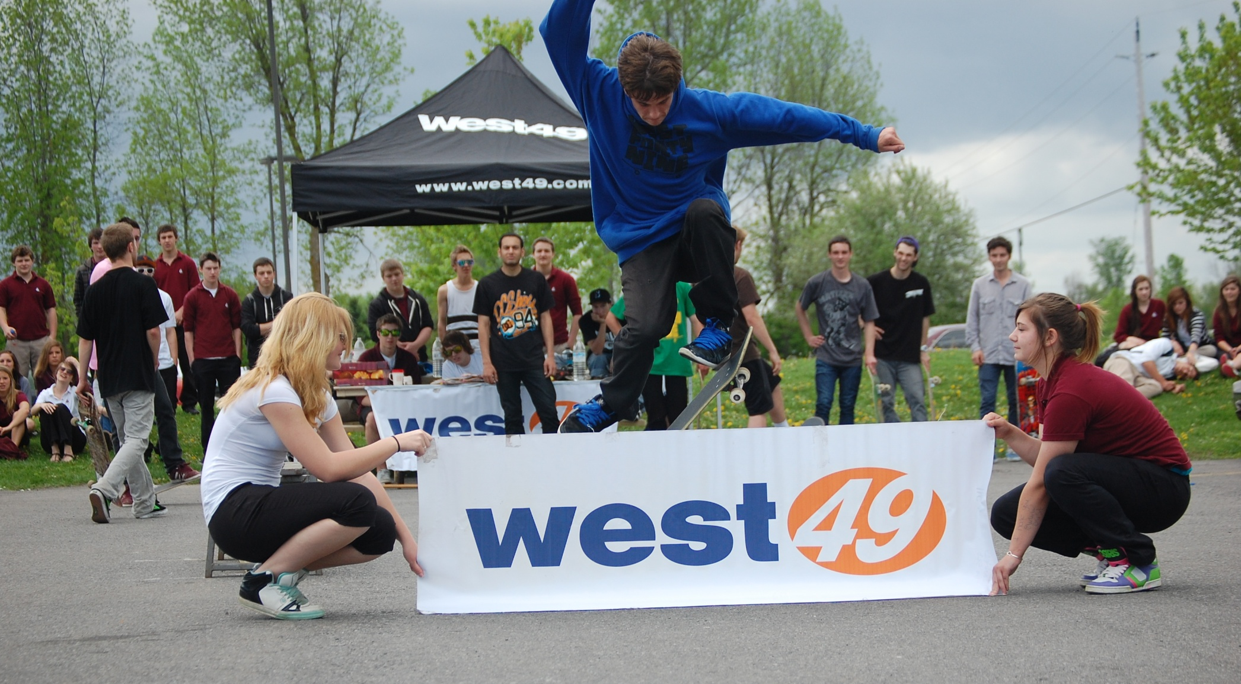
WEST 49 SKATE SPECTACULAR FOR CYSTIC FIBROSIS

Slide 27
WHY CHOOSE ST. THOMAS
AQUINAS CATHOLIC
HIGH SCHOOL?

Slide 28
TREMENDOUS ATHLETIC
PROGRAMMES

Slide 29
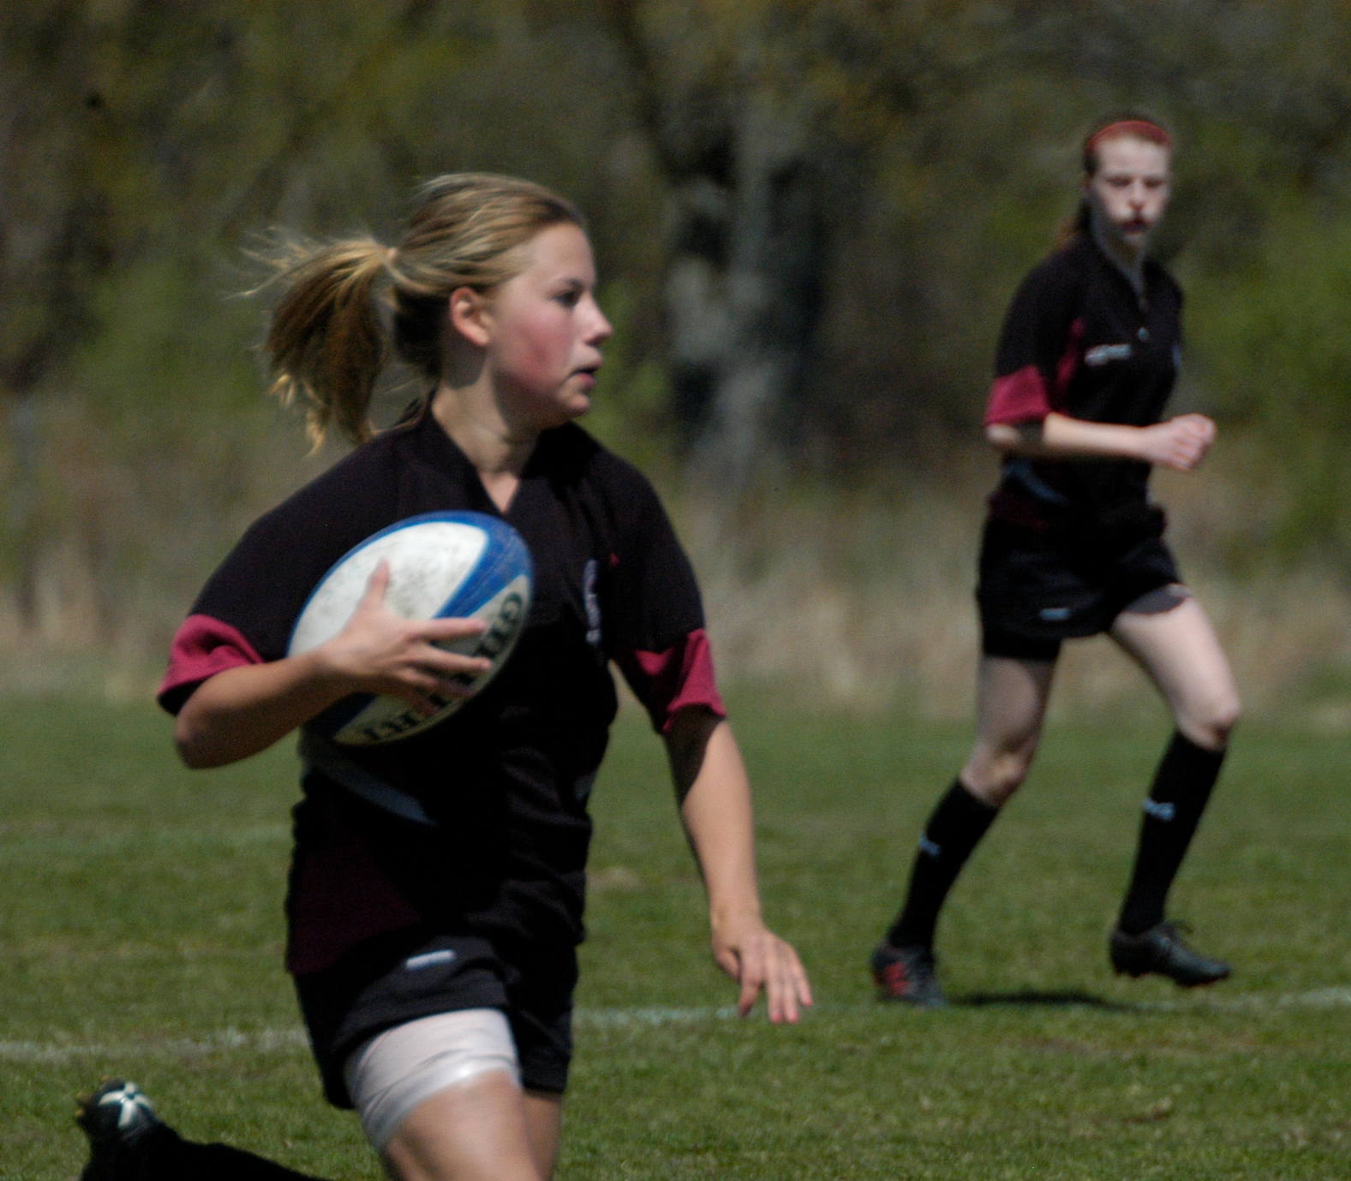

Slide 31
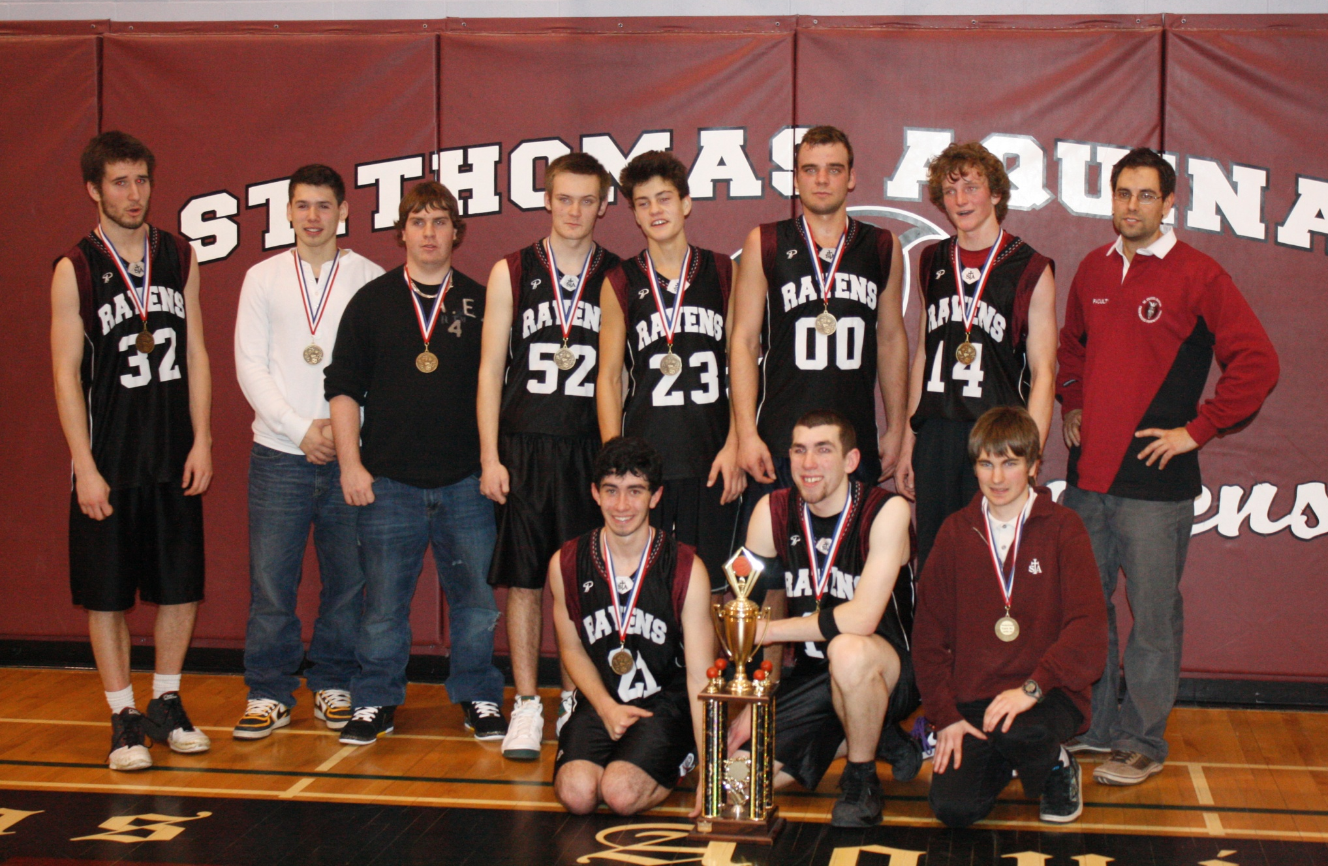

Slide 32
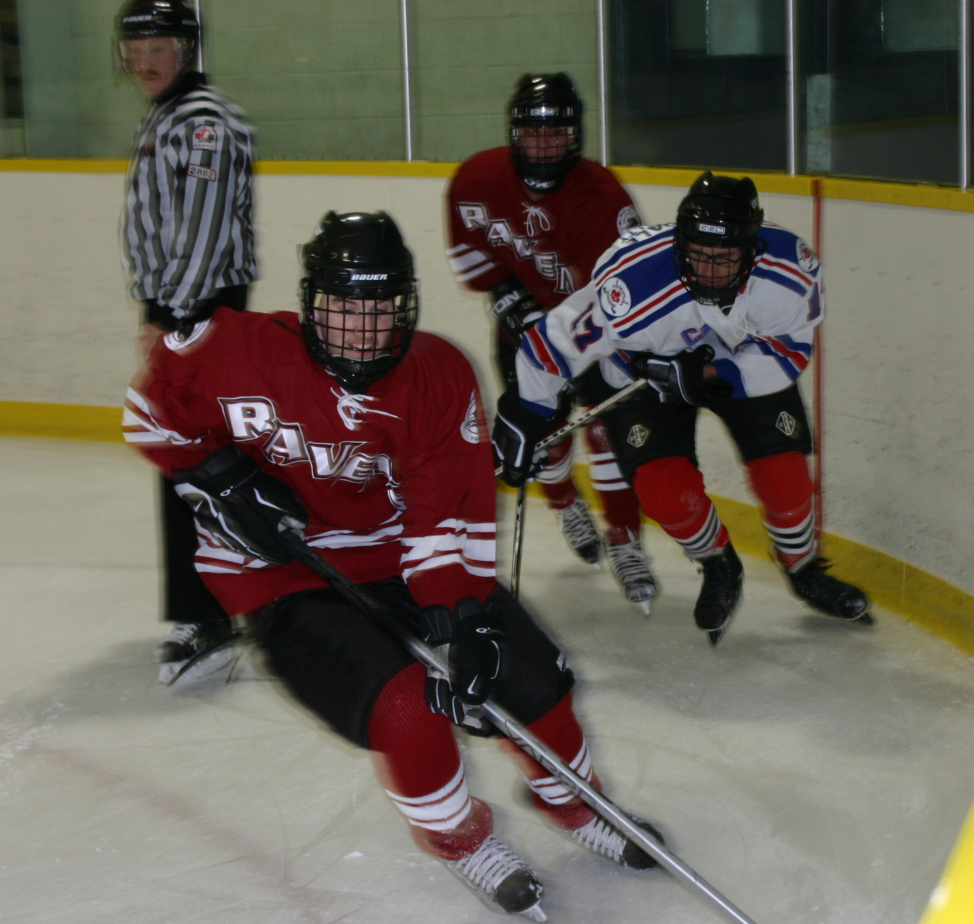

Slide 33
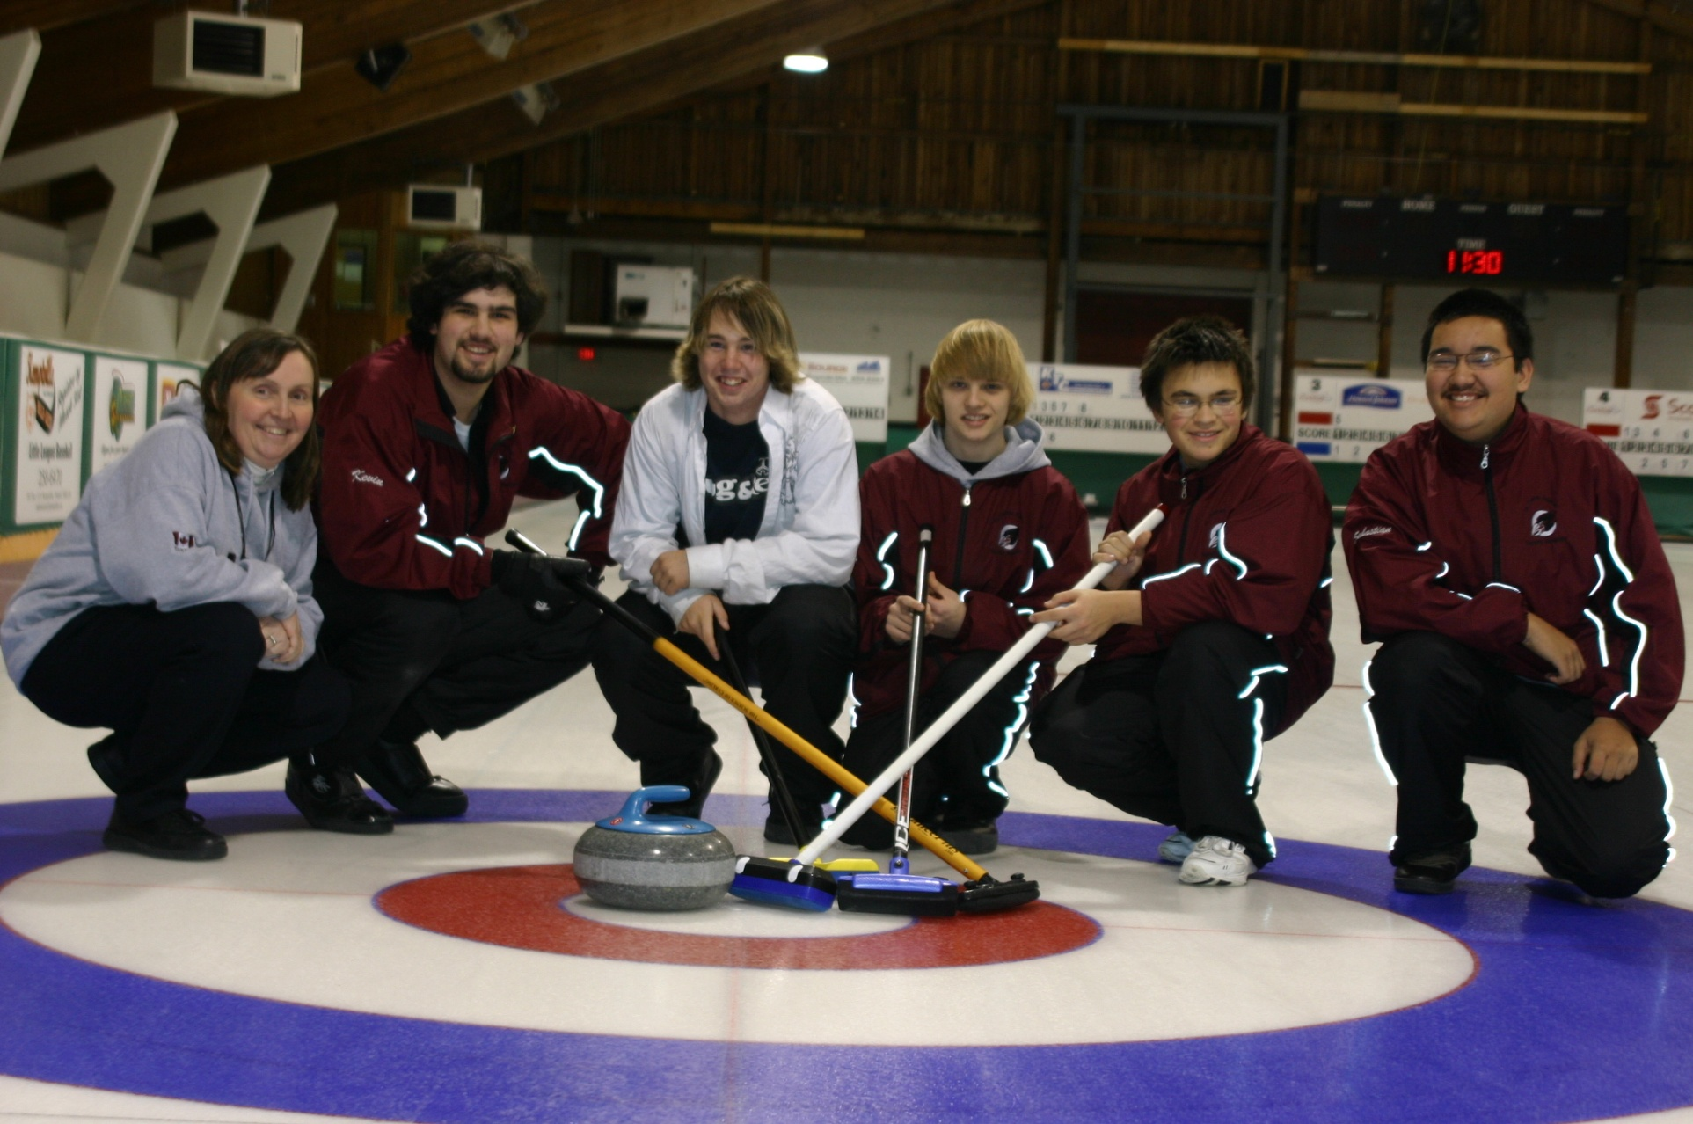

Slide 34
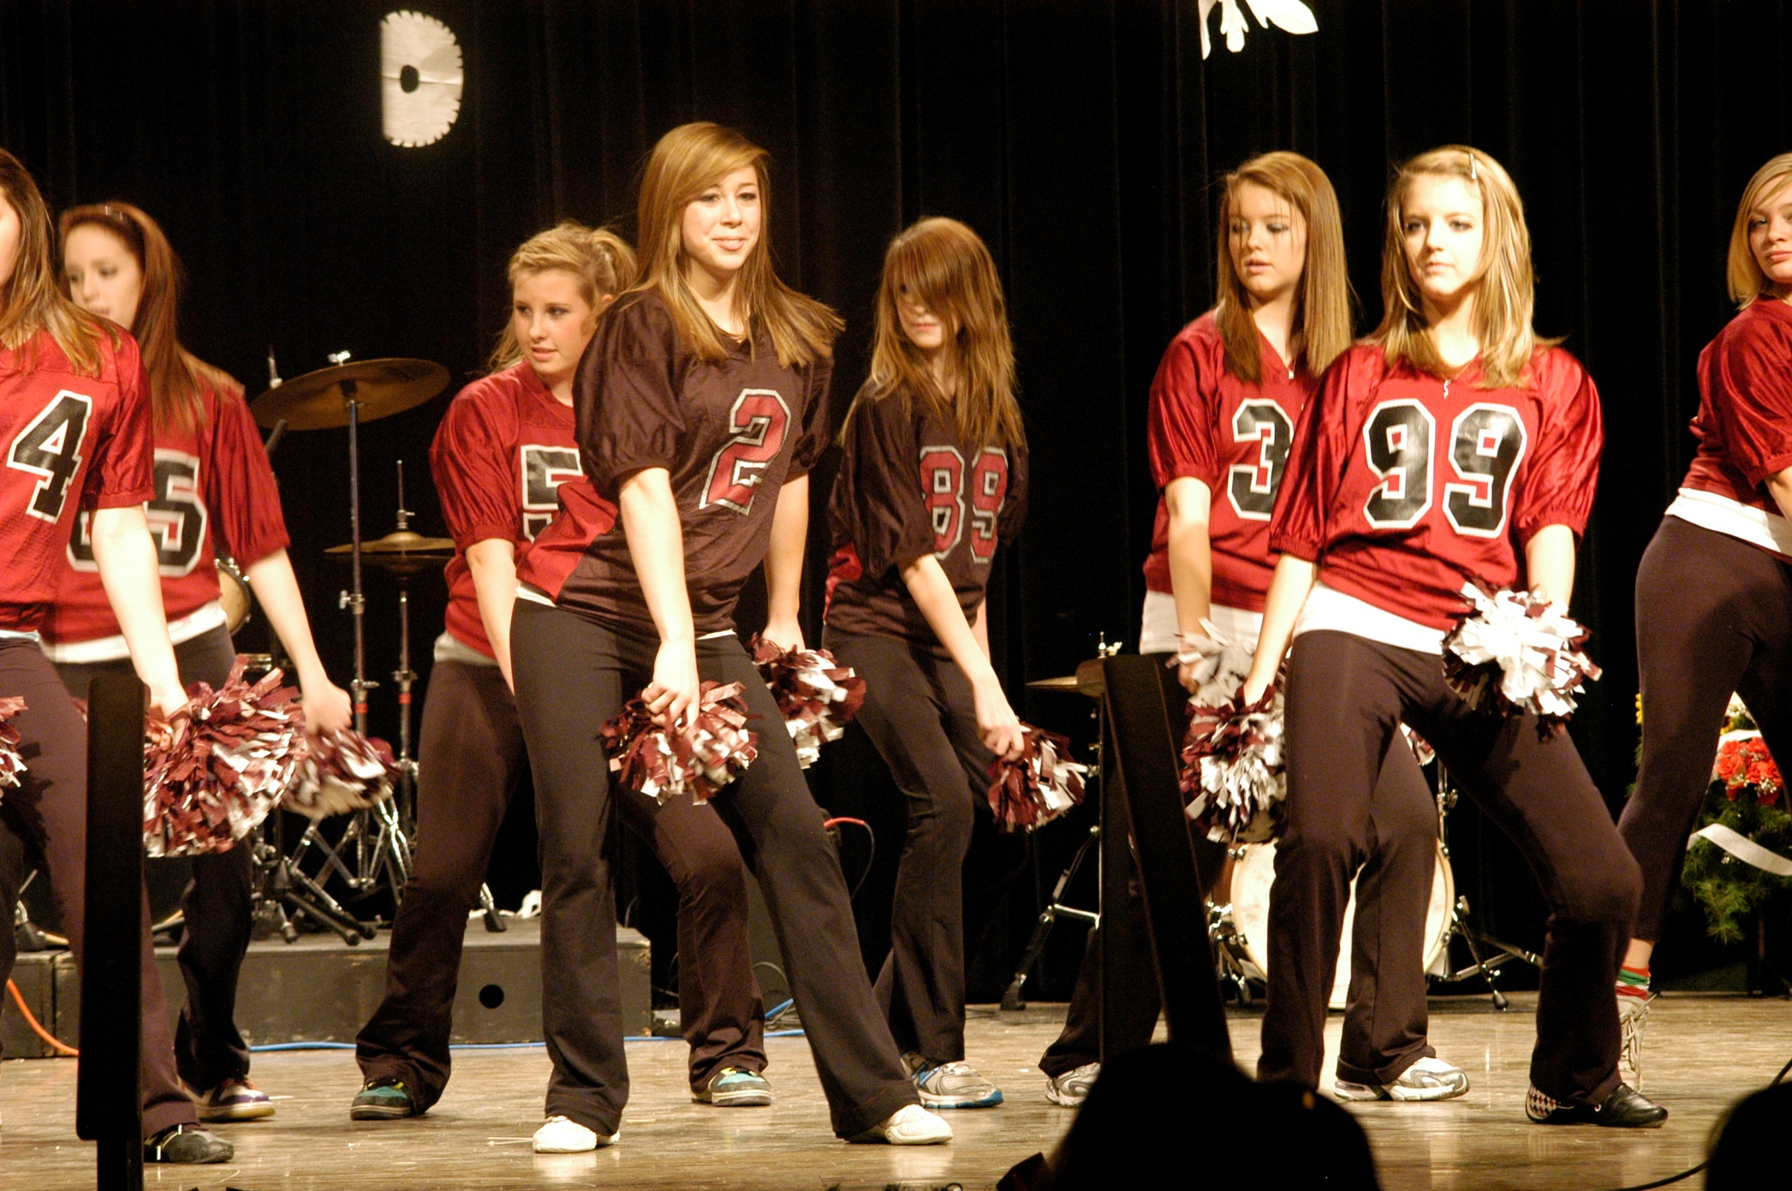

Slide 35
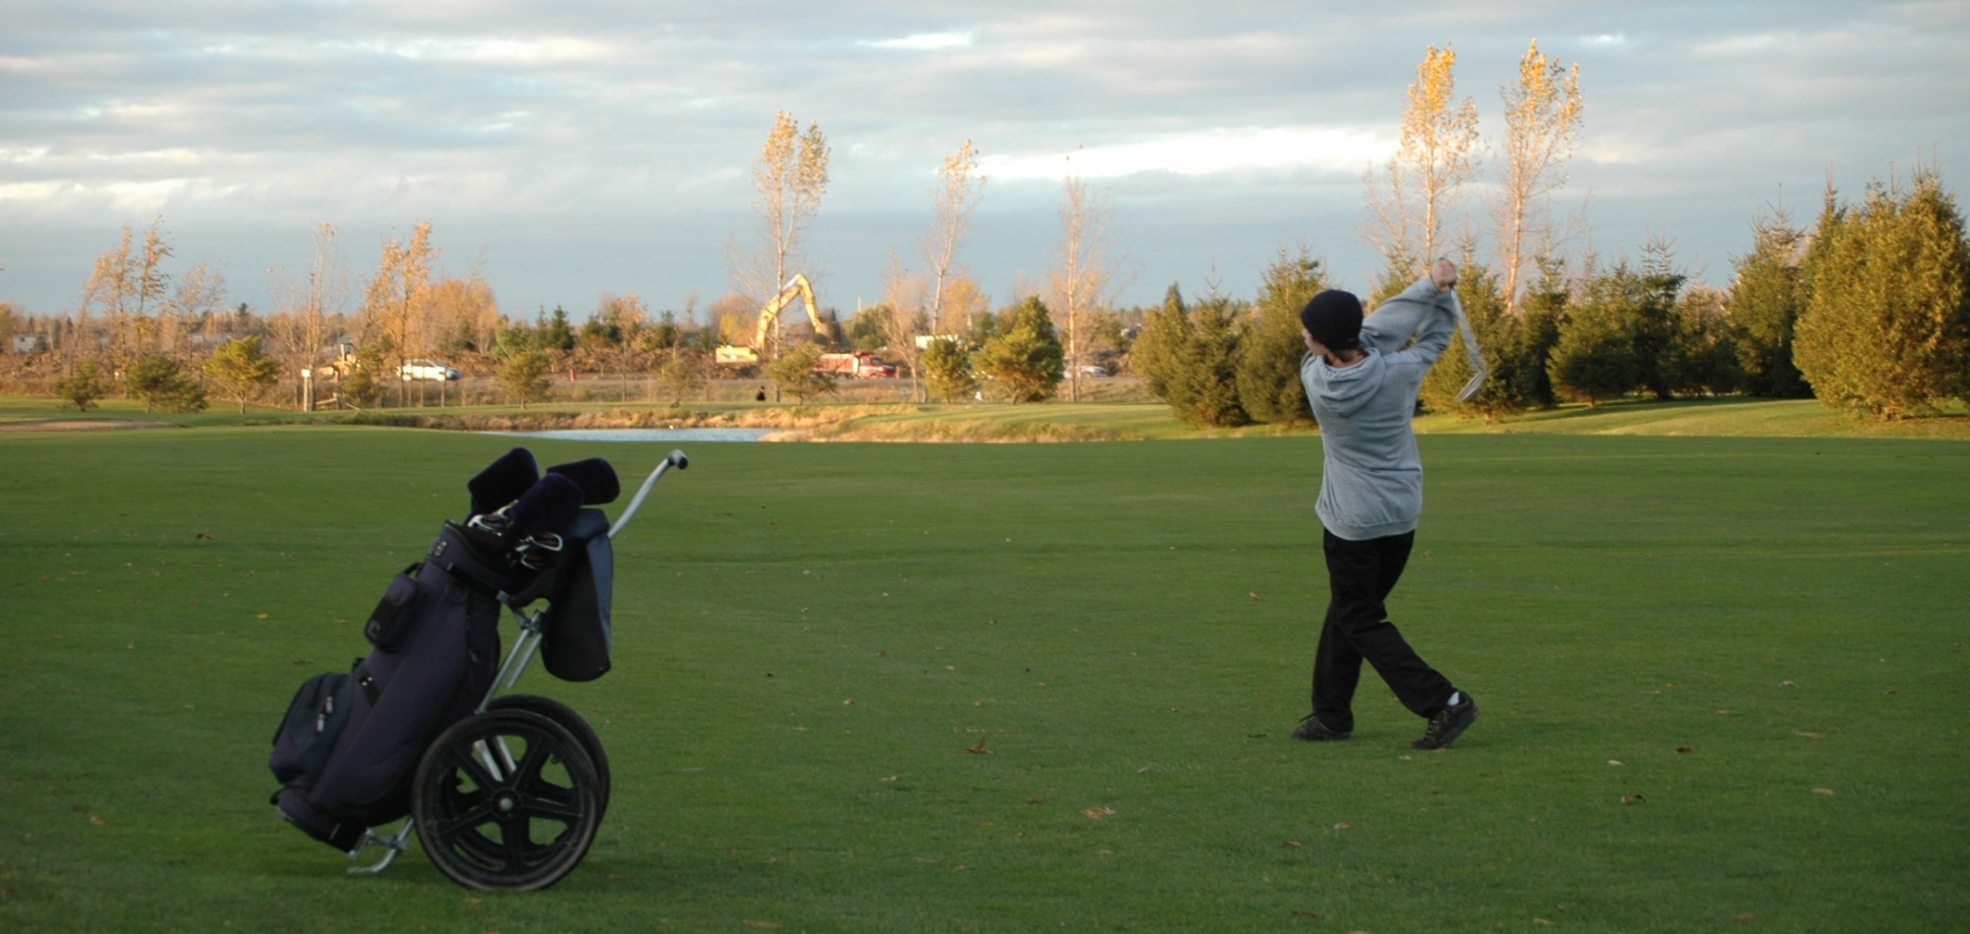

Slide 36
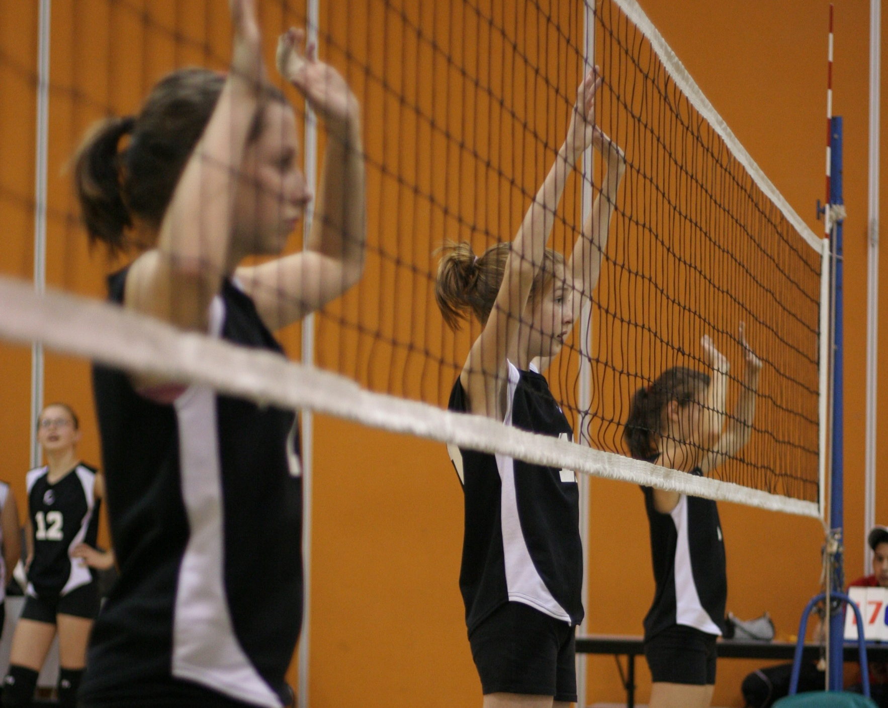

Slide 37
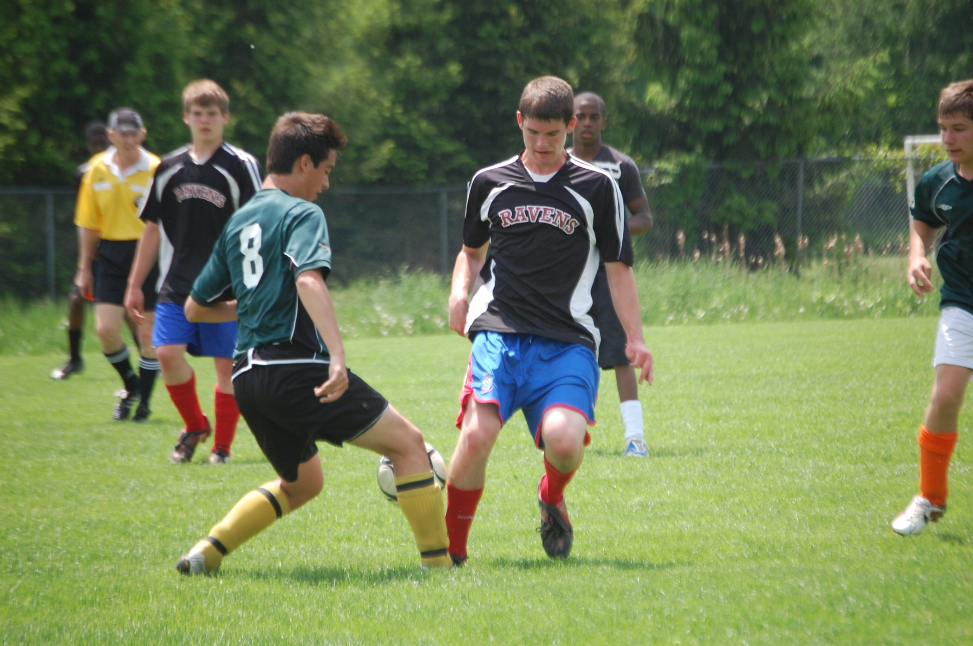

Slide 38
WHY CHOOSE ST. THOMAS
AQUINAS CATHOLIC
HIGH SCHOOL?

Slide 39
FABULOUS FINE ARTS AND
MAGICAL MUSIC

Slide 40
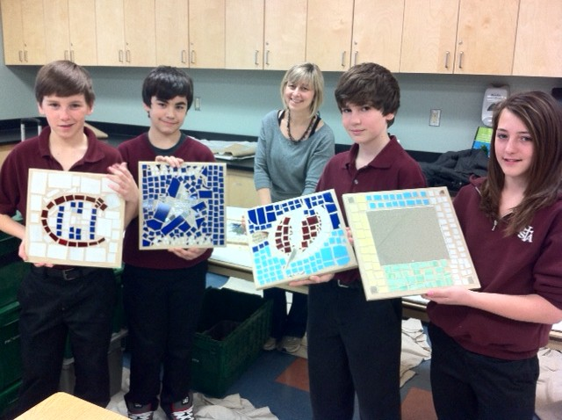

Slide 42
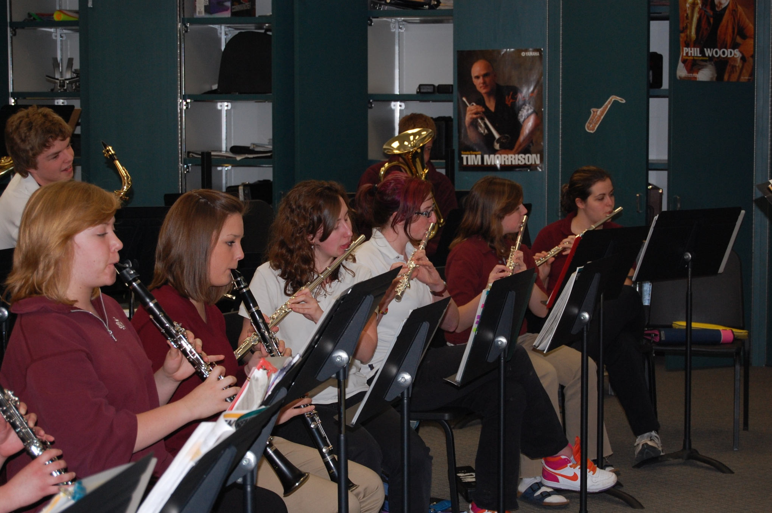

Slide 43
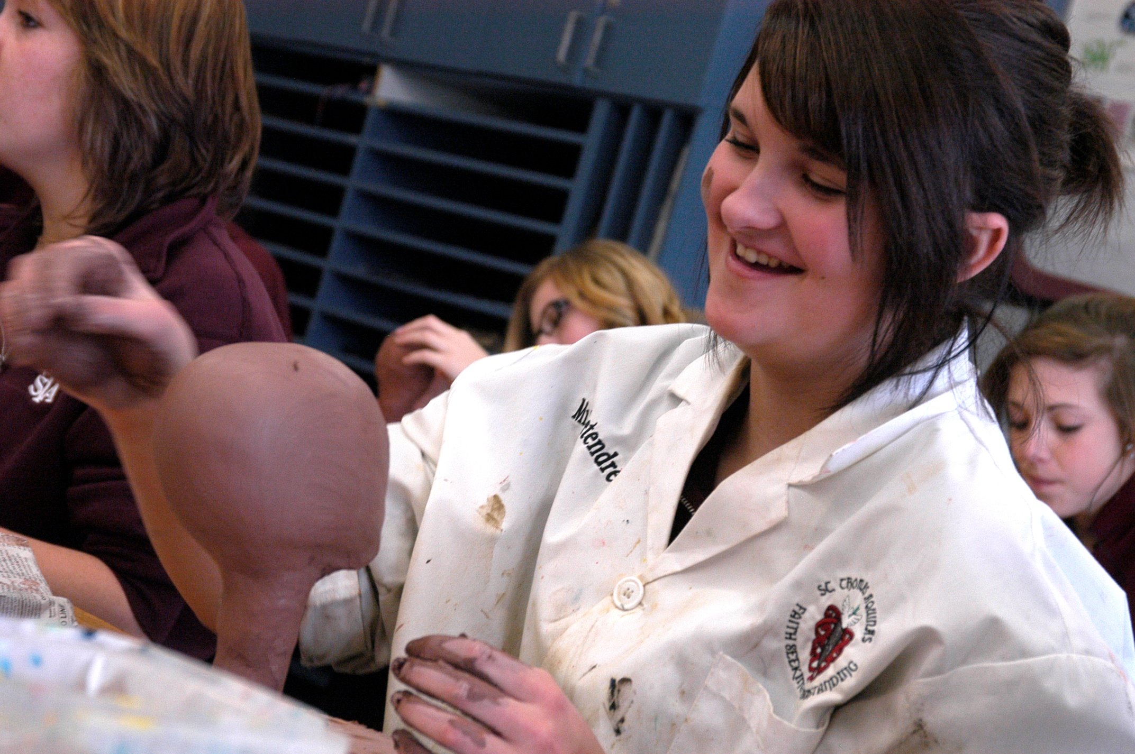

Slide 44
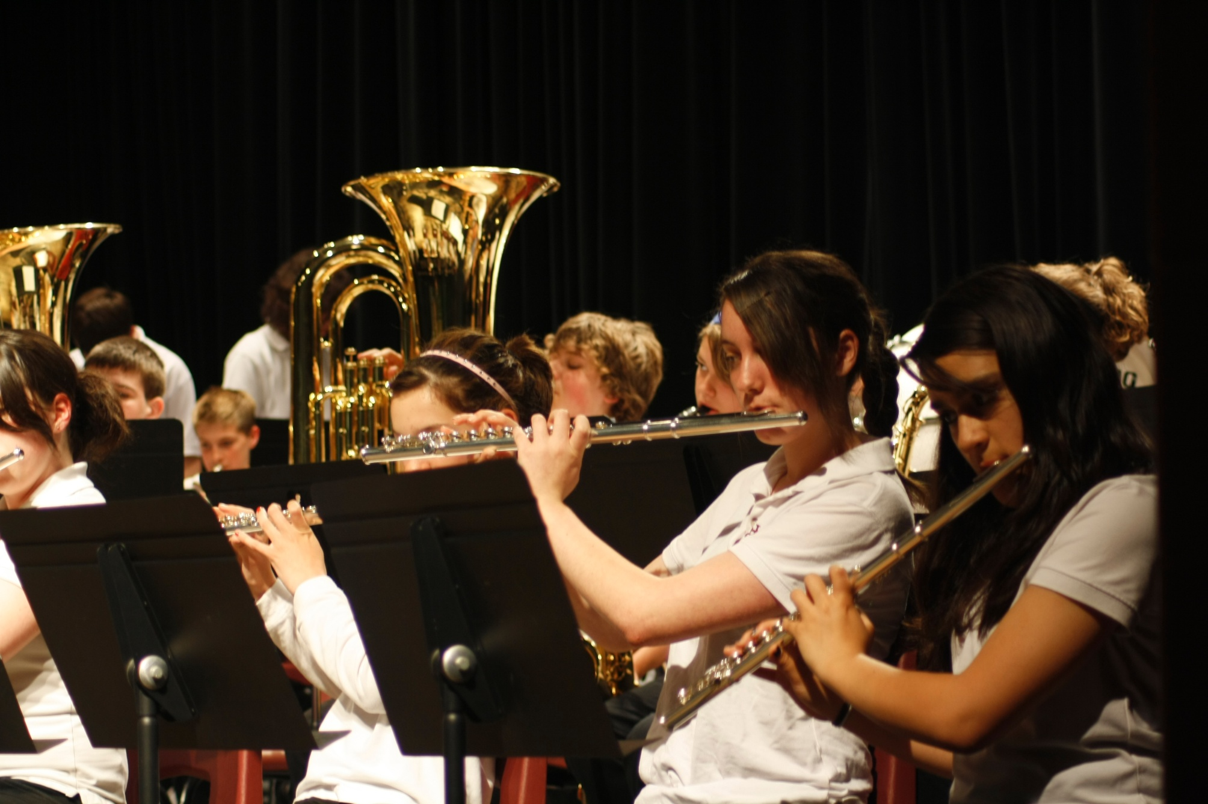

Slide 45
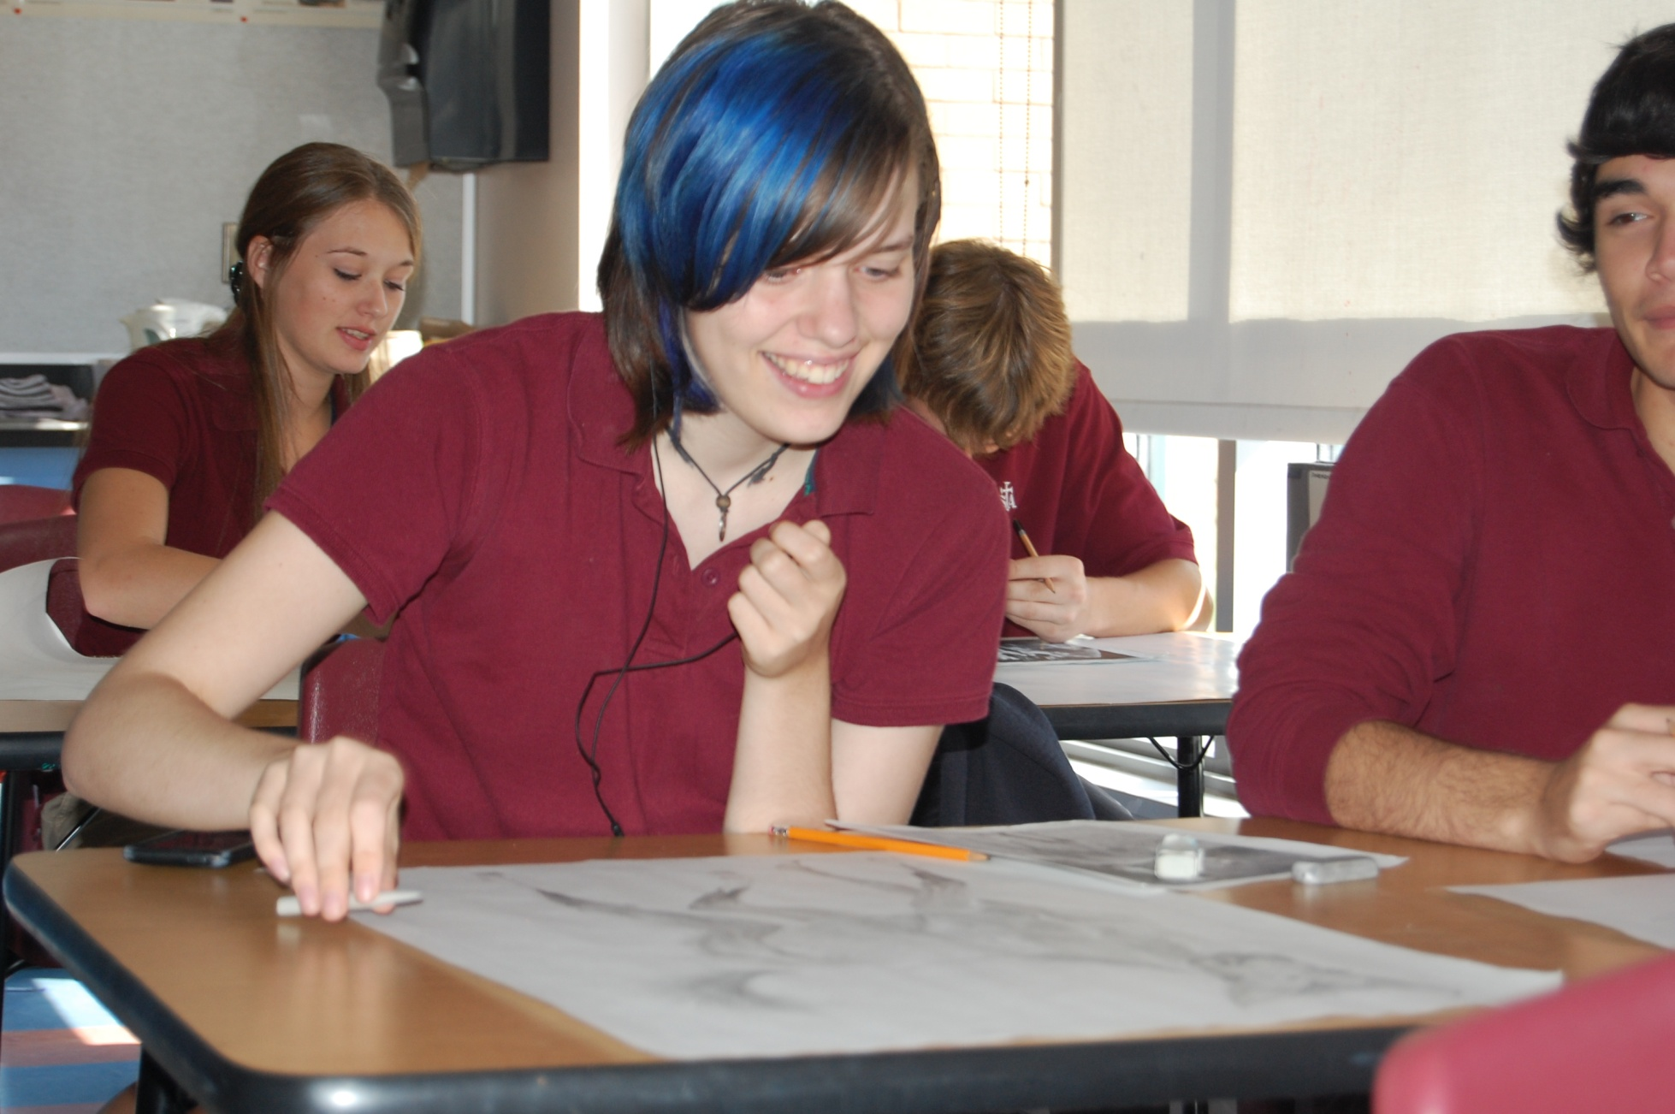

Slide 47
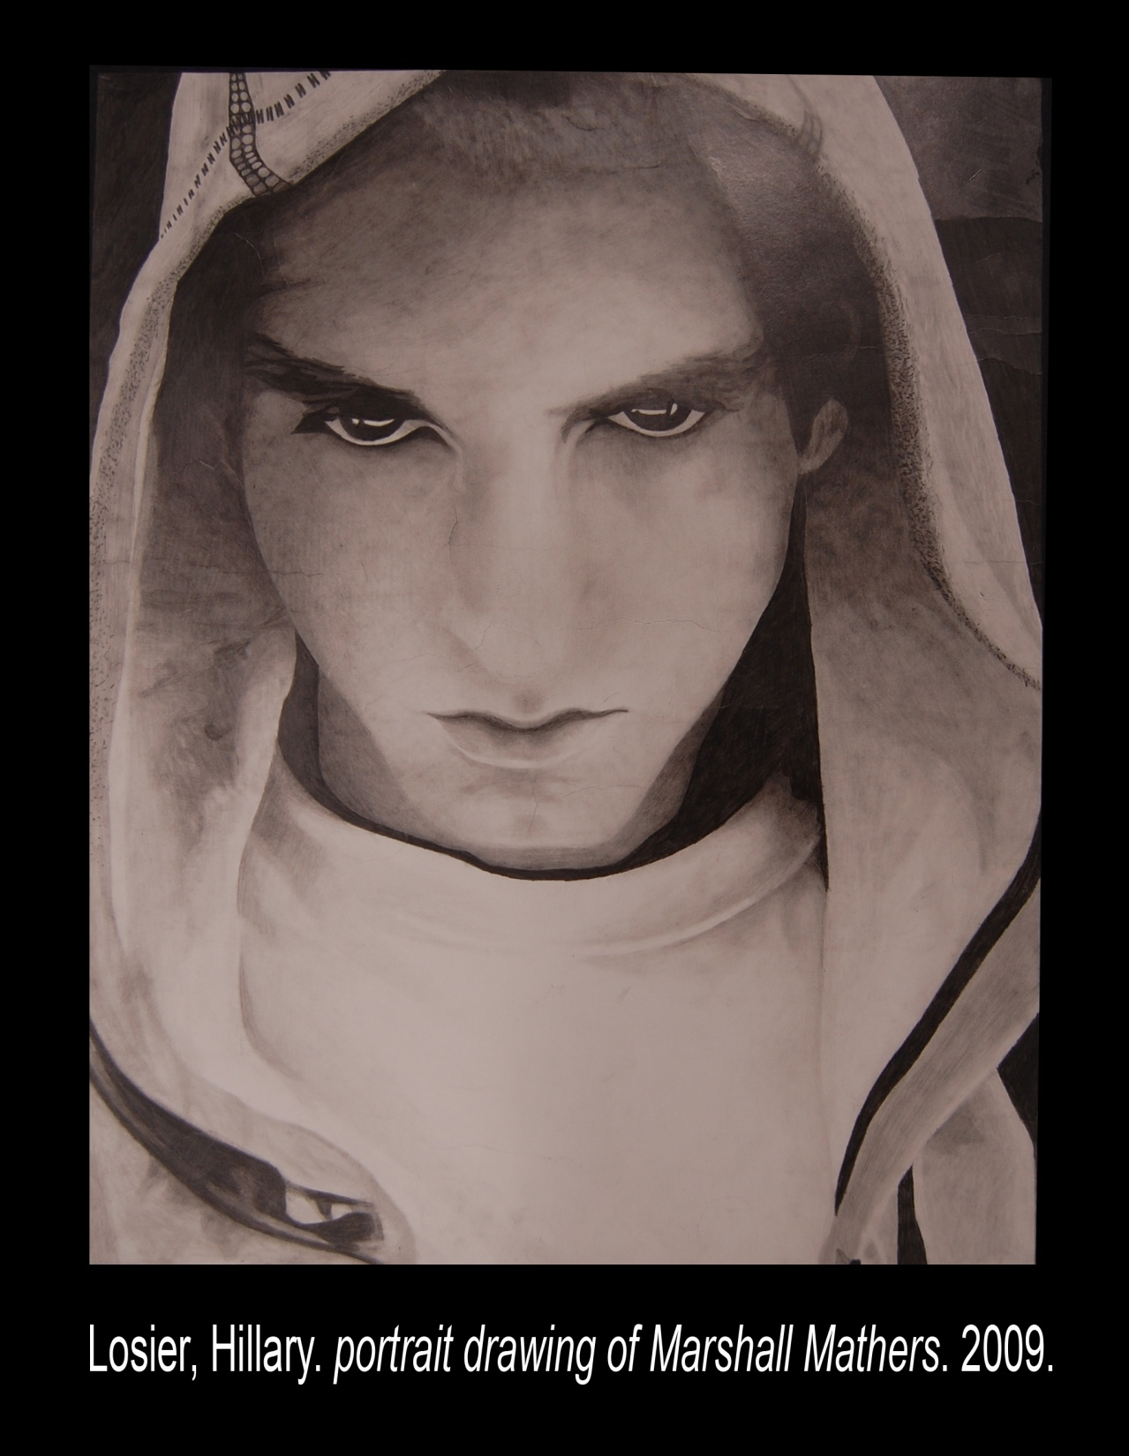

Slide 48
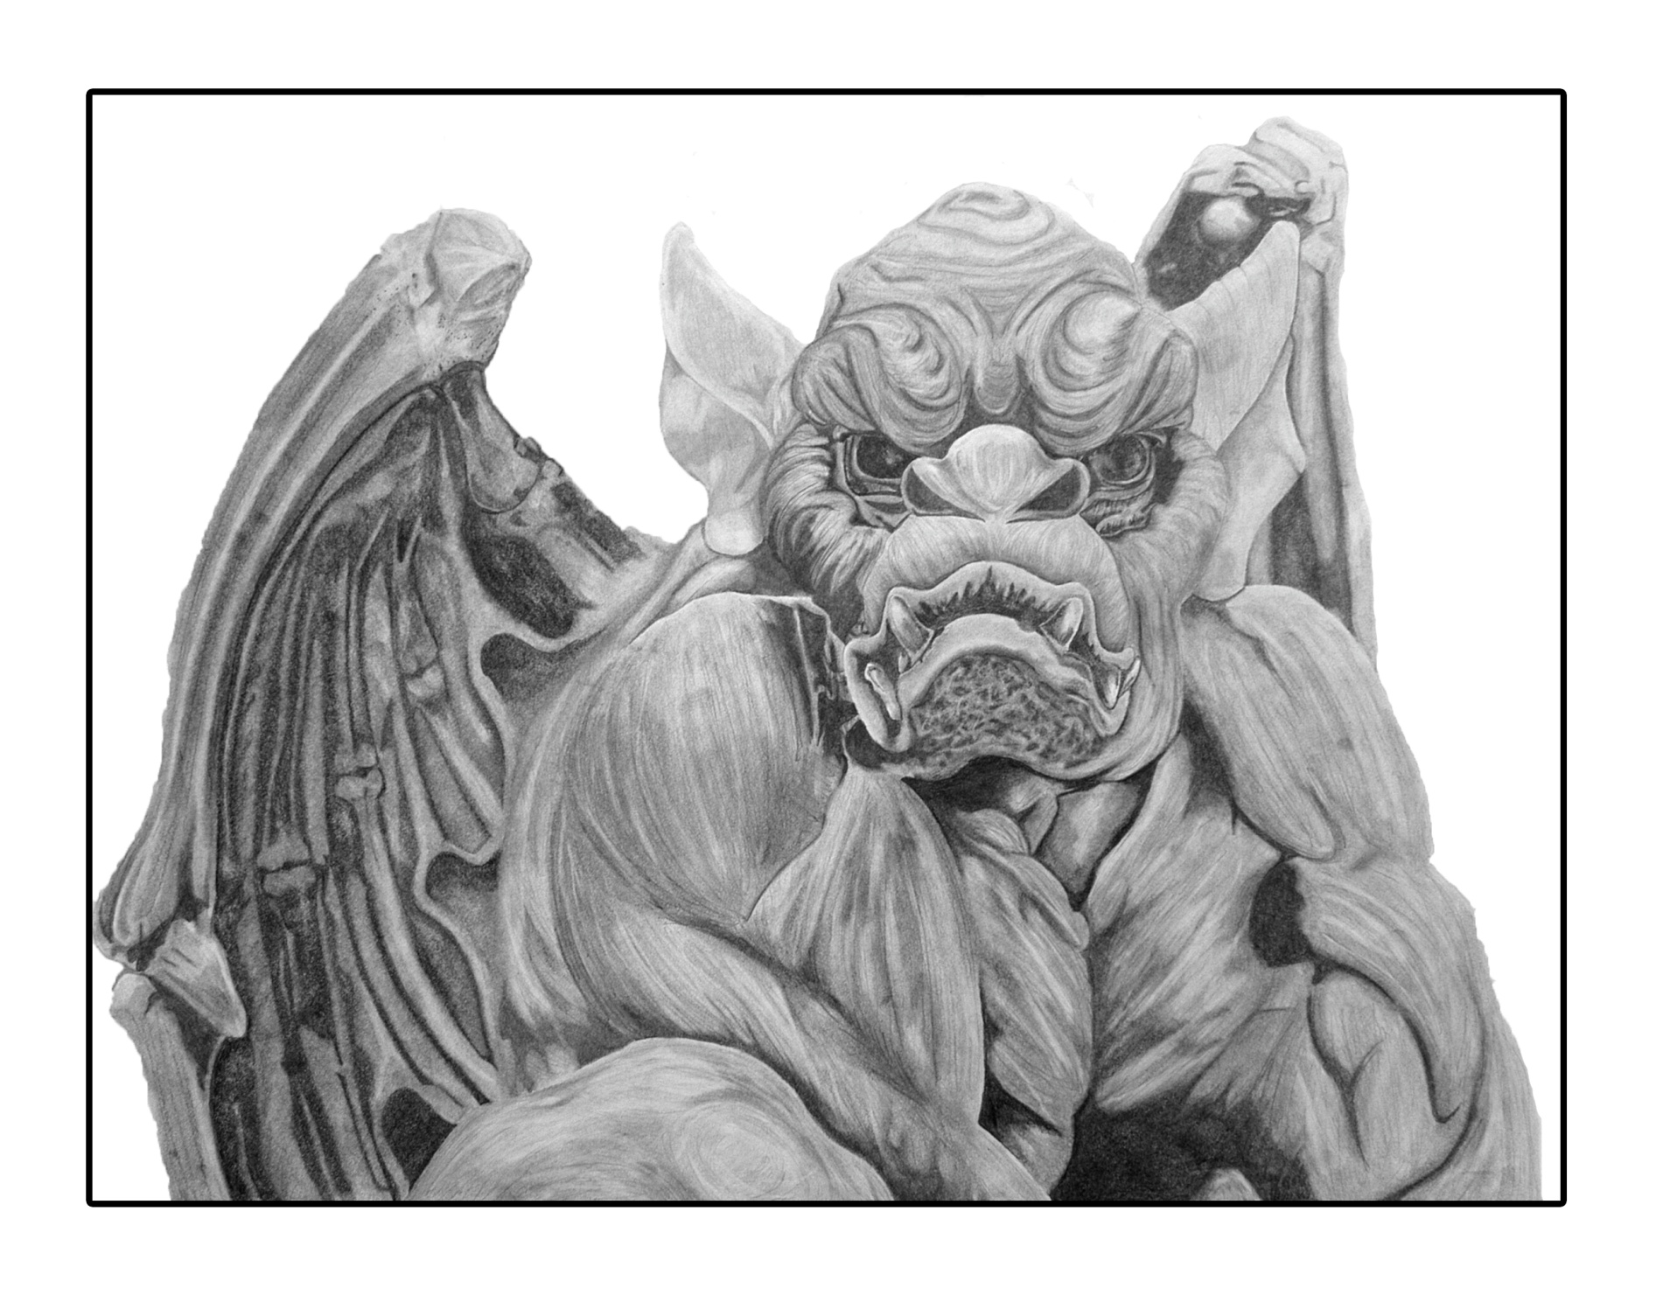

Slide 49
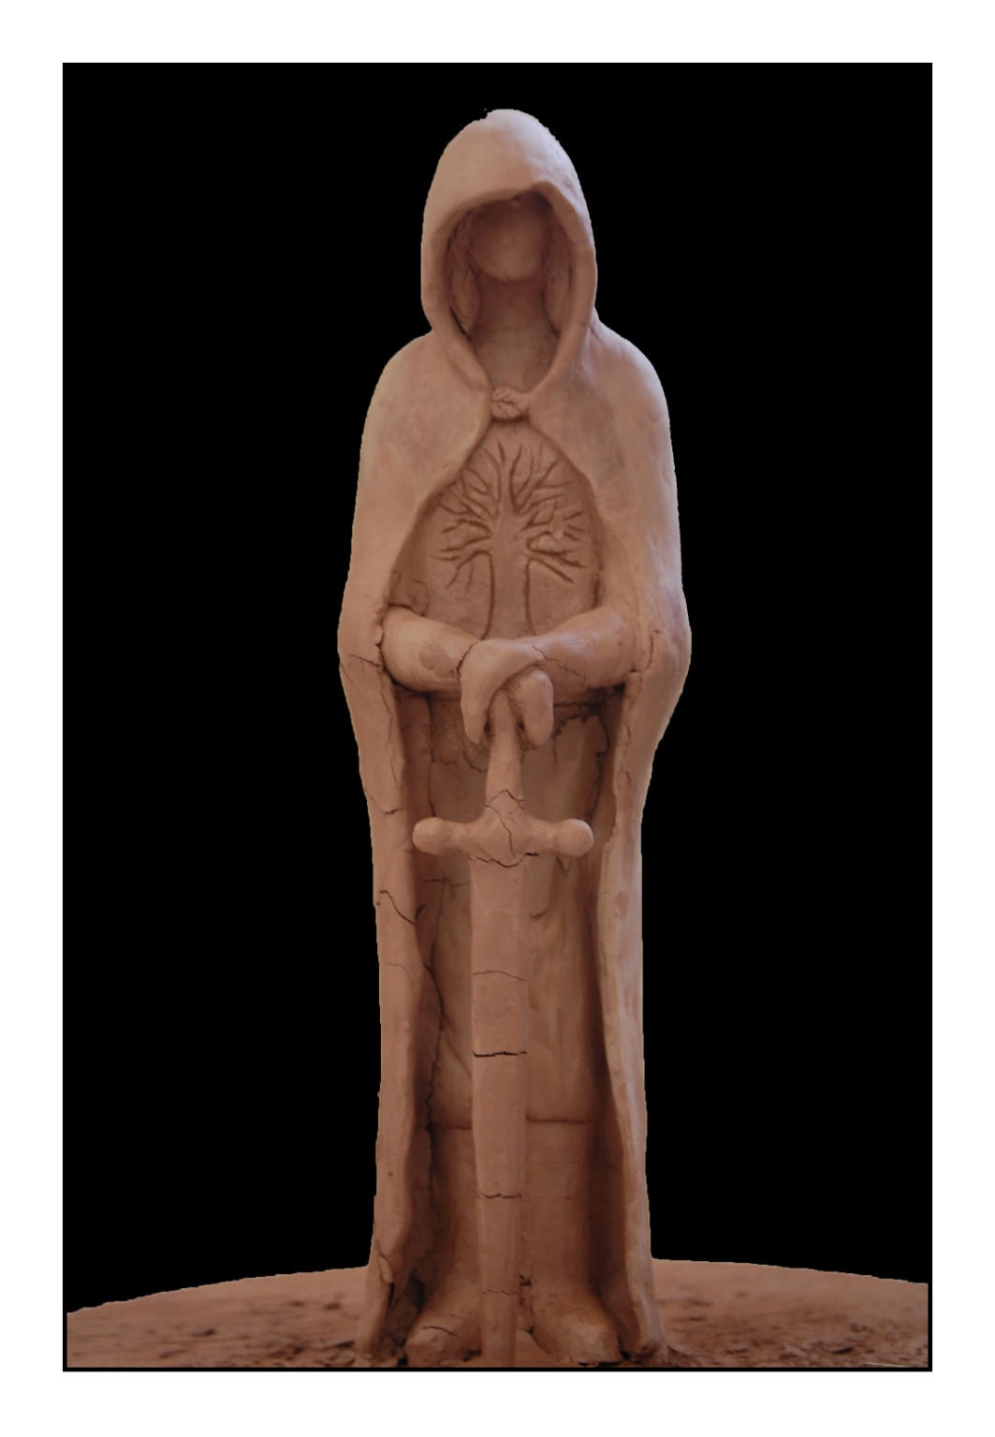

Slide 50
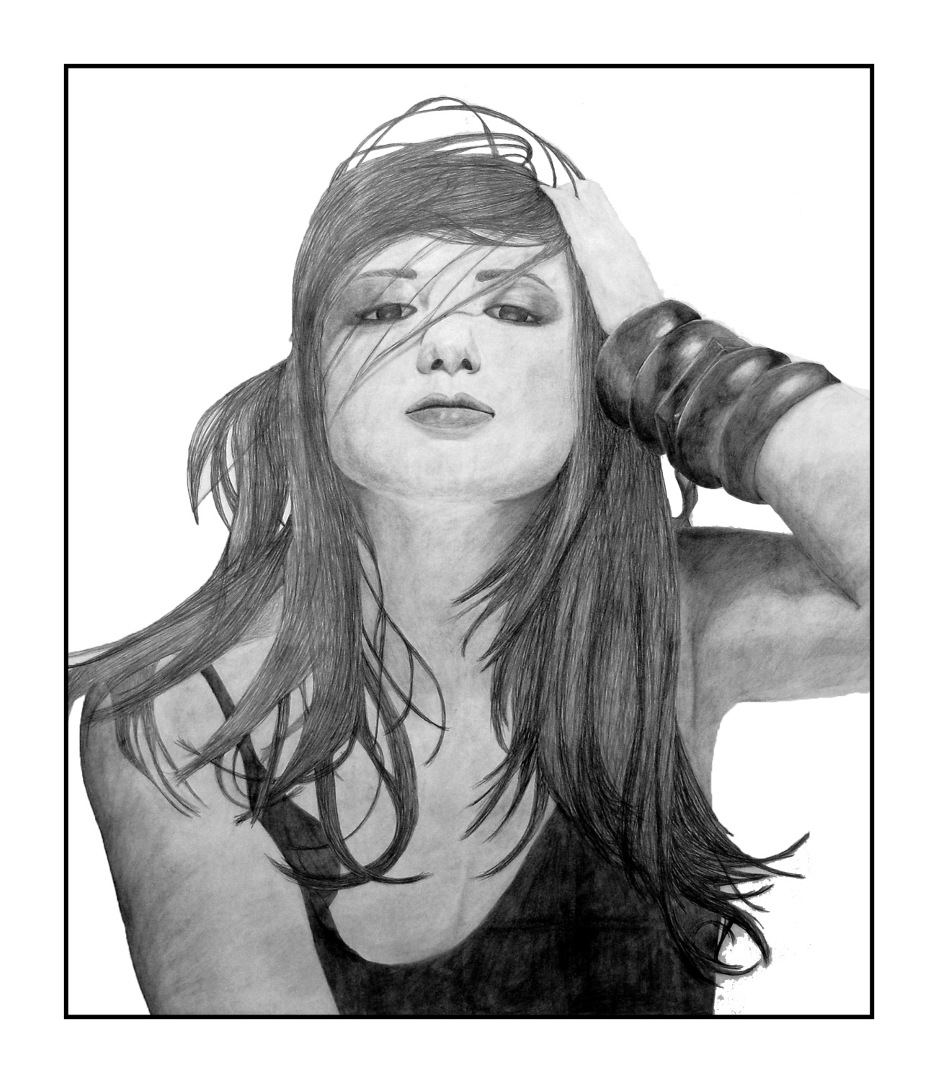

Slide 51
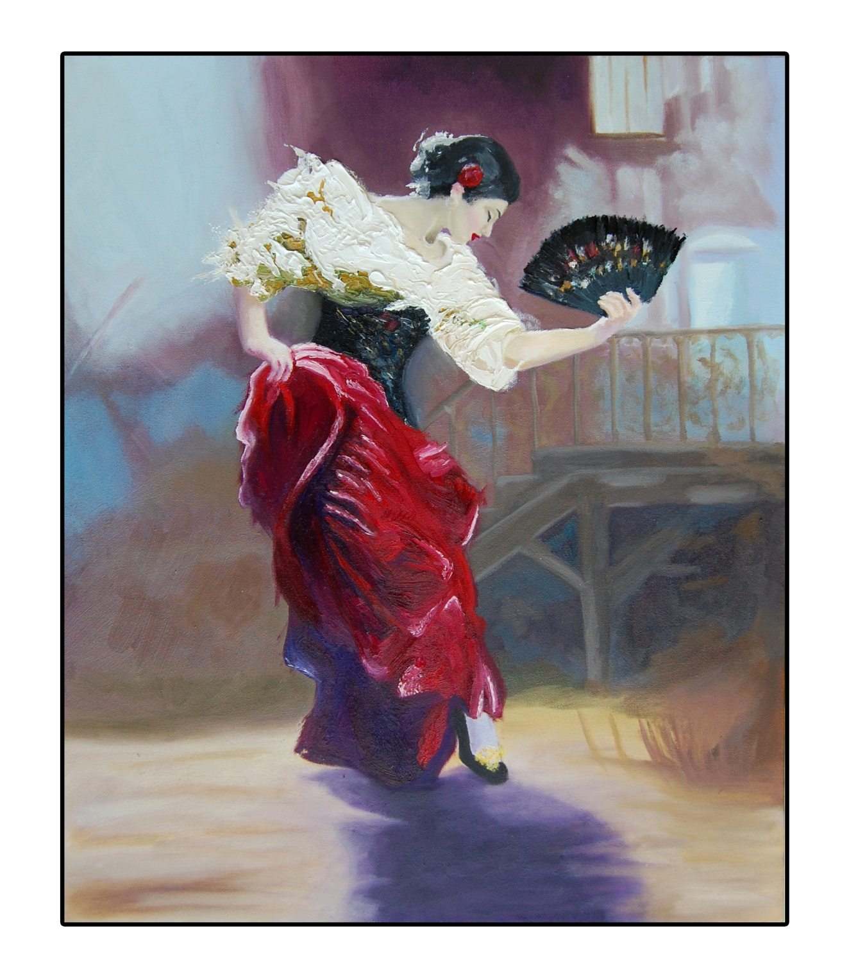

Slide 52
WHY CHOOSE ST. THOMAS
AQUINAS CATHOLIC
HIGH SCHOOL?

Slide 53
SPECIALIST HIGH SKILLS MAJOR
ENVIRONMENTAL SCIENCE

Slide 54
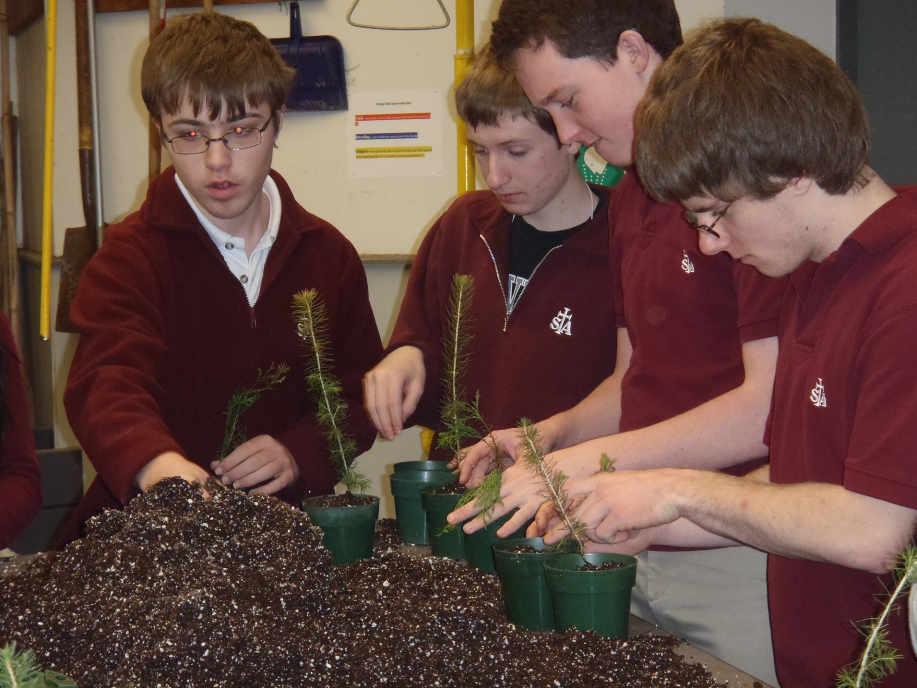

Slide 55
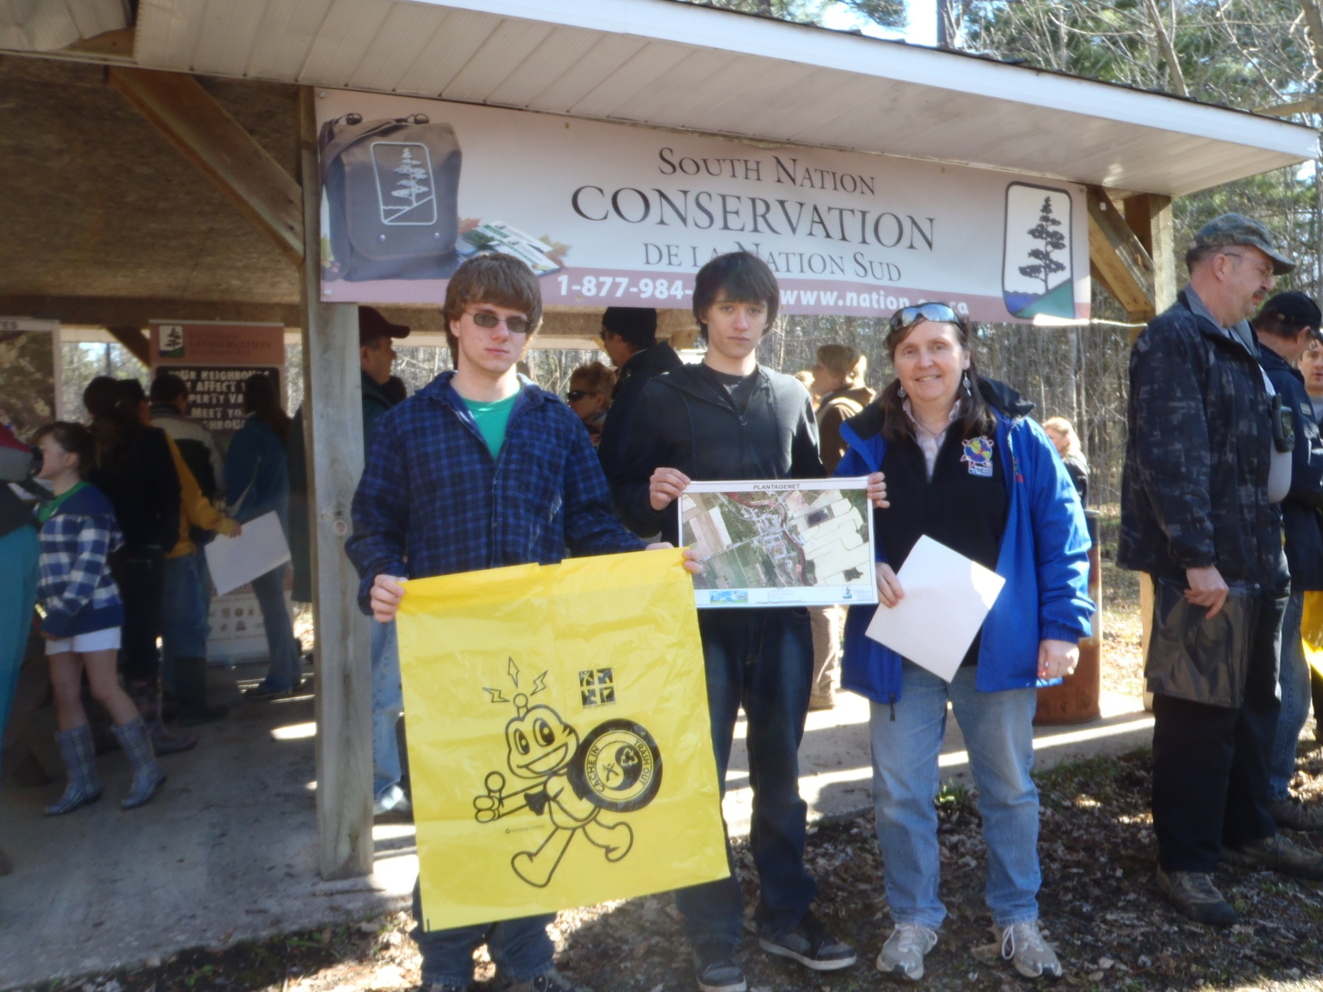

Slide 56
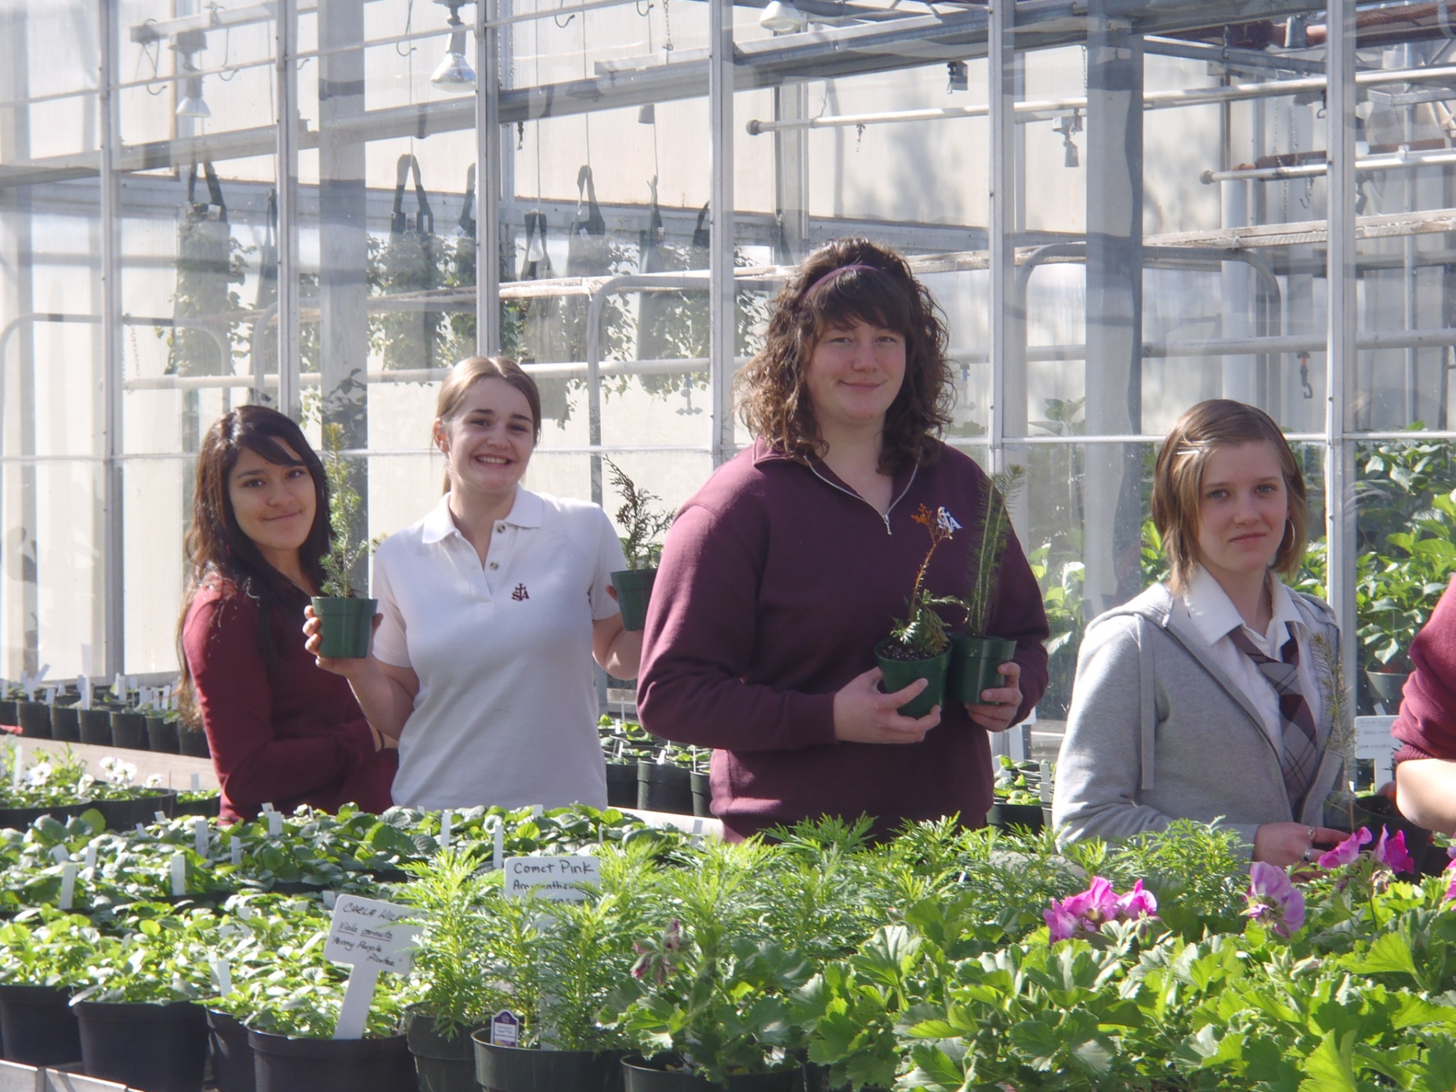

Slide 61
WHY CHOOSE ST. THOMAS
AQUINAS CATHOLIC
HIGH SCHOOL?

Slide 62
OUTDOOR EDUCATION

Slide 70
WHY CHOOSE ST. THOMAS
AQUINAS CATHOLIC
HIGH SCHOOL?

Slide 71
CONCURRENT EDUCATION
DRAMATIC ARTS

Slide 78
WHY CHOOSE ST. THOMAS
AQUINAS CATHOLIC
HIGH SCHOOL?

Slide 79
WHY CHOOSE ST. THOMAS
AQUINAS CATHOLIC
HIGH SCHOOL?

Slide 80
CO-OPERATIVE EDUCATION
OPPORTUNITIES

Slide 89
A SENSE OF COMMUNITY
AND BELONGING

